Slide 1
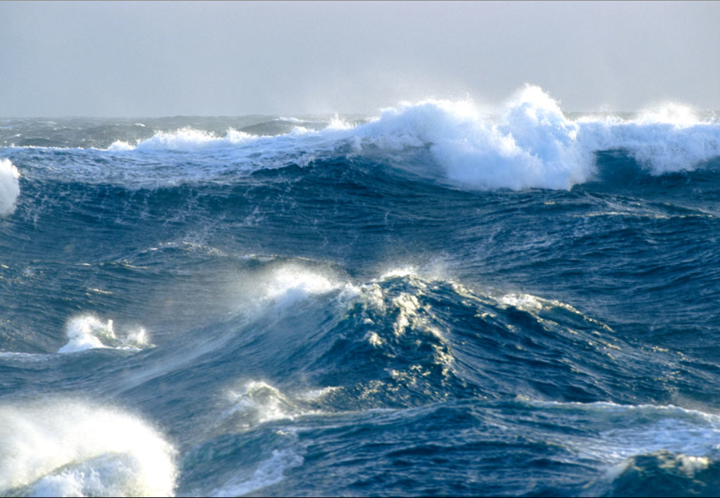
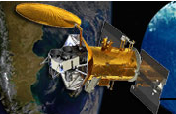
Evaluating the impact of ocean gravity wave variability on Aquarius satellite measurements
D. Vandemark, H. Feng
Univ. of New Hampshire/EOS
N. Reul, F. Ardhuin, B. Chapron
IFREMER/Centre de Brest
within Aq. Cal/Val team efforts
OSST Meeting 2012

Slide 2
Overview
Goal
Develop and refine an empirical satellite salinity correction for long wave impacts that augments the 1st order roughness corrections made using NCEP winds, Aquarius scatterometer, or other ocean roughness information
Approach
Geolocate ancillary ocean wave data with each satellite data point
Detect, characterize, and quantify long-wave impacts seen in the scatterometer, radiometer, and ultimately salinity
Help implement a point-by-point correction using operational wave model data

Slide 3
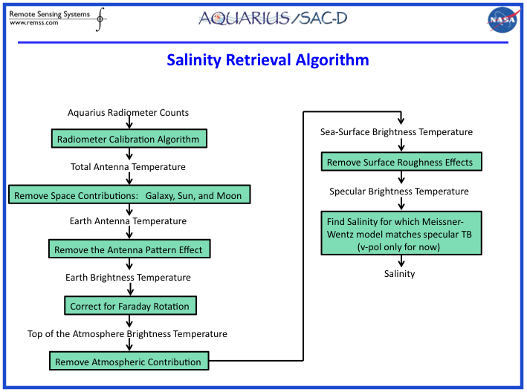

Slide 4
The general geophysical problem
To obtain accurate salinity we need to accurately remove the signal due to rough surface emission
Specifically for Aquarius
1) A three beam radiometer at L band -
Tb_ocean (2 polarizations, 3 incidence angles, look angle) =
F ( variable sea surface waves, S(k) ) ~= rms slopes =
2) A three beam radar scatterometer at L-band (Bragg waves ~ 18 cm)
NRCS_ocean (2 polarizations, 3 incidence angles, look angle) =
F ( variable sea surface waves ) ~= S(k_{Bragg}) + tilting effects
3) The portion of the wave spectrum and EM interaction differs for the radar and radiometer and for each beam’s incidence angle – how well correlated are 1) and 2)?
4) Usual surrogate for sea surface wave information is wind – unlikely to provide sufficient precision to correct for the true ocean wave field.

Slide 5
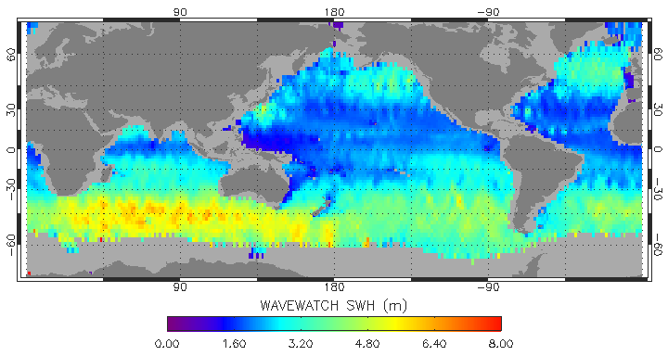
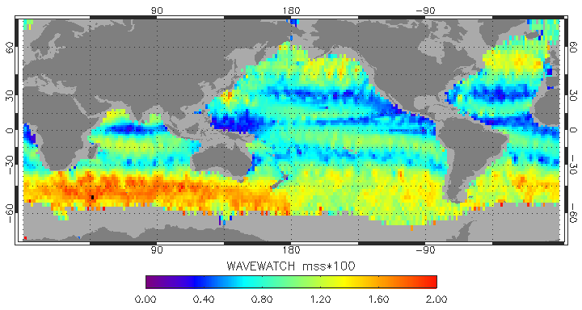
Global Wave model fields, Aquarius L2_wwav files, Day 240-271 2011
Aquarius *L2_wwav files are assembled daily at UNH for the Aq. cal/val team
available at PO.DAAC

Slide 6
Aquarius Level 2 wave model collocation products: Processing status (March 2012)
Near Real Time processing
( Latency: 1 day after Aq-L2 V1.1 data become available at GSFC)
Aq-L2 V1.1 SCIdata (daily wget)
L2V1.1_wwav*
Ifremer/Previmer WW3 model product
( Partial dataset: 5 NRT variables, limited QC)
* ftp access via PODAAC for Aq. Cal/Val team members
Science level processing
( Latency: 50-60 days after Aq-L2 data become available)
Aq-L2 V1.2 EVSCI data (2011)
Aq-L2 V1.2.3 EVSCI data (2011, 2012)
L2V1.2_wwav (2011)*
L2V1.2.3_wwav (2012)*
Ifremer/Previmer WW3 model product
(Full wave model dataset: 14 variables with QC)

Slide 7
Diagnosis using Significant Wave Height (SWH)
Evaluate Aquarius L2 scatterometer and SSS data
Expectations:
For fixed wind speed we’ll see long wave impacts in the scatterometer roughness and derived wind speeds
For fixed wind speed we’ll see long wave impacts in the radiometer-derived salinity

Slide 8
Aquarius Scatterometer sigma0 vs. significant wave height
(17 weeks; Day 240-362) ; X-axis=NCEP wind
VV POL
INNER BEAM
θ = 28 deg.
VV POL
OUTER BEAM
θ = 46 deg.
HH POL
INNER BEAM
θ = 28 deg.
HH POL
OUTER BEAM
θ = 46 deg.
LARGEST IMPACT
LEAST IMPACT

Slide 9
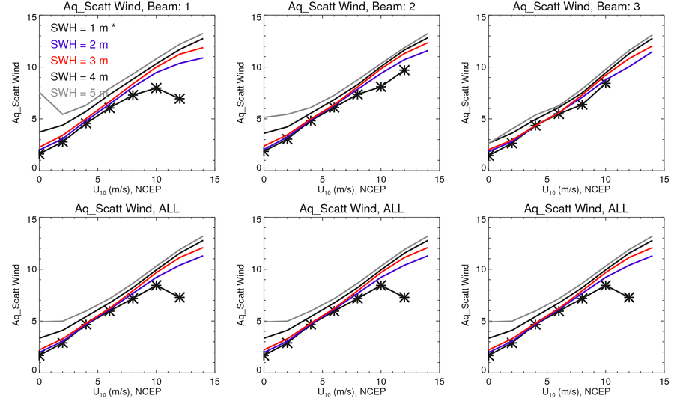
Aquarius Scatterometer Wind vs. significant wave height
(17 weeks; Day 240-362) ; X-axis=NCEP wind
OUTER BEAM
θ = 46 deg.
INNER BEAM
θ = 28 deg.
LARGEST IMPACT
WEAKER IMPACT
Long-waves lead to wind speed error when seas are exceedingly high
This is a good thing – indicates that the scatterometer is
sensitive to longer waves that likely impact the radiometer

Slide 10
Getting sidetracked
All wind products show significant systematic differences – likely associated with ocean currents. wind waves, and atmospheric stability (SST) impacts.
NCEP, ECMWF, SSM/I, Aquarius Scatterometer

Slide 11
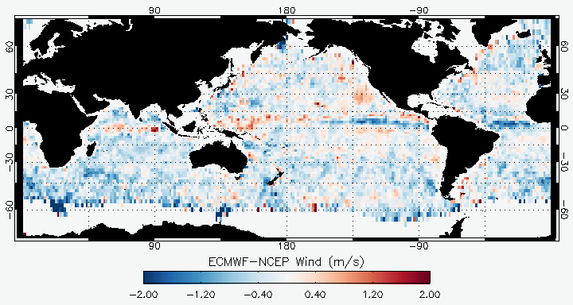
Wind products and spatial differences
Day 240-270

Slide 12
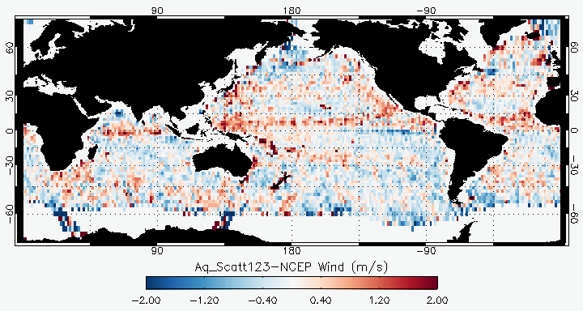
Wind products and spatial differences
Day 240-270

Slide 13
Onto radiometer derived SSS
Some substantial improvement already L2 V1.2 -> 1.3

Slide 14
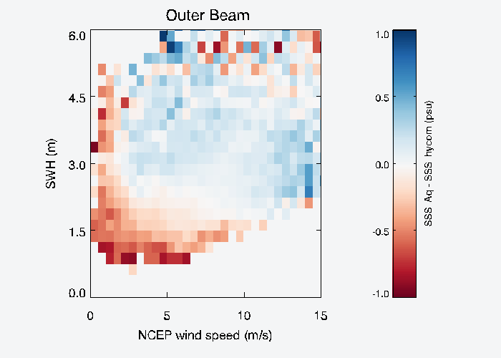
Aquarius Radiometer Salinity error vs. SWH
(17 weeks; Day 240-362) ; X-axis=NCEP wind, V`1.2; DESC
Residual Salinity
with respect to HYCOM
Residual Salinity
taken with respect to HYCOM model SSS
Long-waves lead to salinity anomaly – low for low seas, high for high seas

Slide 15
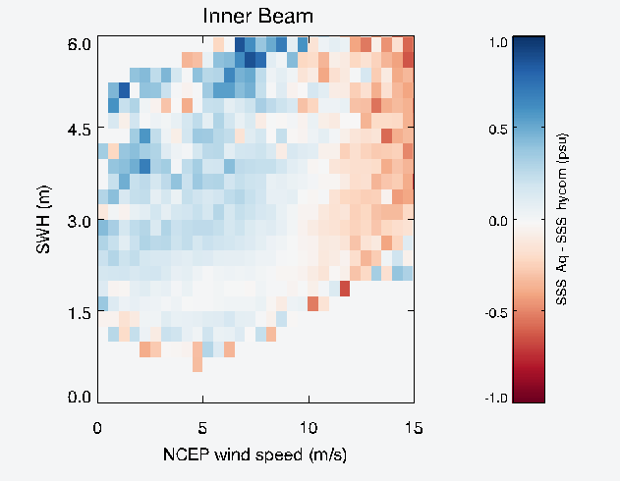
Aquarius Radiometer Salinity error vs. SWH
(17 weeks; Day 240-362) ; X-axis=NCEP wind; Ver 1.2.3; DESC; OUTER BEAM
Residual Salinity
with respect to HYCOM
Residual Salinity
taken with respect to HYCOM model SSS
Long-waves lead to salinity anomaly – low for low seas, high for high seas

Slide 16
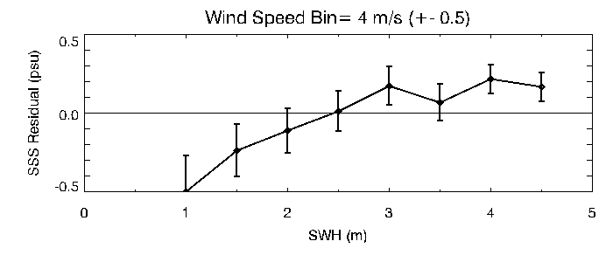
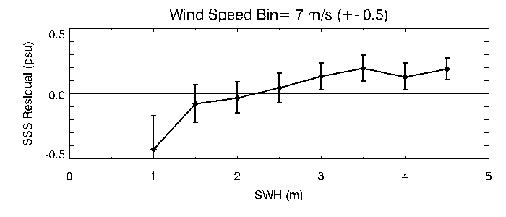
Aquarius Scatterometer Wind vs. significant wave height
(17 weeks; Day 240-362) ; X-axis=NCEP wind; V1.2
0.35 psu/ 1m sea state change
OUTER BEAM
θ = 46 deg.
DESCENDING
V1.2
0.21 psu/ 1m sea state change
OUTER BEAM
θ = 46 deg.
Long-waves lead to wind speed error of
order when seas are exceedingly high
Long-waves can lead to wind speed error of
order when seas are exceedingly high
Desc Pass data, Galactic refl < 1 K

Slide 17
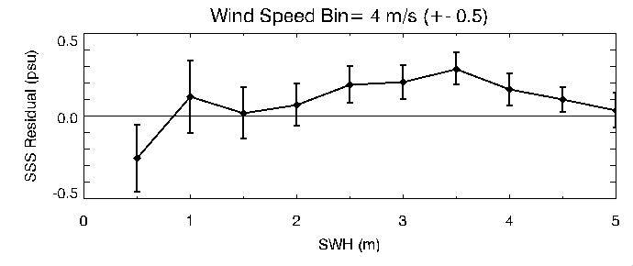
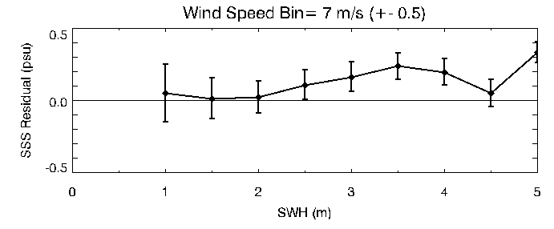
Aquarius Scatterometer Wind vs. significant wave height
(17 weeks; Jan-Feb2012) ; X-axis=NCEP wind; Ver. 1.3
0.1 psu/ 1m sea state change
OUTER BEAM
θ = 46 deg.
DESCENDING
V1.3
<0.1 psu/ 1m sea state change
OUTER BEAM
θ = 46 deg.
Substantial improvements
Desc Pass data, Galactic refl < 1 K

Slide 18
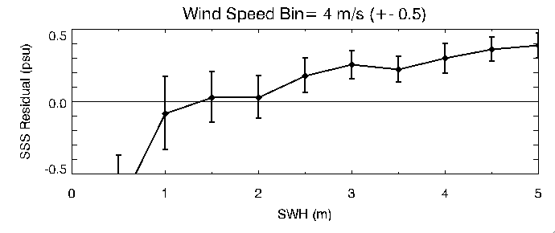
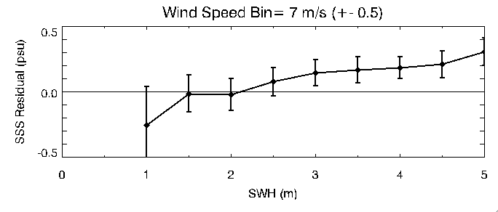
Aquarius Scatterometer Wind vs. significant wave height
(17 weeks; Jan-Feb2012) ; X-axis=NCEP wind; Ver. 1.3
>0.1 psu/ 1m sea state change
OUTER BEAM
θ = 46 deg.
But not done yet
ASCENDING
V1.3
~0.1 psu/ 1m sea state change
OUTER BEAM
θ = 46 deg.
ASC Pass data, Galactic refl < 1 K

Slide 19
Some caveats and future work
Final Aquarius surface Tb_V and Tb_H are still being developed with issues such as reflected Galaxy and Faraday rotation correcting impacting these 2nd order ocean wave impact results (V1.4?)
ascending vs. descending results differ
time dependence
highest wind/wave environment are in coldest waters
SST-wave covariance
Fully exploit and document the certain benefit of using the scatterometer for SSS inversion
Further formal evaluation of the radiometer and radar data within a scattering/emission model + global wave field data
What wind model to use as a reference? SSM/I != NCEP != ECMWF

Slide 20
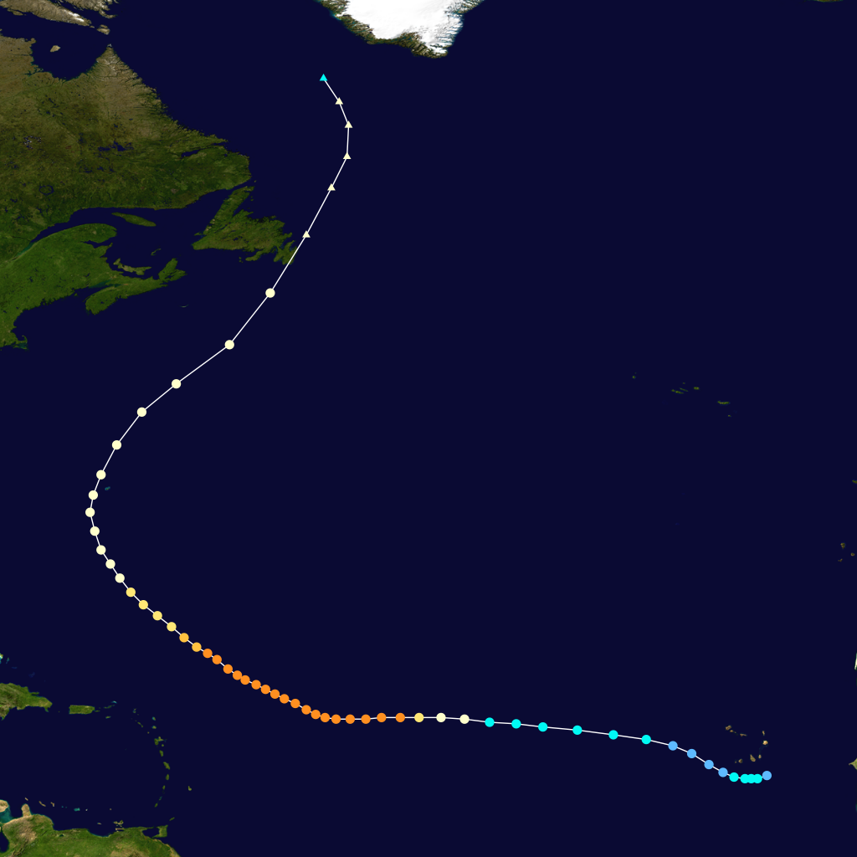
Analysis of Satellite SSS signatures over
Hurricane IGOR 11-24 Sep 2010 using SMOS
Cat 4-5

Slide 21
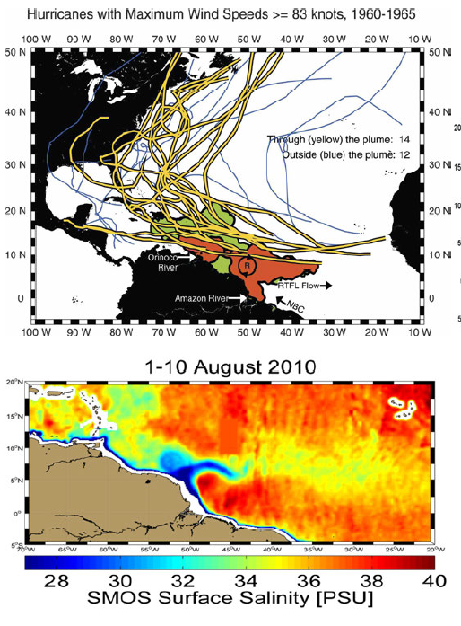
Surface salinity signal variability associated with
Hurricane-induced mixing near the Amazon/Orinoco plume – Igor case study – Sept 2010
Nico Reul with Chapron, Tenerelli, Vandemark, Vialard, ...
Freshwater Plume=> warmer SST & shallow
stable surface layer (barrier layer)
65% of TC crossing the Amazon Plume evolve into cat 5 Hurricanes Ffield (J. Clim 2007)
Amazon & Orinoco plumes
=>Strong positive SST anomalies (~1°C)
Impact of plume SST on storm intensity
addressed using WRF simulation
Vizy and Cook, (JGR 2010)
Can we use SMOS retrieved SSS to study
ocean-atmosphere interactions in TCs ?

Slide 22
Analysis of SMOS data signature over
Hurricane IGOR 11-24 Sep 2010
Cat 4-5

Slide 23
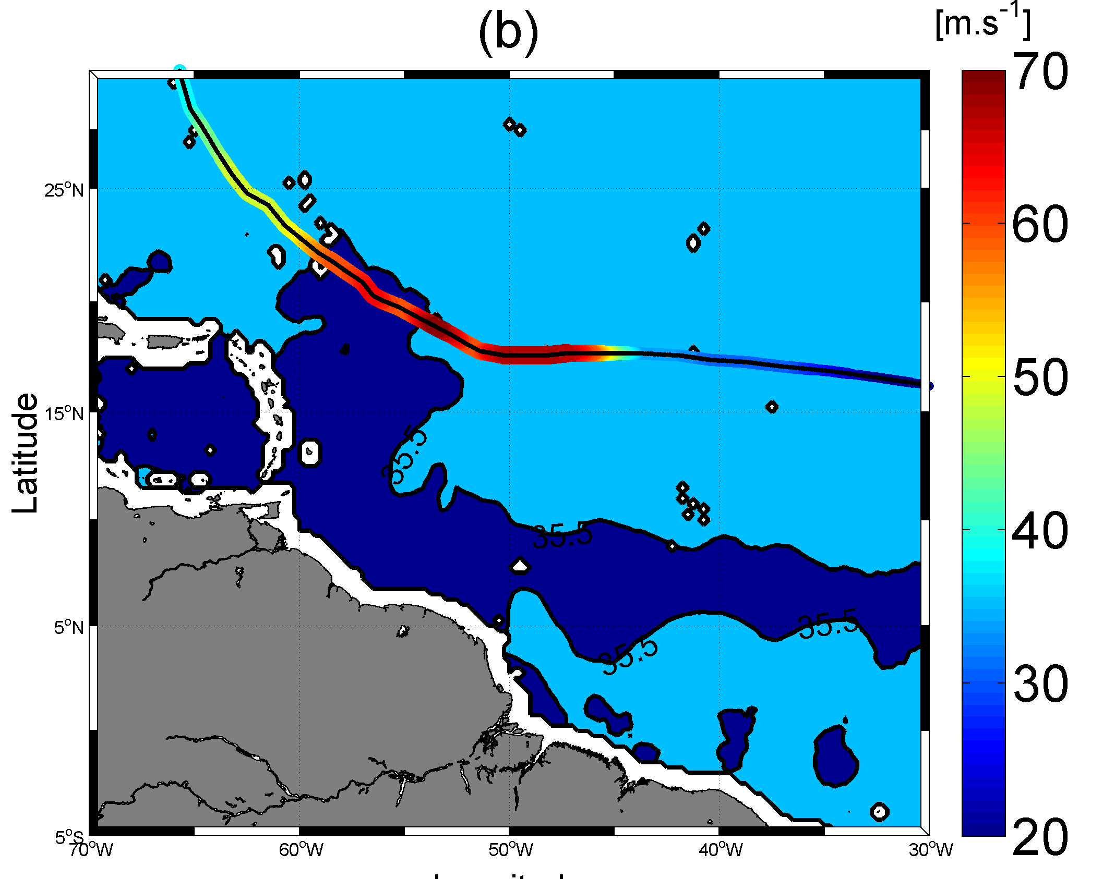
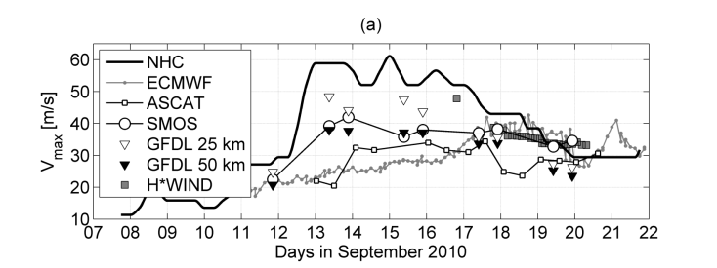
Coincident or causal Hurricane Igor wind droping at the plume/open ocean transition ?
09/17/2010
09/15/2010
09/13/2010
Location of the
Plume (SSS<35.5)
the last
10 days
before
Igor passage (5->13 Sep)

Slide 24
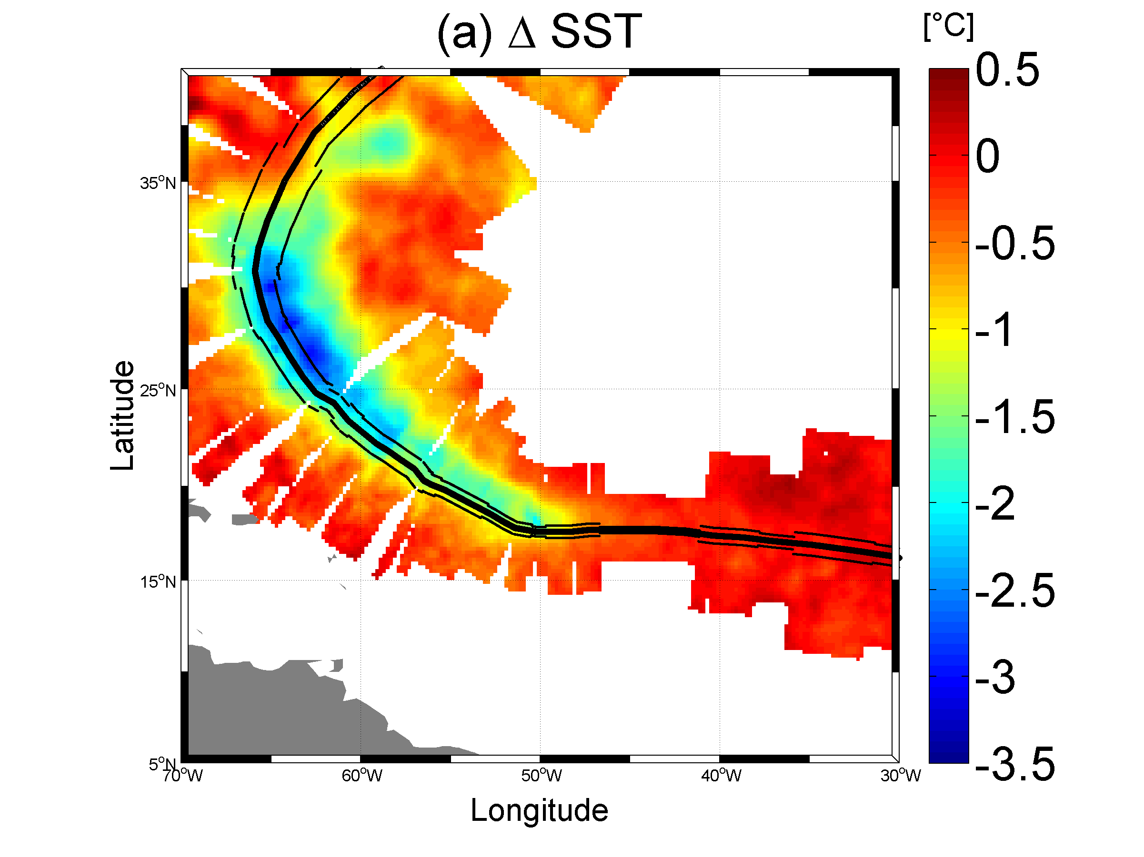
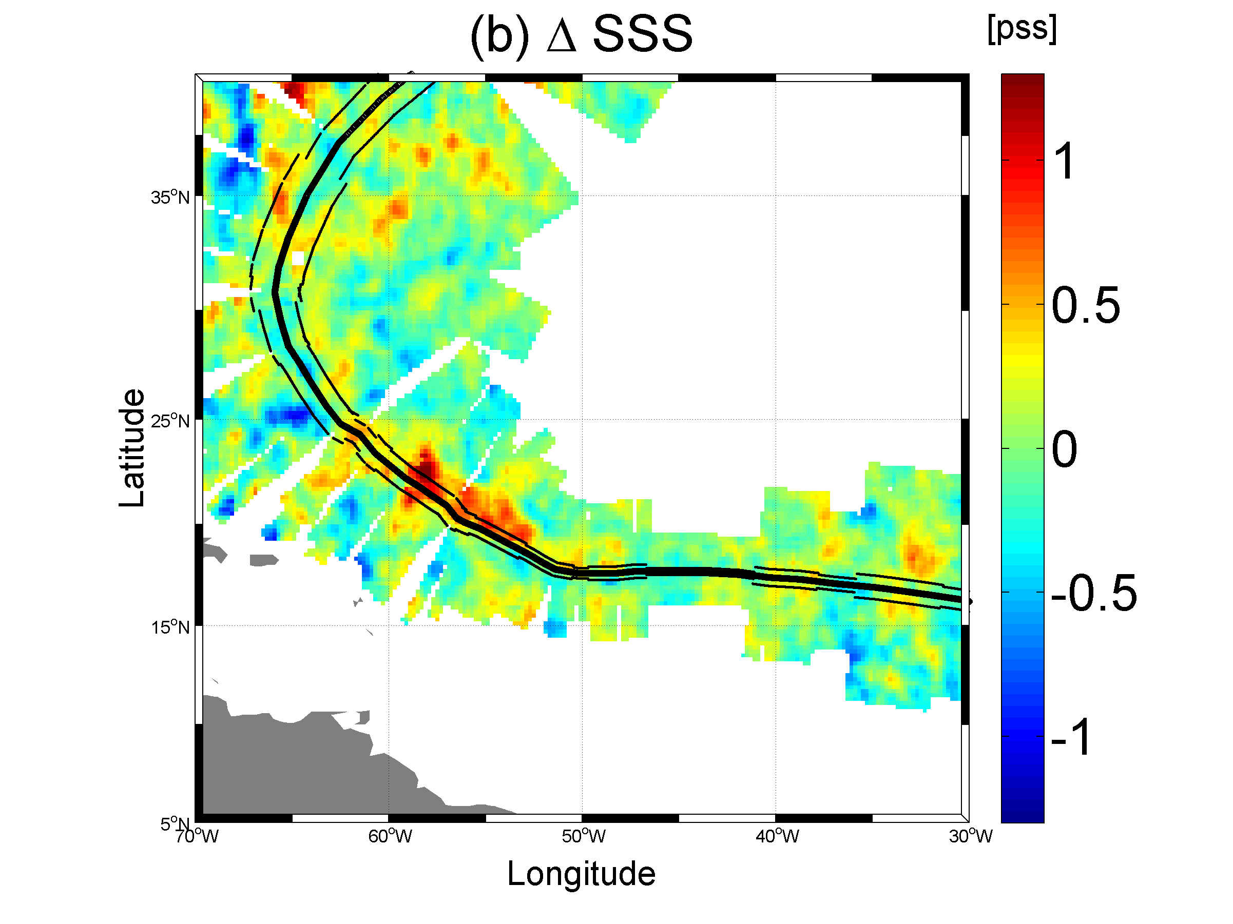
Thermo-haline wakes behind Igor hurricane
Cool Wake induced by Igor:
SST= GHRSST OSTIA (MetOffice)
Salty Wake induced by Igor:
SSS=SSS SMOS (CATDS/ifremer)
Strong resalinisation of the
SSS after Igor passage, over the path of
the storm Right-hand quadrant:
ΔSSS~>+1-1.5 pss
are cross-track locations from the eye at t_{o}

Slide 25
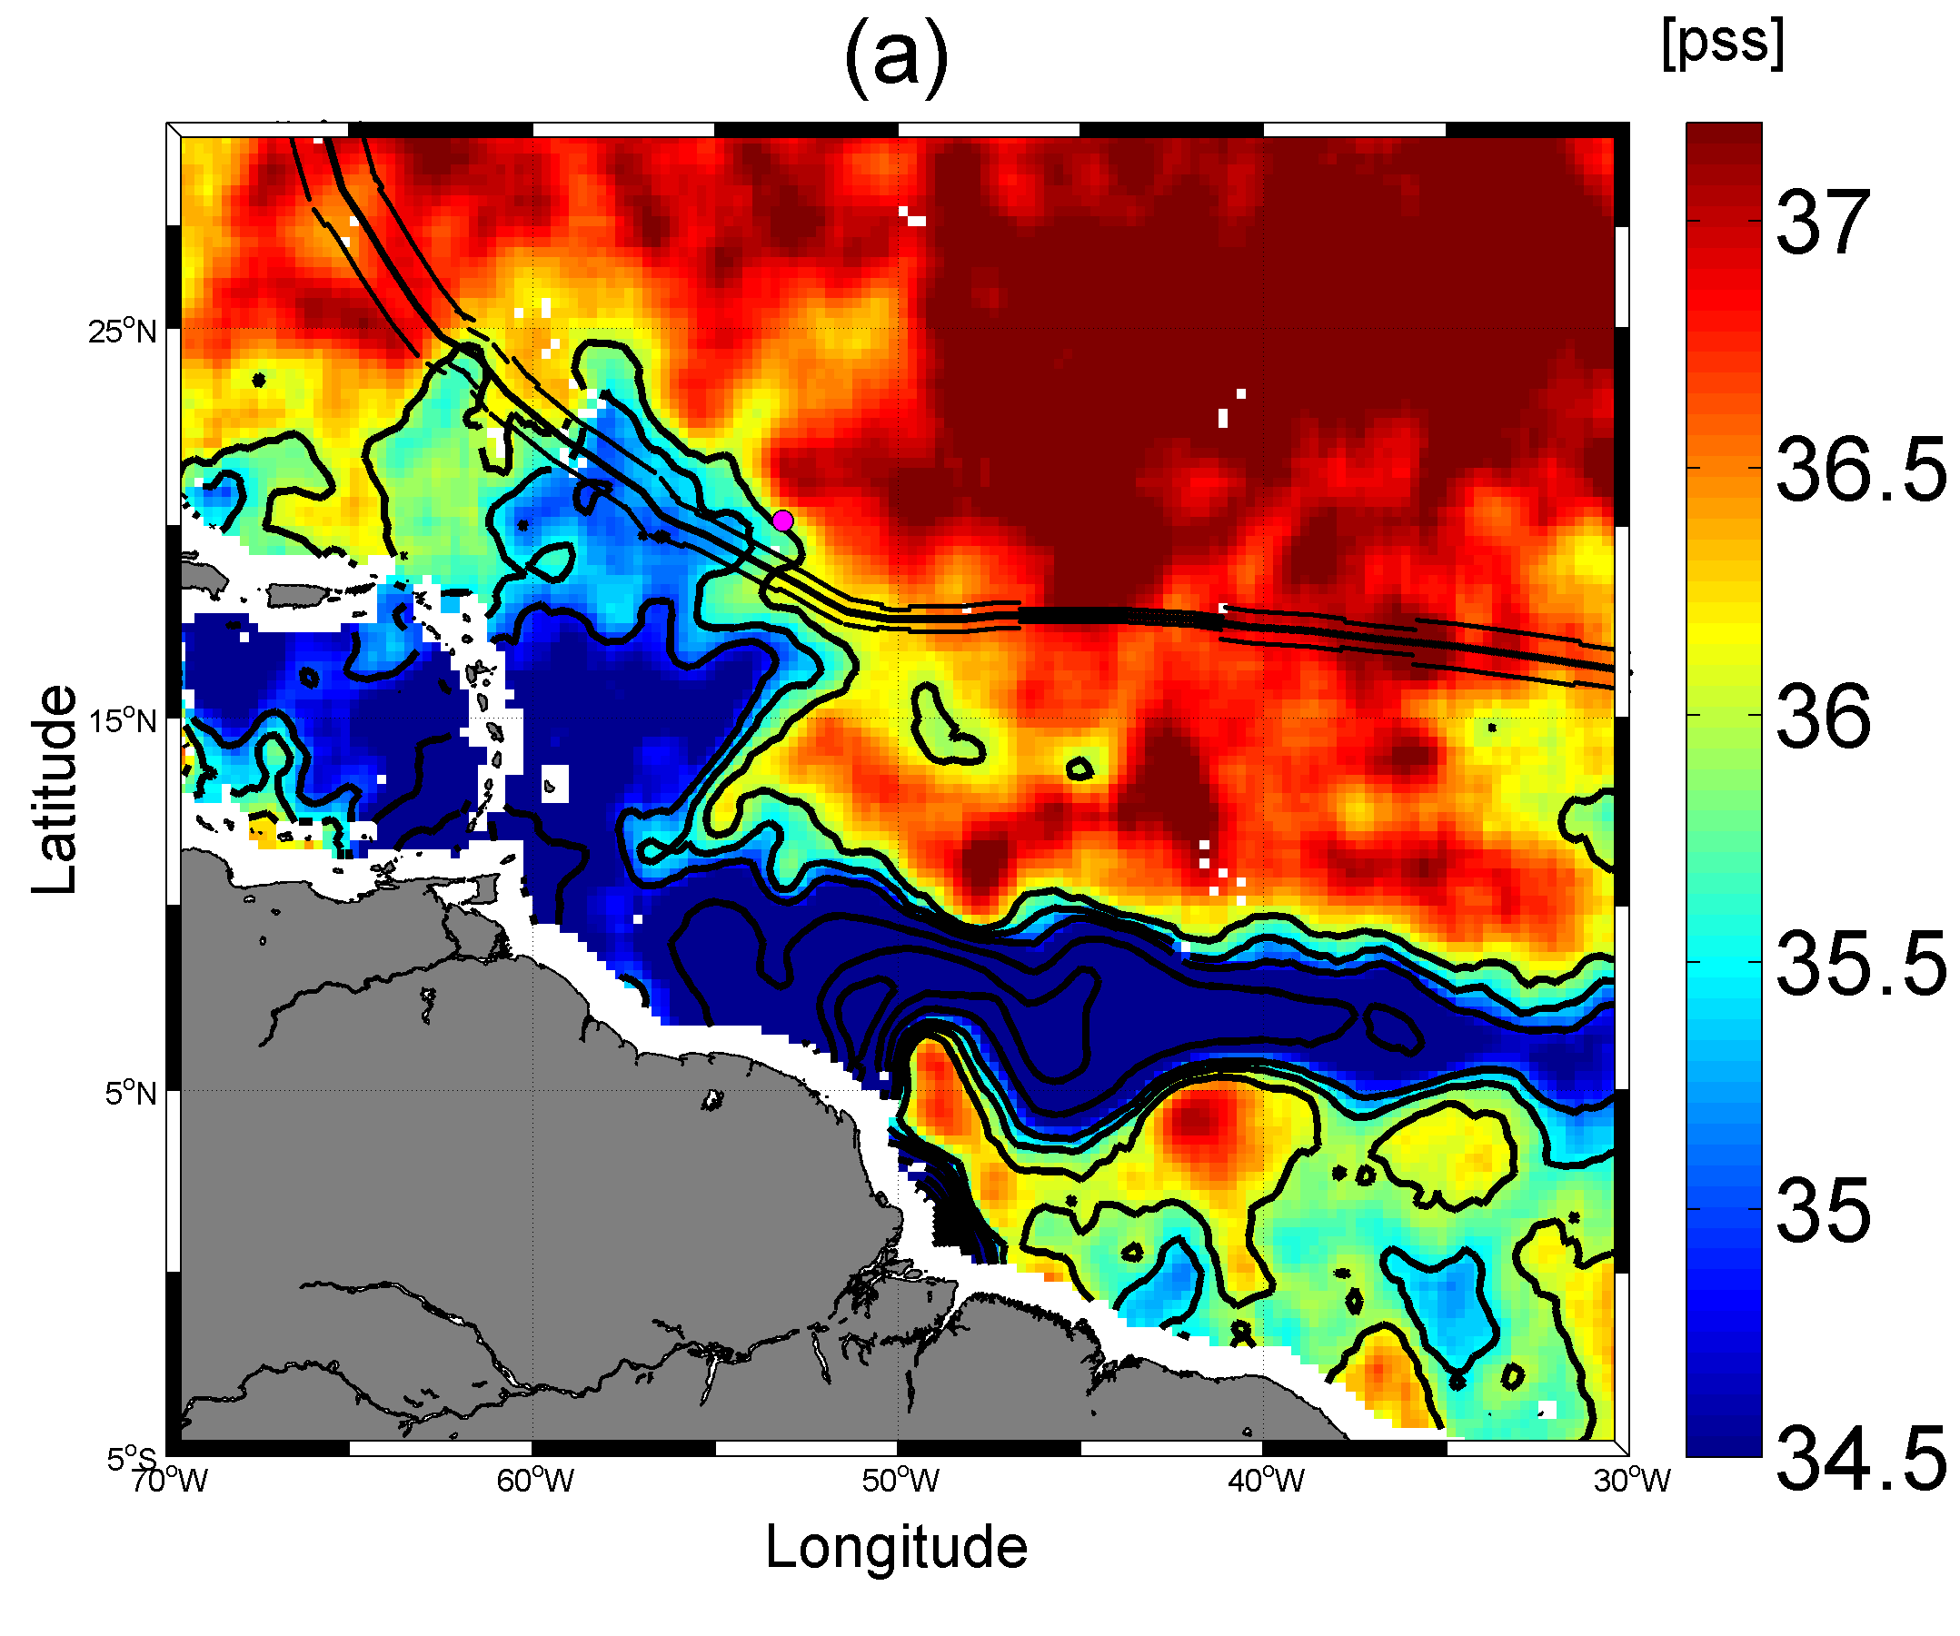
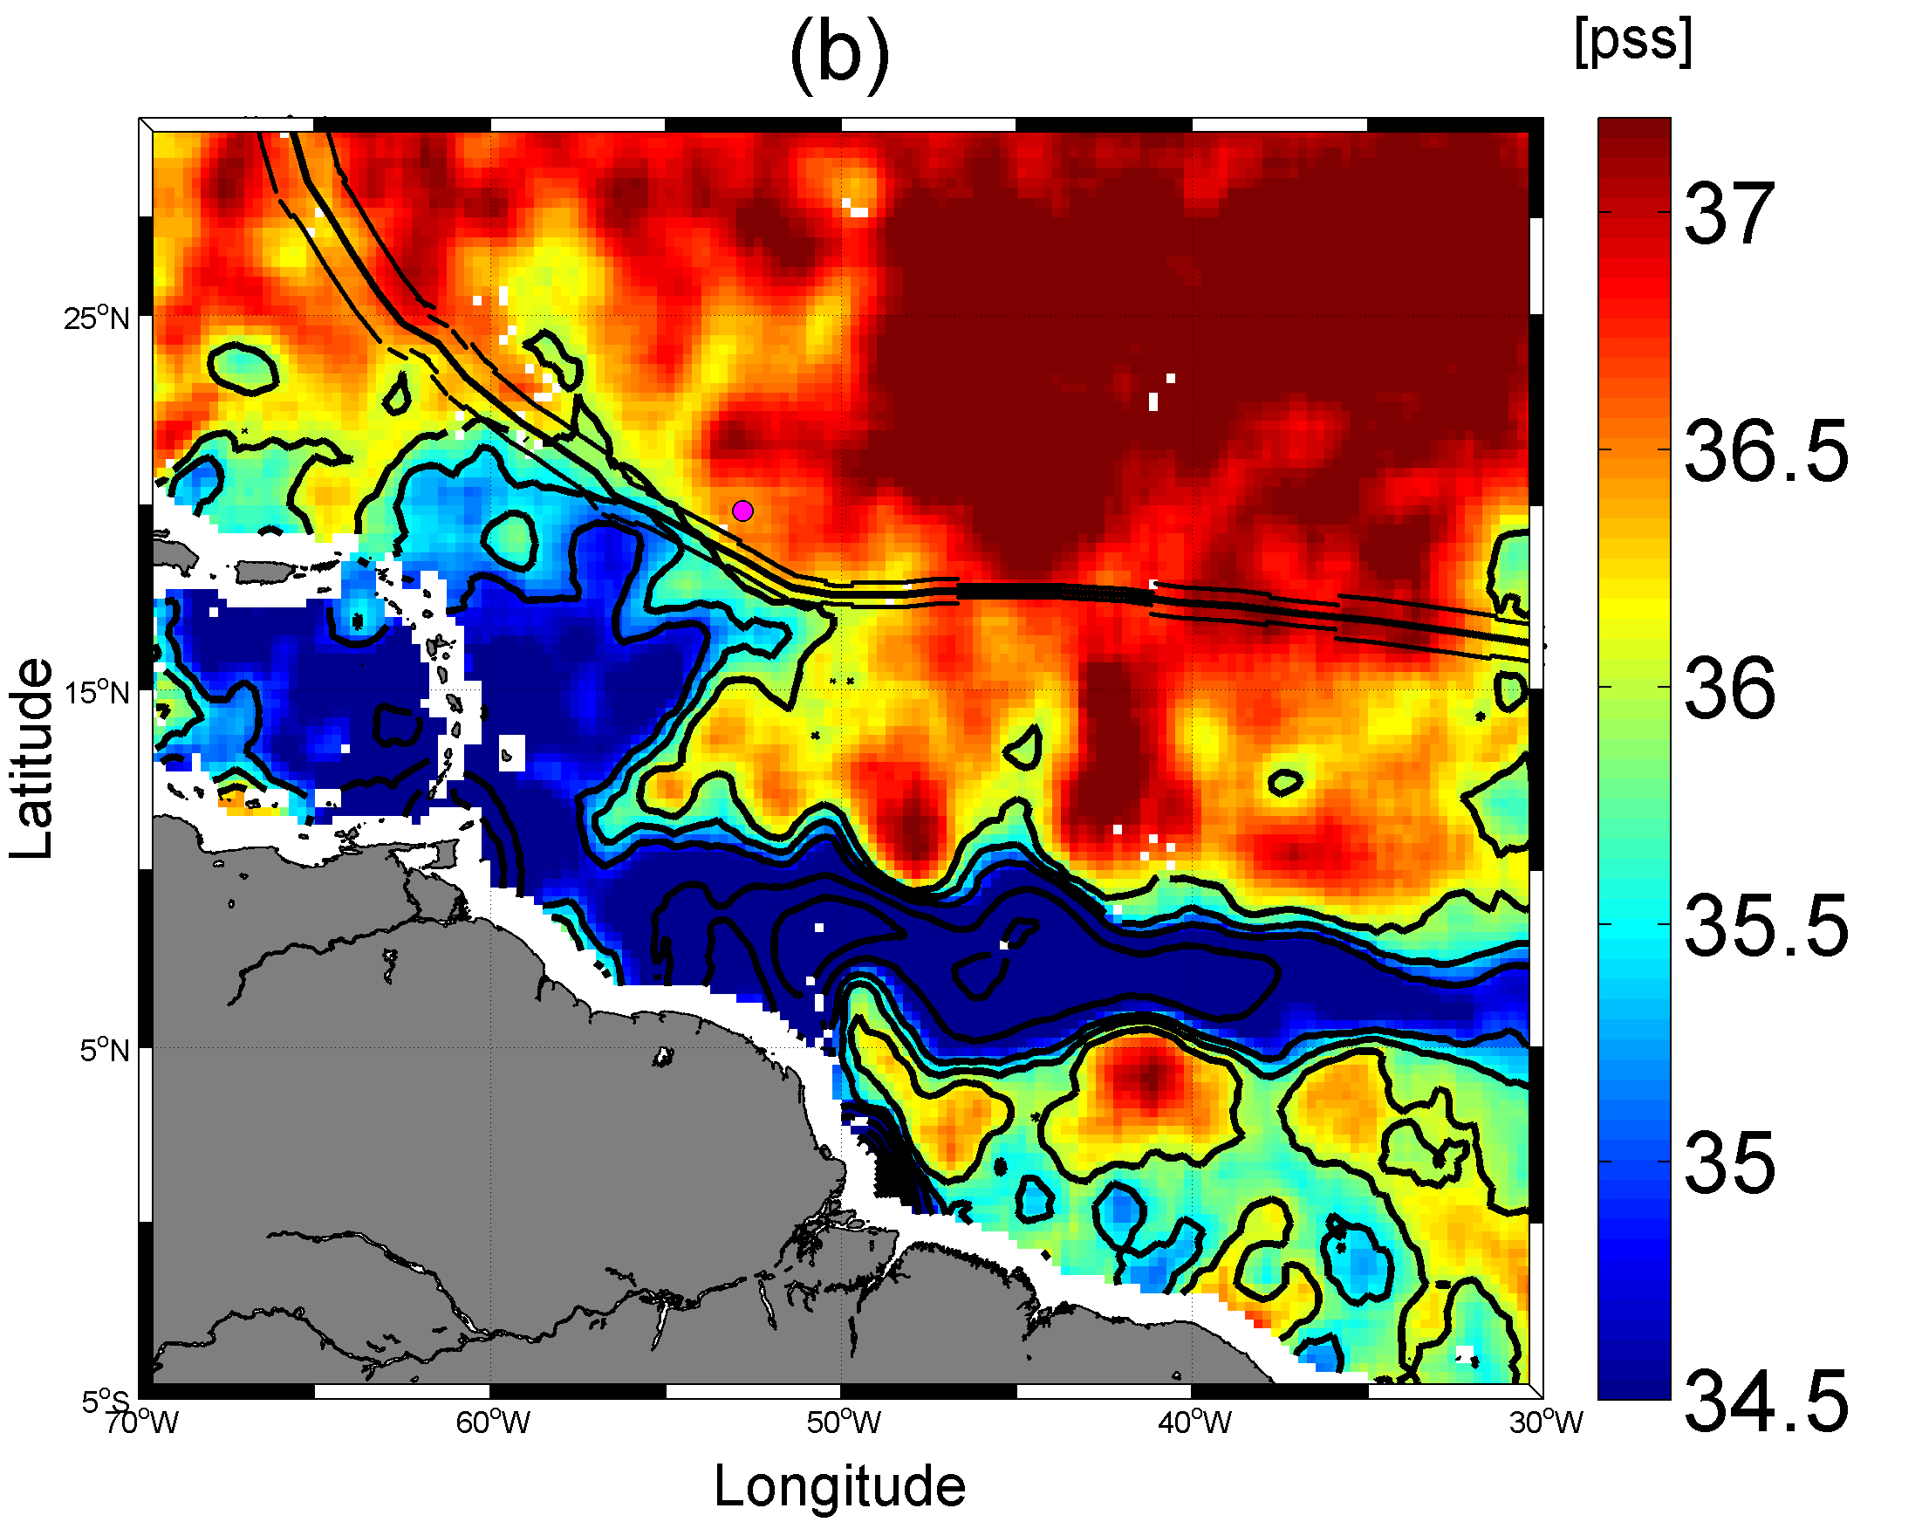
Erosion of the Amazon/Orinico Plume after Igor passage (Right-hand side of the TC)
SSS averaged 5-11/09
(3-5 days before Igor)
SSS averaged 19-24/09
(3-5 days after Igor)
ARGO profiler
#4900819
7/09
ARGO profiler
#4900819
17/09
Apparent Erosion of the freshwater surface layer on the right-hand side quadrants
of the storm

Slide 26
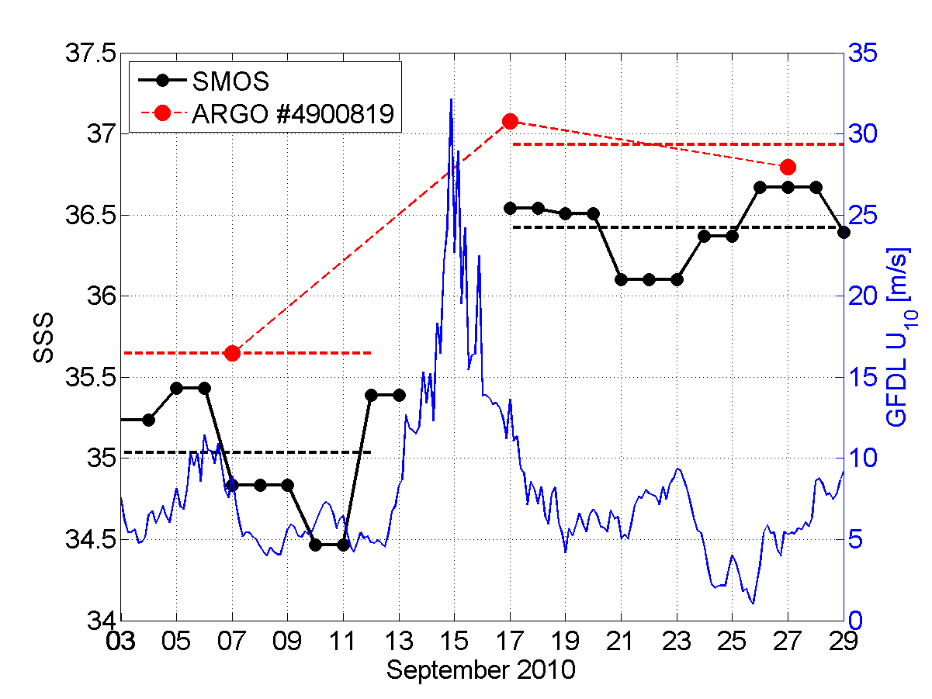
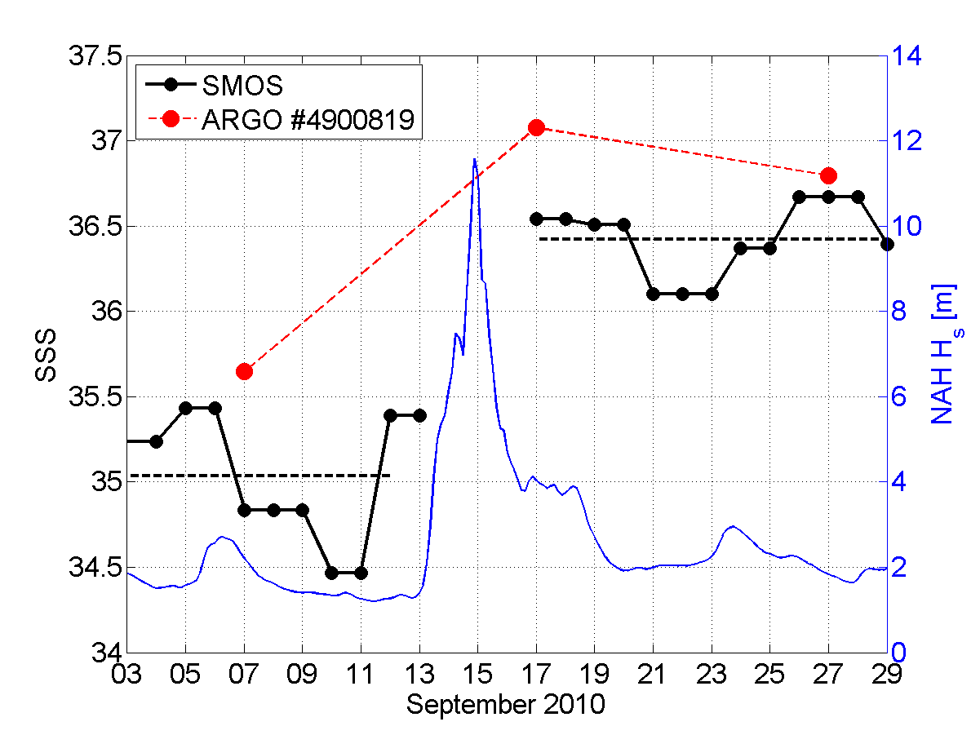
Sea surface Salinity conditions at the ARGO float location before/after IGOR (right-hand side quadrant)
ΔSSS _{argo}=+1.3
ΔSSS _{smos}=+1.4
Enhancement of Sea Surface Salinity as seen by ARGO after IGOR passage: ΔSSS_{argo}~+1.3
Excellent consistency with SMOS observation trend: ΔSSS_{smos}~+1.4 .
SMOS SSS is however systematically ~0.5 pss fresher than ARGO observations at 5 m depth
Maximum surface Wind encountered at the argo float location is ~33 m/s (GFDL model)
Maximum significant wave height up to 11 m (Wave Watch III, NAH)

Slide 27
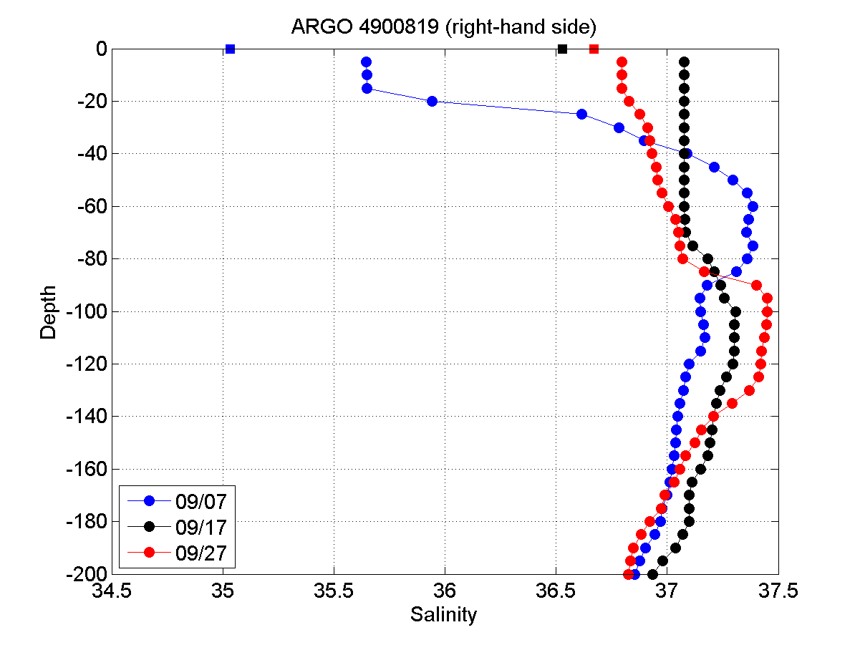
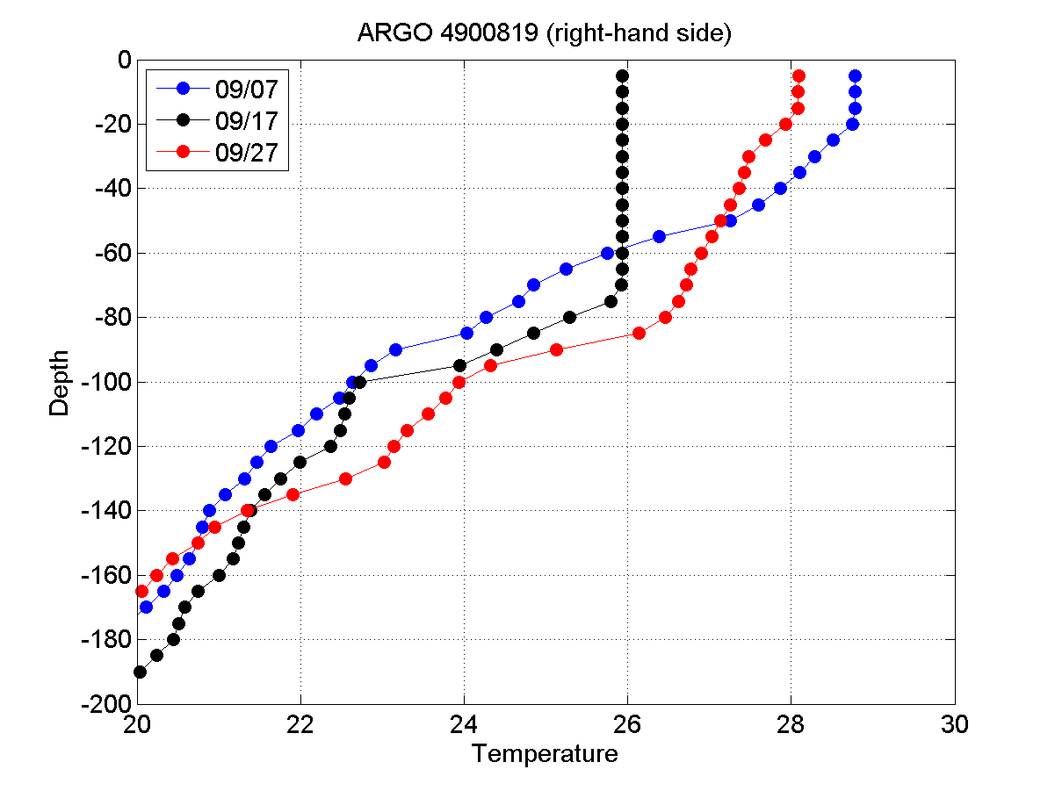
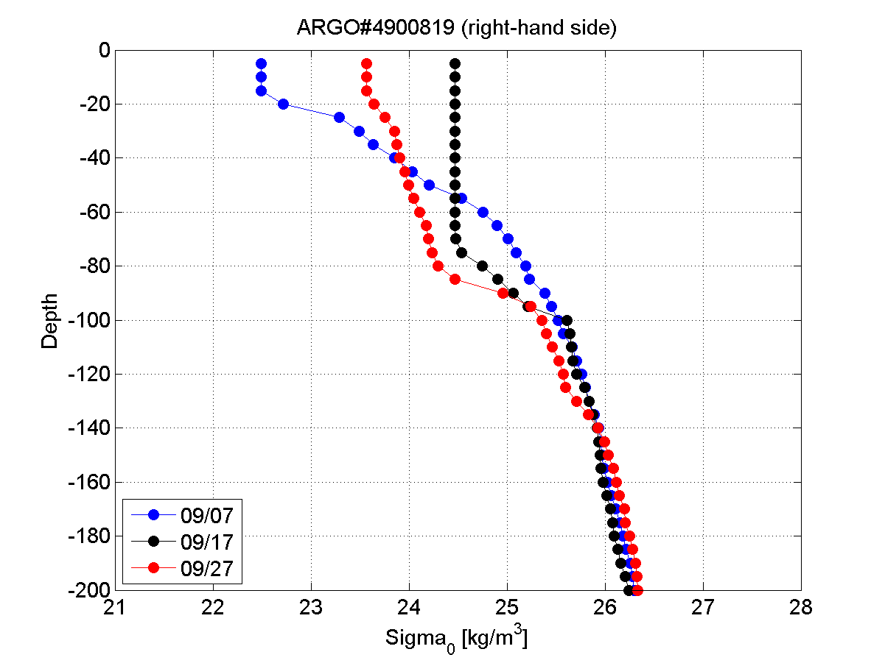
Vertical stratication before/after in the right-hand side quadrant
Mixing of the Warm freshwater surface layer by Hurricane Igor (ARGO#4900819)
Salinity Argo #4900819
Temperature Argo
#4900819
6 days Before Igor
1 day after Igor
9 days After Igor
Original Plume surface freshwater layer ~20 m thick
After the passage of Igor:
=>Drop of sea surface temperature Δ T~2.8°C
=>Enhancement of Sea Surface Salinity by ΔS=1.4
Excellent consistence with SMOS obs~1.5
Increase in sea surface density ~2 kg/m³
Density Argo
#4900819
Deepening of the Mixed surface layer
From 20 m down to ~90 m depth

Slide 28
Erosion of the Amazon/Orinico Plume after Igor passage (Left-hand side of the TC)
SSS averaged 5-11/09
(3-5 days before Igor)
SSS averaged 19-24/09
(3-5 days after Igor)
ARGO profiler
#6900590
4/09
ARGO profiler
#6900590
24/09

Slide 29
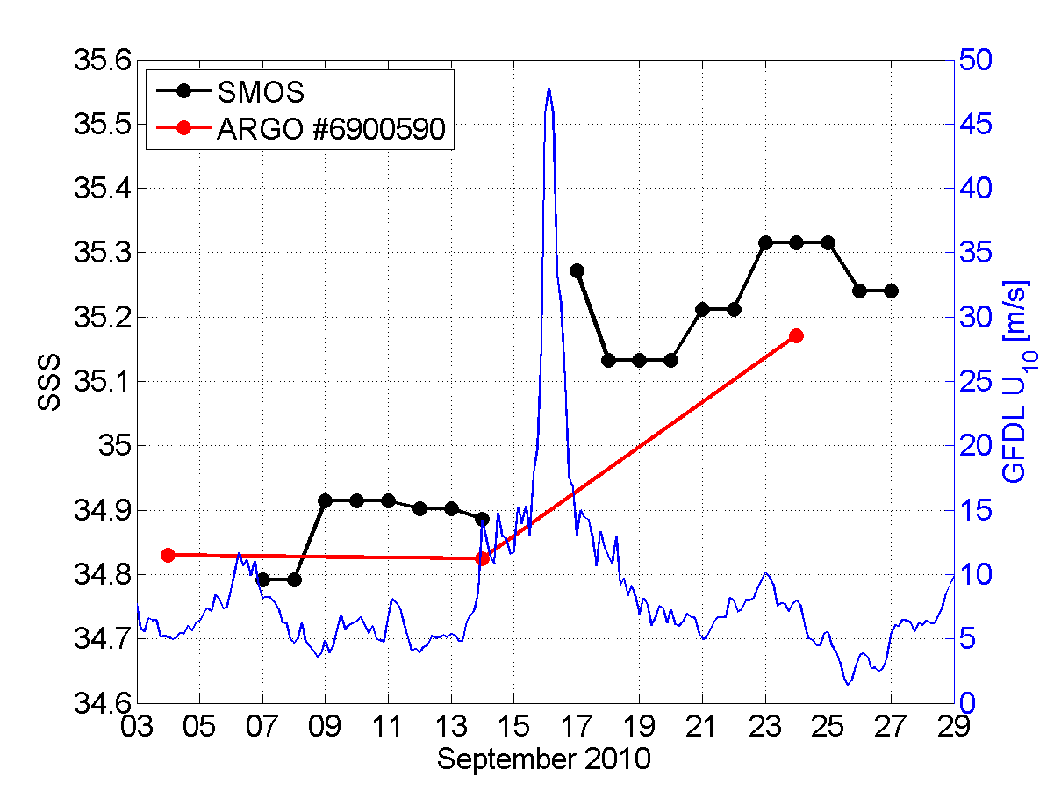
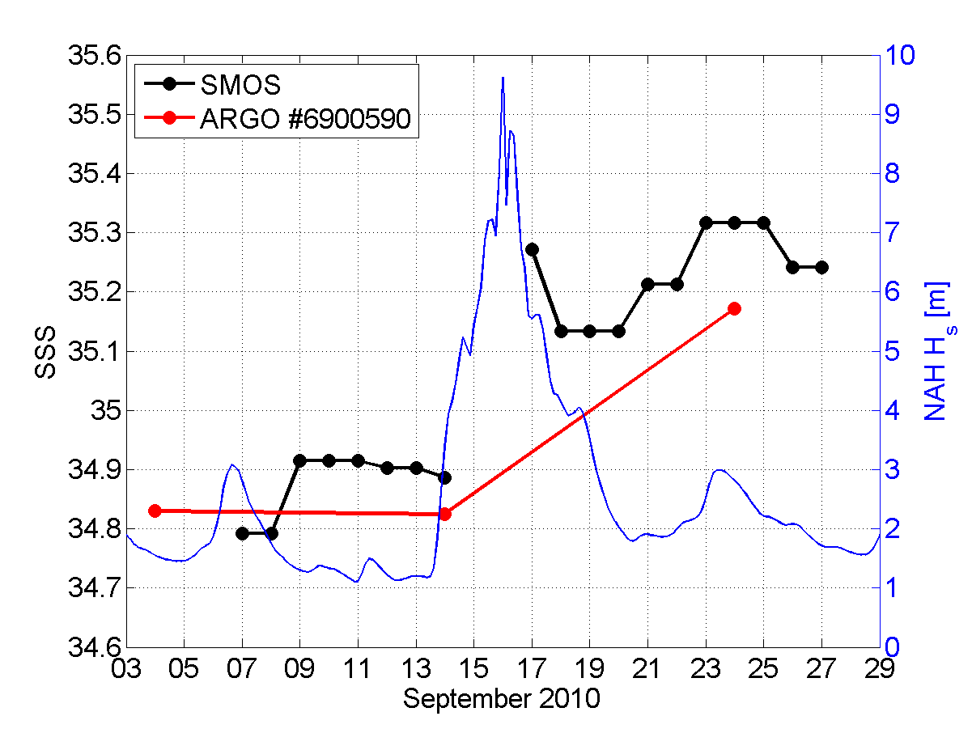
Sea surface Salinity conditions at the ARGO float location before/after IGOR (left-hand side quadrant)
ΔSSS _{argo}=+0.3
ΔSSS _{smos}=+0.4
Surface wind speed encountered >15 m/s up to 48 m/s from 09/15->09/17
Significant wave height >3 m up to 9 m from 09/15->09/17
SMOS SSS in general saltier than Argo SSS by ~0.05-0.1 pss
However very consistent SSS temporal trend from before to after Igor between ARGO float & SMOS surface data:
=>both are showing a +0.3-0.4 pss increase following the surface mixing induced by IGOR on its left hand side quadrant.

Slide 30
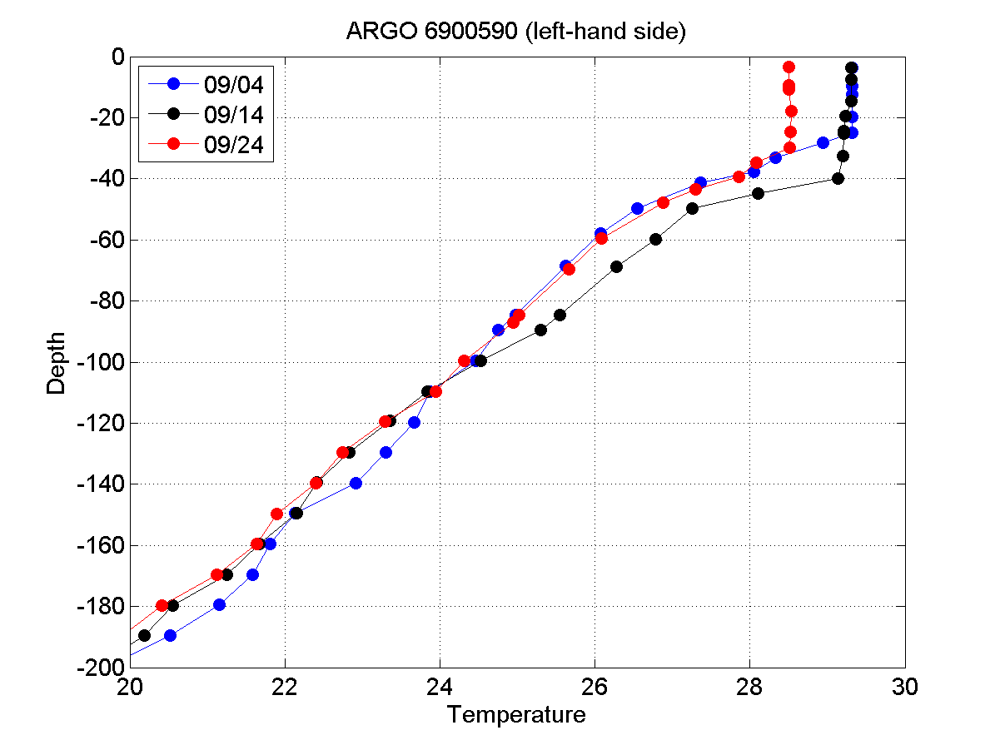
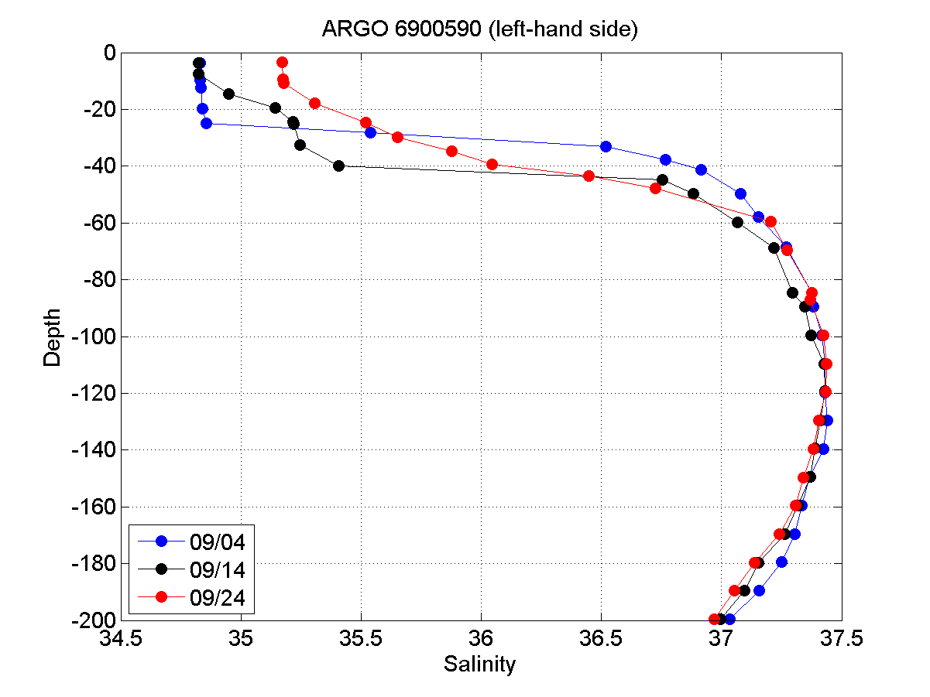
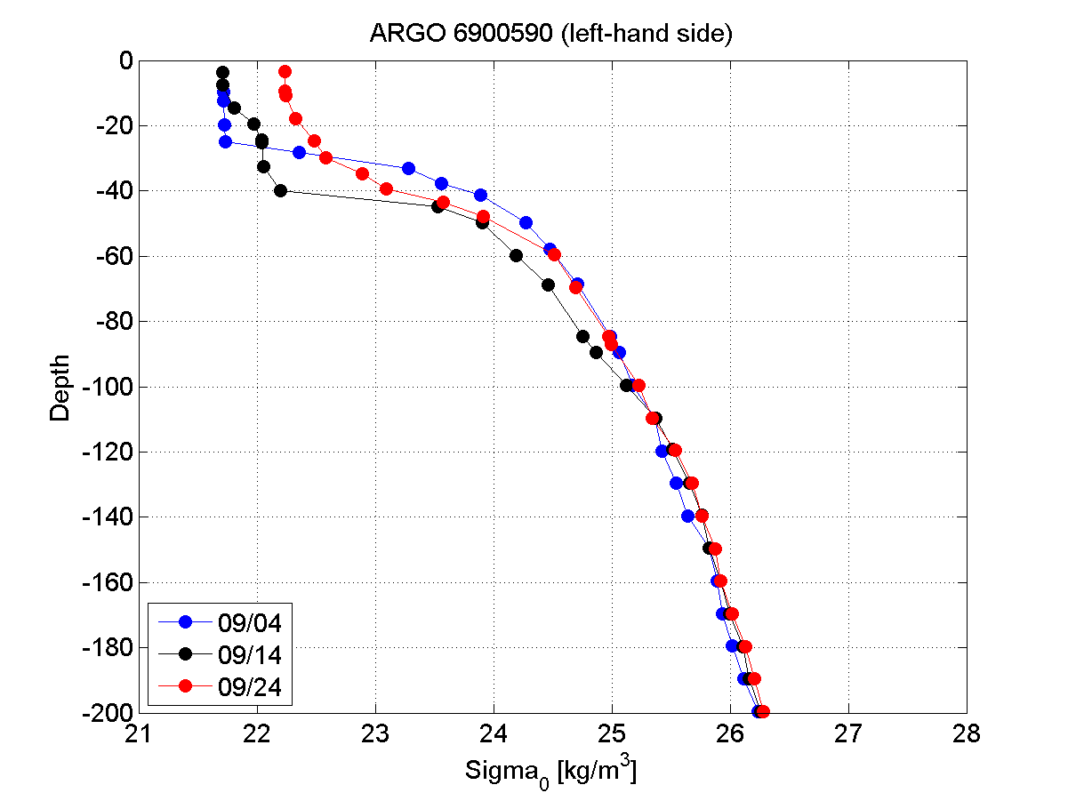
Vertical stratication before/after in the left-hand side quadrant
9 days Before Igor
1 day before Igor
6 days After Igor
Cooling ~1°C
Mixing
Damped
By the thicker
Plume
Barrier layer
On the LHS ?
More intense
wave mixing
On the RHS ?

Slide 31
EARLY CONCLUSIONS
SMOS SSS data able to produce before and after snapshots of plume location associated with TC passage
Satellite SSS data yielding accurate SSS perturbation due to TC as compared to two ARGO floats – 0.5 to 1.5 SSS INCREASE
New look at plume-TC interaction with SSS + SST perhaps allowing enhanced diagnosis

Slide 32
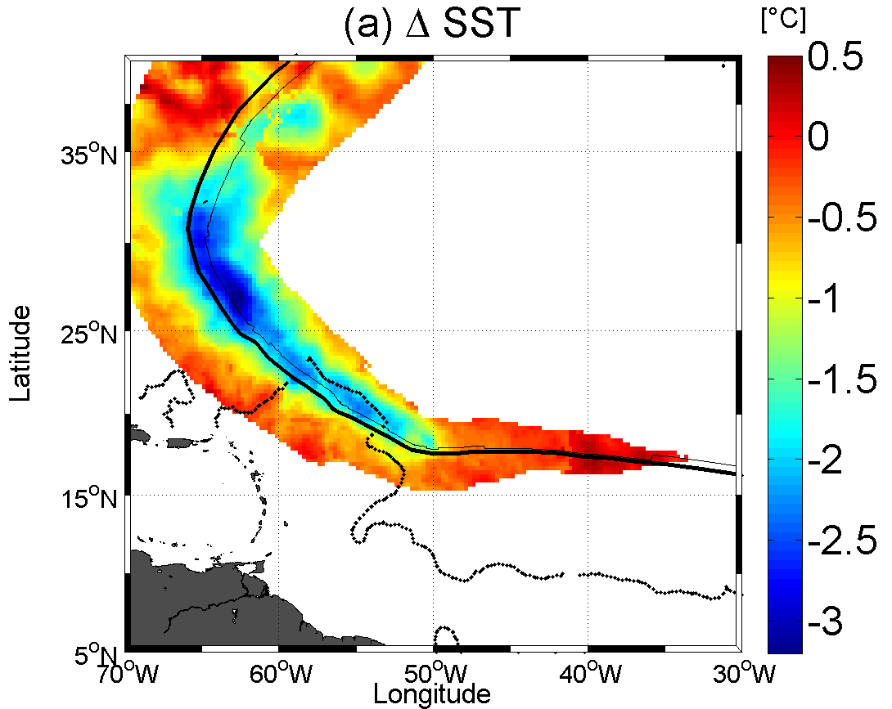
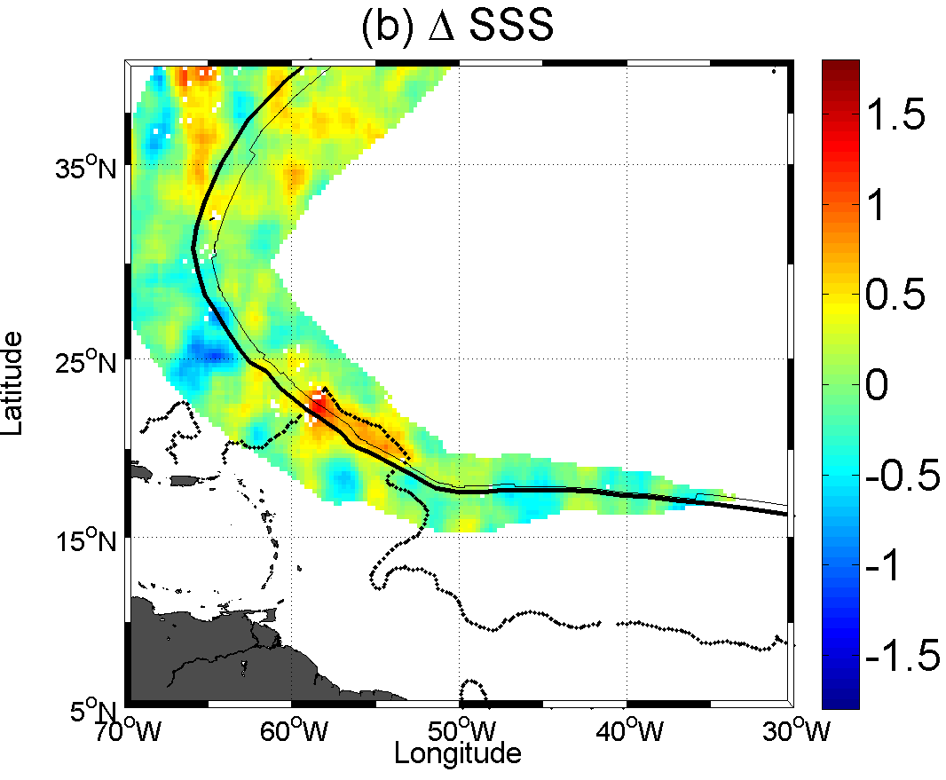
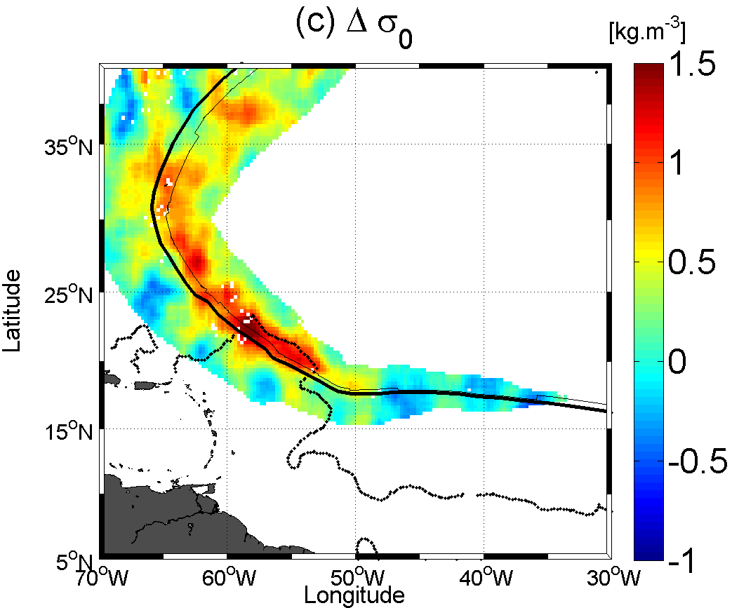
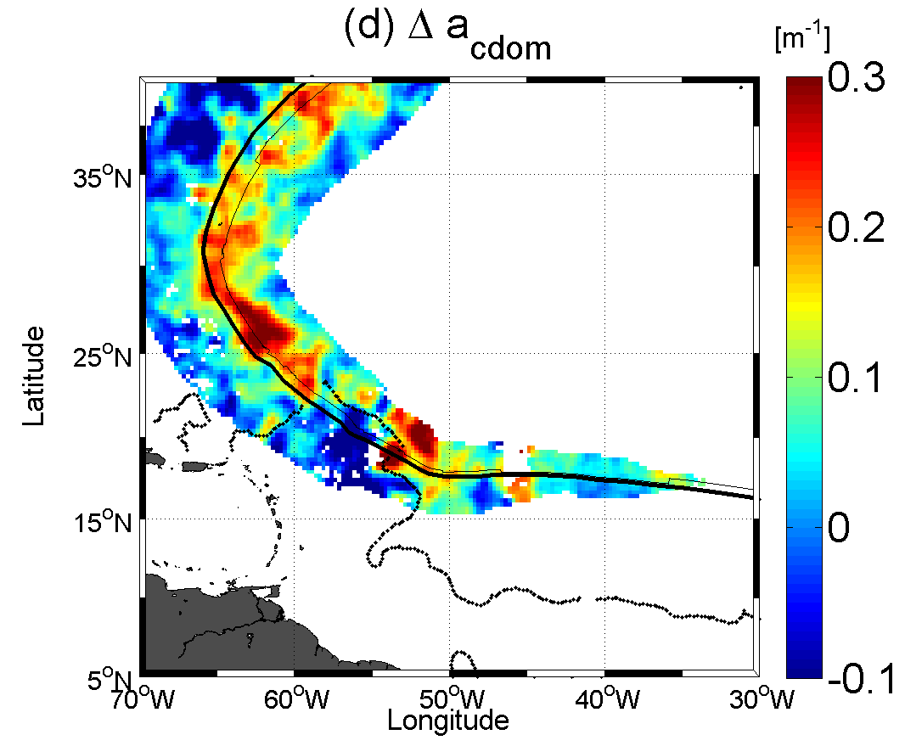
Surface wakes of Igor
Six days of data centered on t_{o}–(+) 4 days have been averaged to construct the pre (post)-cyclonic quantities.
Here
a_{cdom} = a_{d} + ag ag: CDOM (dissolved
matter)
ad: non living
particulate organic
material, bacteria,
inorganic material
and bubbles
Figure 4: Surface wakes of Hurricane Igor. Post minus Pre-hurricane (a) Sea Surface Temperature (ΔSST ) (b) Sea surface Salinity (ΔSSS), (c) Sea Surface Density (Δσ _{o} ) and (d) Sea Surface CDOM absorption coefficient .The thick and thin curves are showing the hurricane eye track and the locii of maximum winds, respectively. The dotted lines is showing the pre-hurricane plume extent.
ΔSST, ΔSSS, Δσ _{o} wakes were only evaluated at spatial locations around the eye track for which the wind exceeded 34 knots during the passing of the hurricane.

Slide 33
Thanks!
This work is supported by NASA’s Ocean Surface Salinity Science Team – Grant NNX09AU69G

