Slide 1

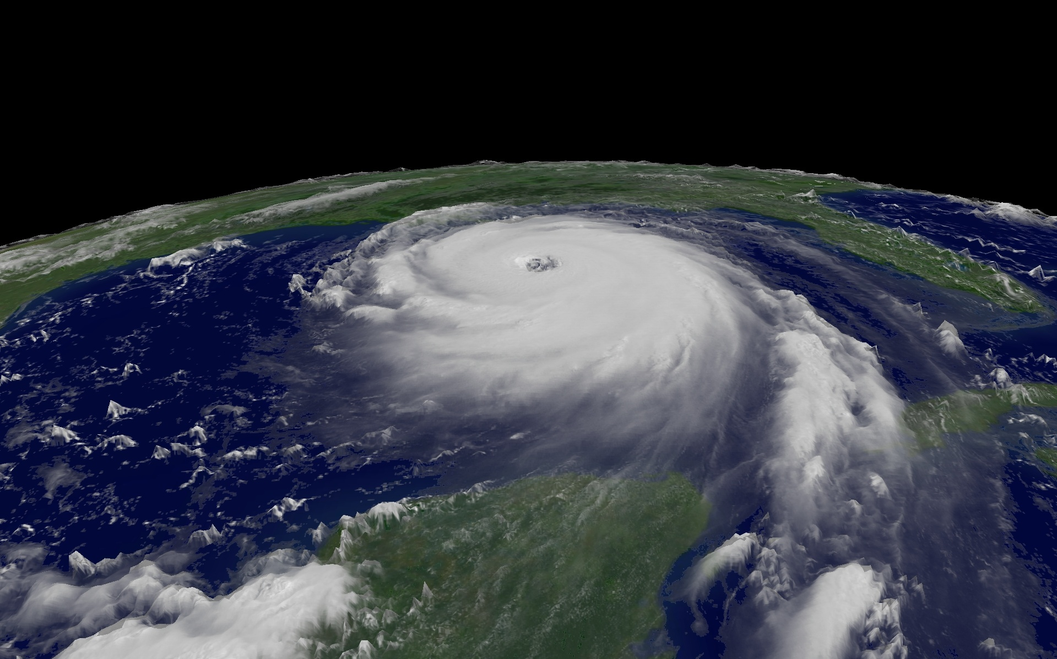
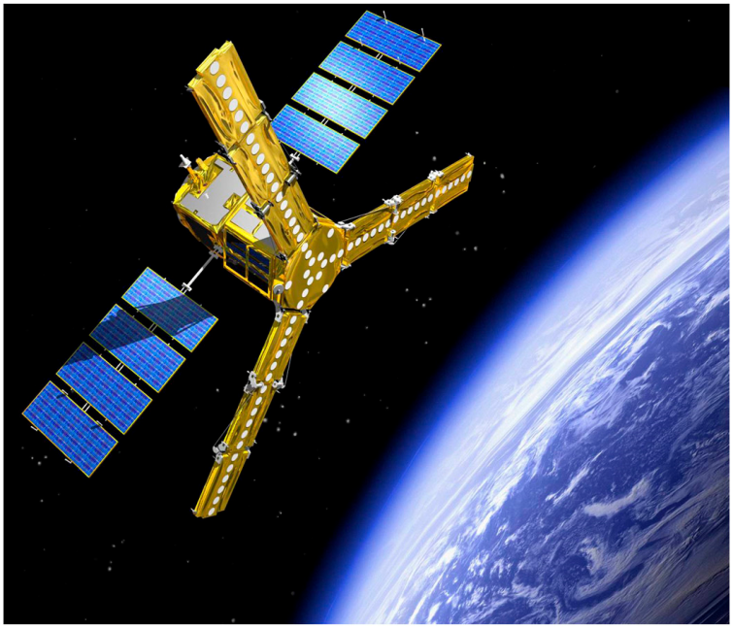



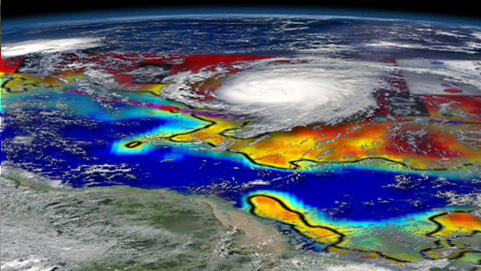
Observations of Ocean response to Hurricane Igor: A Salty Tropical Cyclone Wake observed from Space
Nicolas Reul¹, Joseph Tenerelli²
¹IFREMER, Laboratoire d'Océanographie Spatiale, France
²Collect Localisation Satellite, France

Slide 2
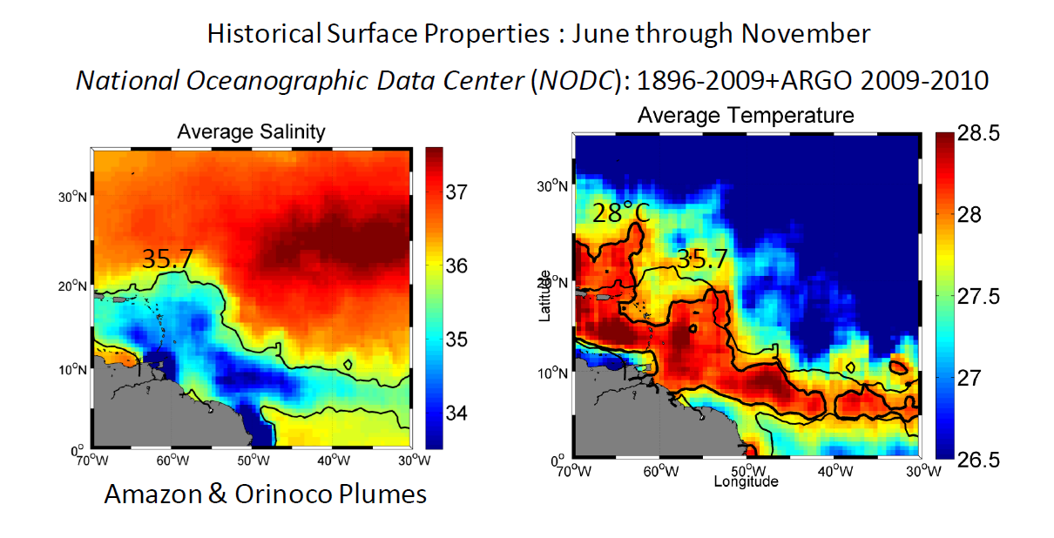
Freshwater Plume waters warmer by >1°C than open ocean
Waters during the hurricane season

Slide 3
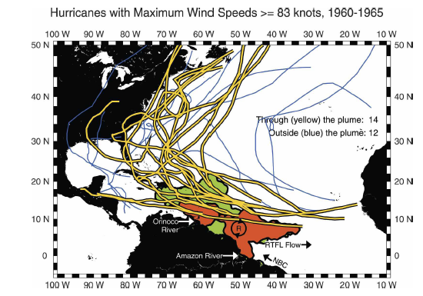
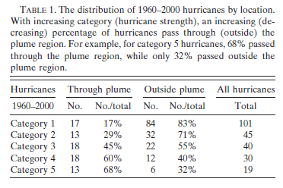
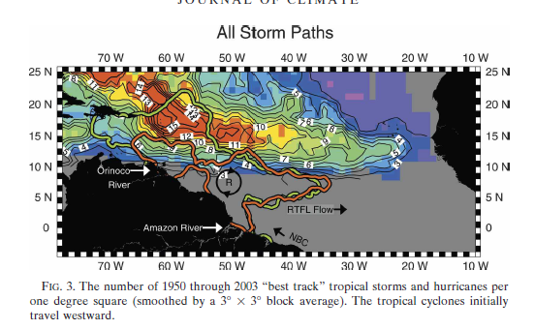
Amazon and Orinoco River Plumes and NBC Rings: Bystanders or Participants in
Hurricane Events?
A. FFIELD, J CLIM 2007
Warm anomaly,
NBC rings &
Freshwater plume Barrier-layer effects

Slide 4
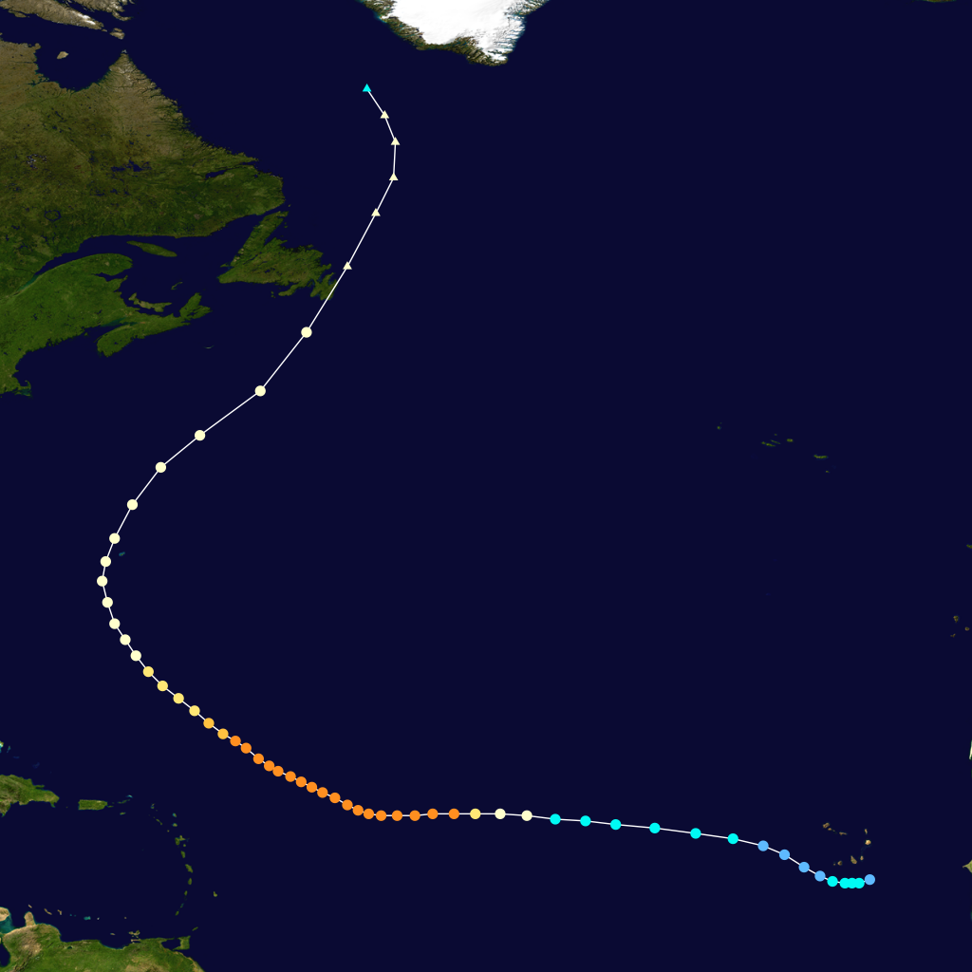
Category 4 Hurricane Igor in September 2010
09/19
Cat 4-5
09/17
09/13
09/11
09/15

Slide 5
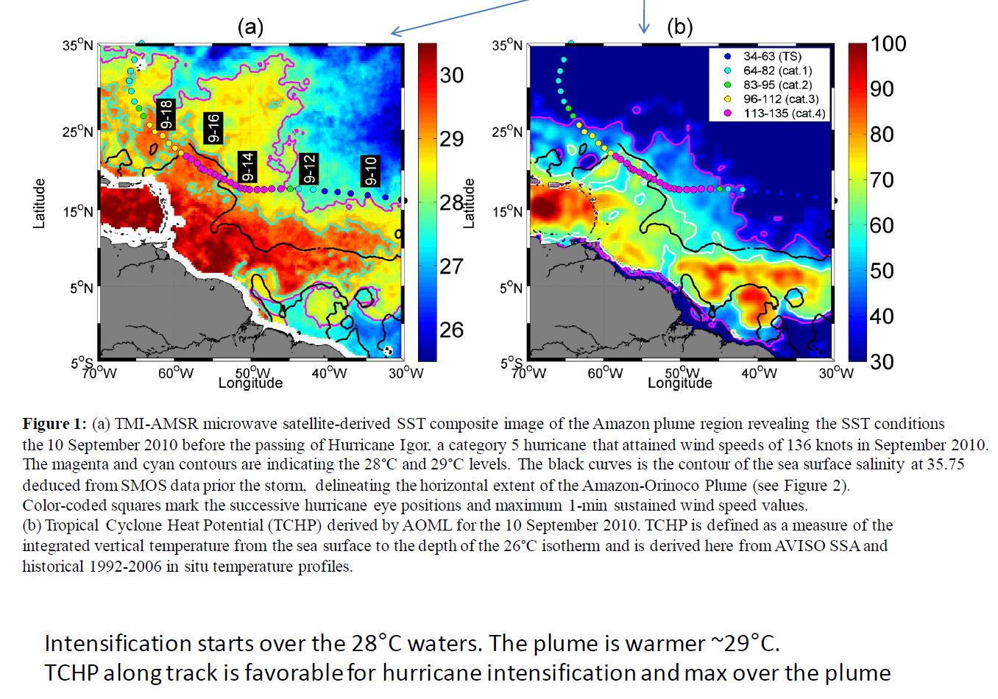
Pre-storm conditions
Tropical Cyclone Heat Potential (TCHP)
derived by AOML 10 Sep
TMI-AMSRE SST 10 Sep
[kJ cm²]
Amazon Plume extent from SMOS data 1 week before Igor (SSS=35.5)

Slide 6
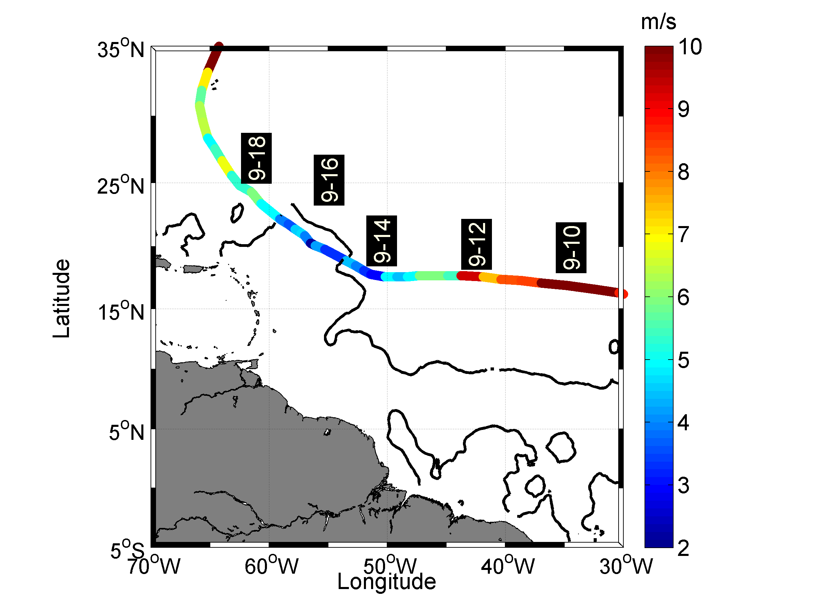
Storm Forward Translation Speed
Igor slowed down as it travelled across the Amazon River Plume: Vt=3-5 m/s

Slide 7
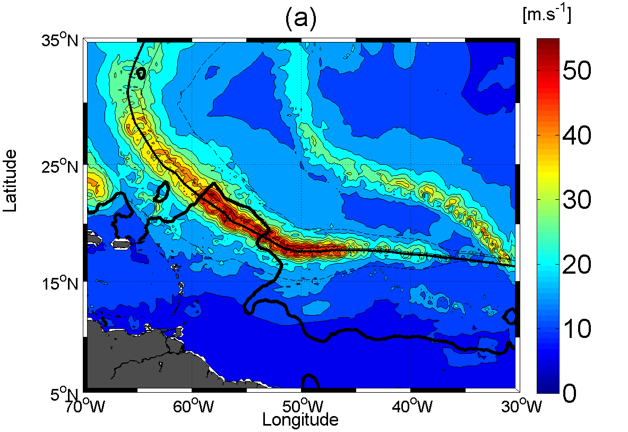
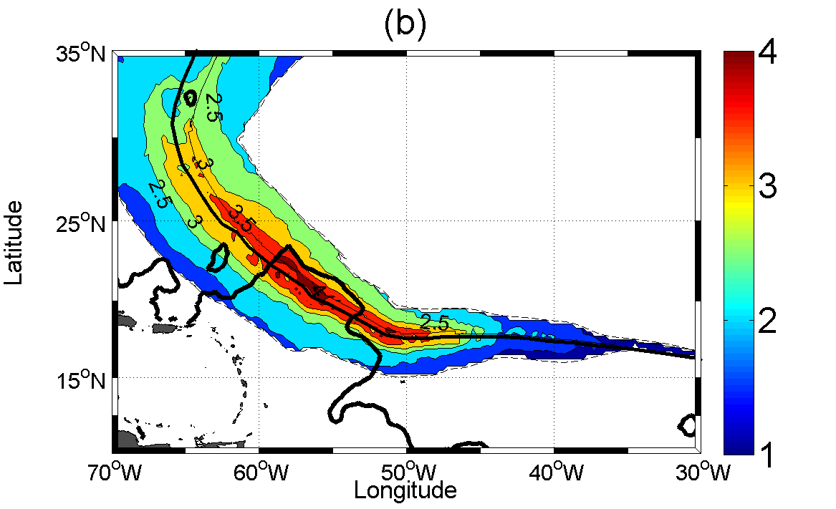

Atmospheric forcing
Max Wind Speed
Wind Power Index
Radius at 34 knts
GFDL model data
=>good agreement with obs
during Igor
(Reul et al, JGR 2012)
Proxy for wind energy input
to the ocean (Vincent et al, JGR 2012)
=>Strongest atmospheric forcing over the Amazon River Plume

Slide 8
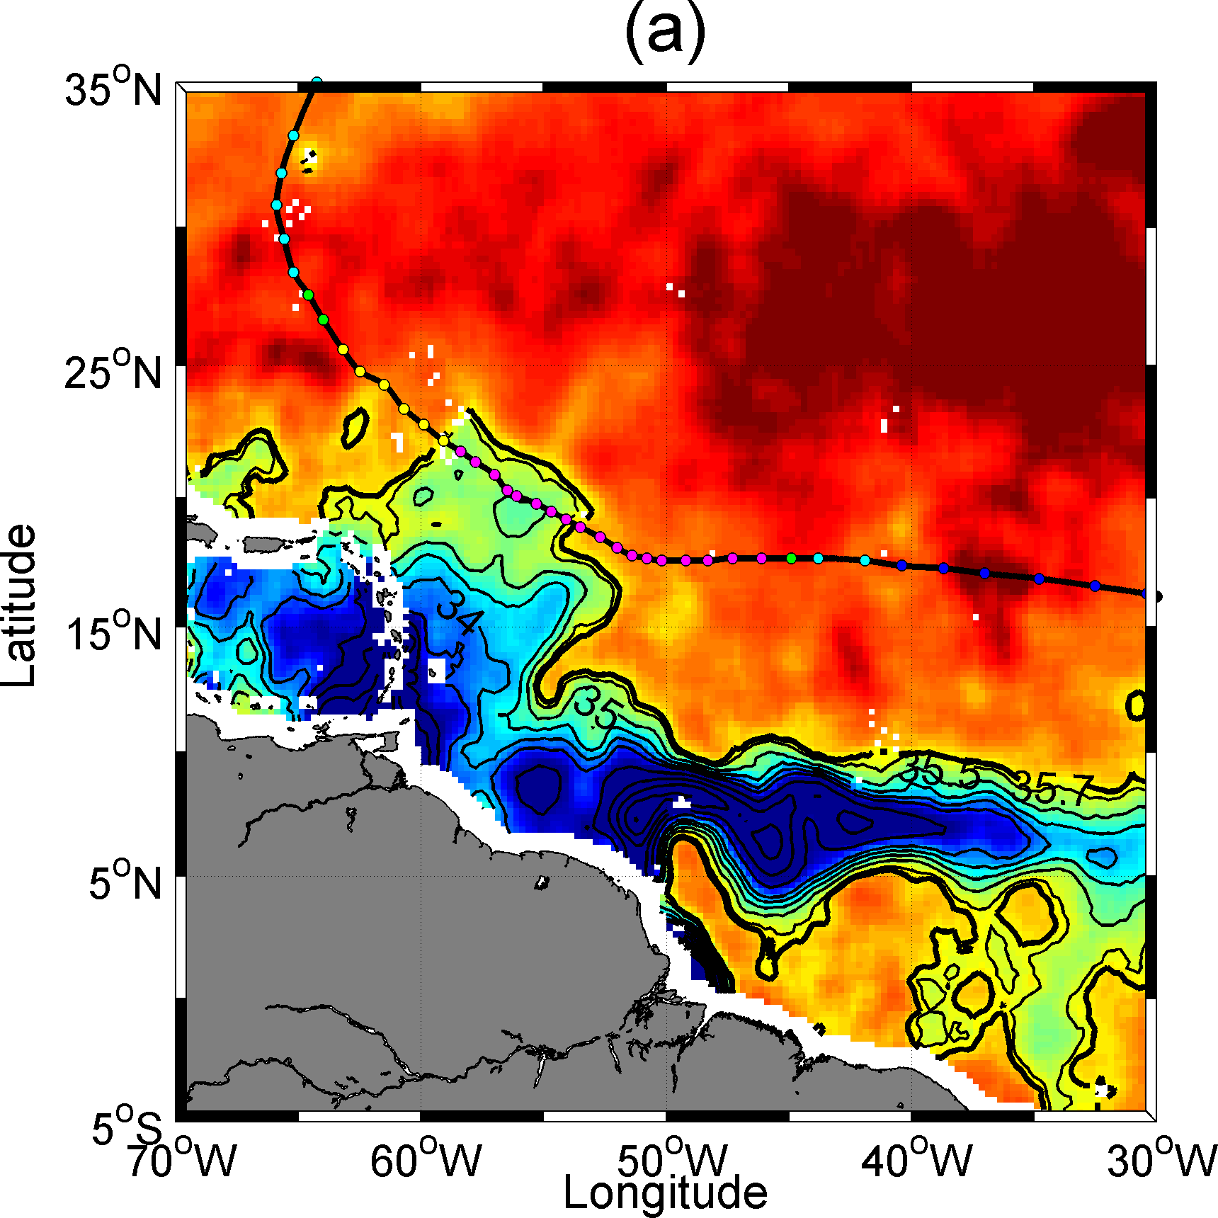
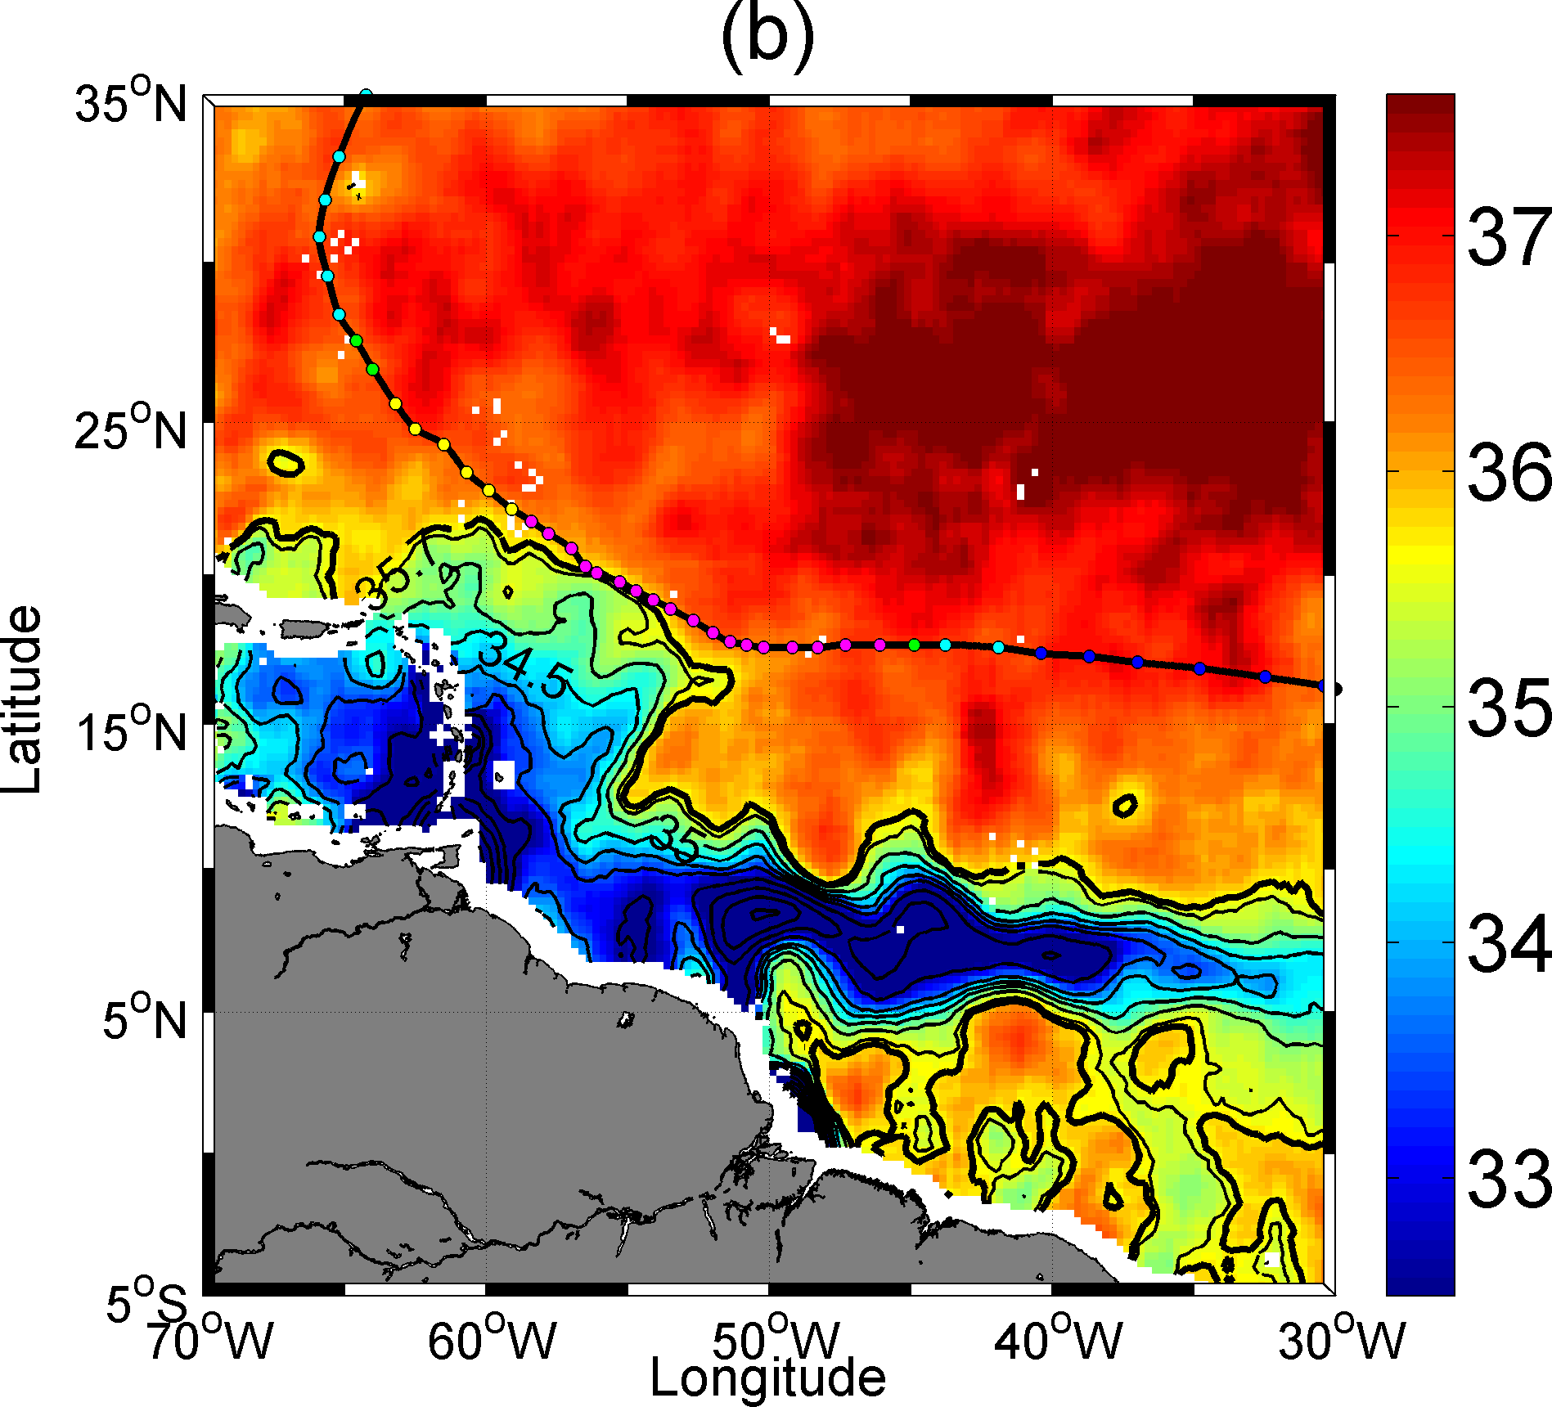
Surface area~ 89000 km²> Lake Superior, the world largest freshwater lake: a transfer of 1 GTo of Salt in 5 days
SMOS SSS 1 week Before IGOR
SMOS SSS 1 week After IGOR
Figure 2: Two SMOS microwave satellite-derived SSS composite images of the Amazon plume region revealing the SSS conditions
(a) before and (b) after the passing of Hurricane Igor, a category 5 hurricane that attained wind speeds of 136 knots in September 2010.
Color-coded circles mark the successive hurricane eye positions and maximum 1-min sustained wind speed values in knots.
Seven days of data centered on (a) 10 Sep 2010 and (b) 22 Sep 2010 have been averaged to construct the SSS images, which are smoothed
by a 1° x 1° block average.

Slide 9
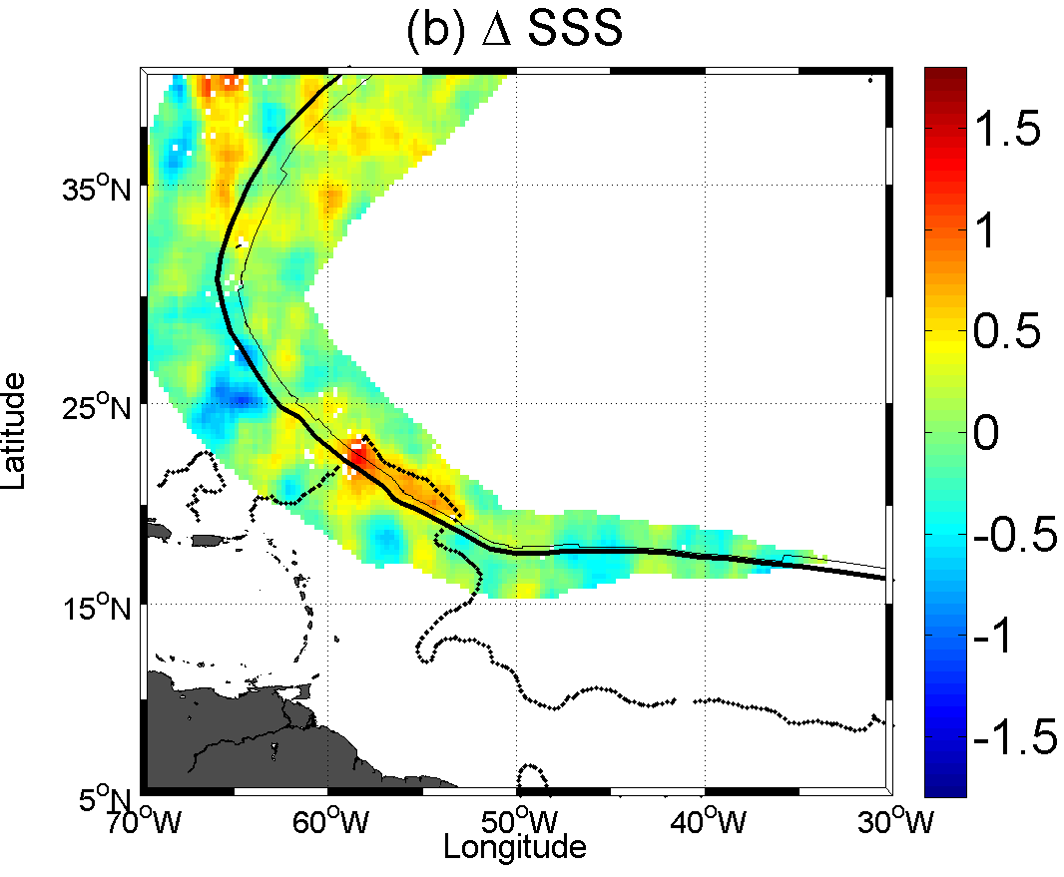
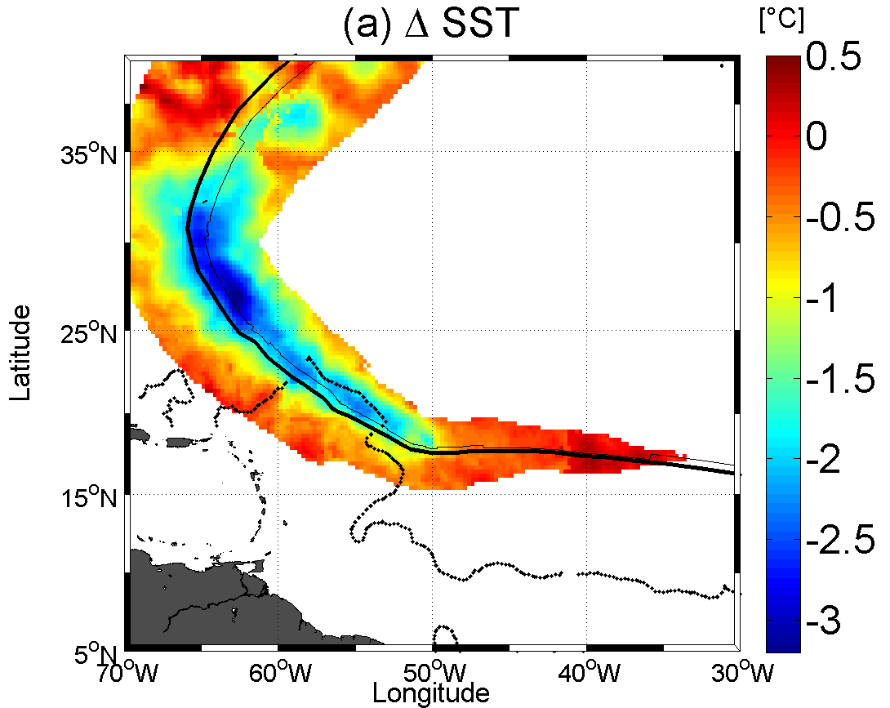
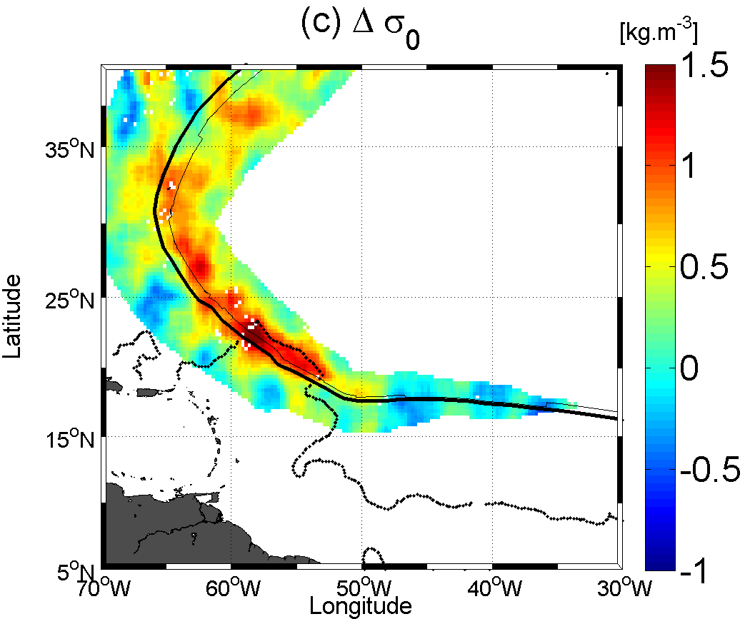
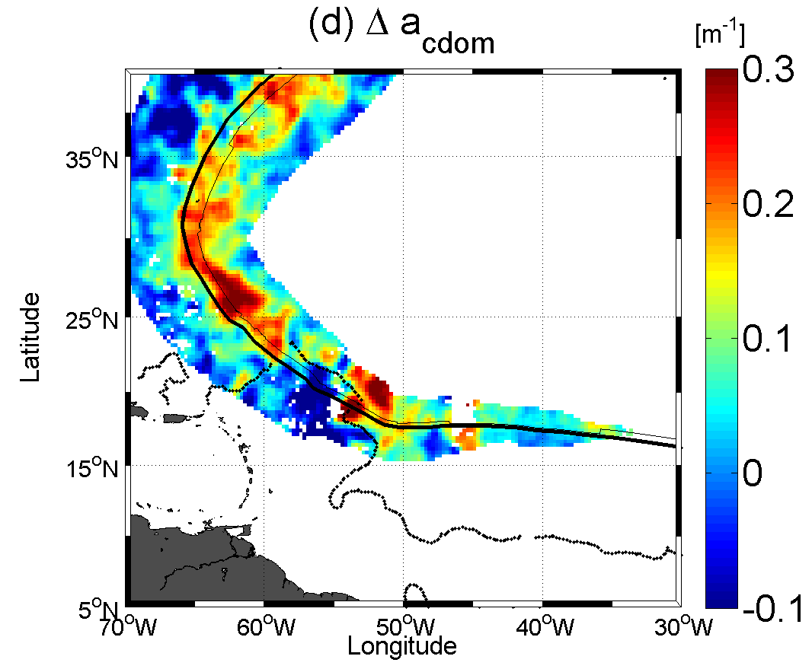
Surface wakes of Igor: SST, SSS,Density, Color

Slide 10
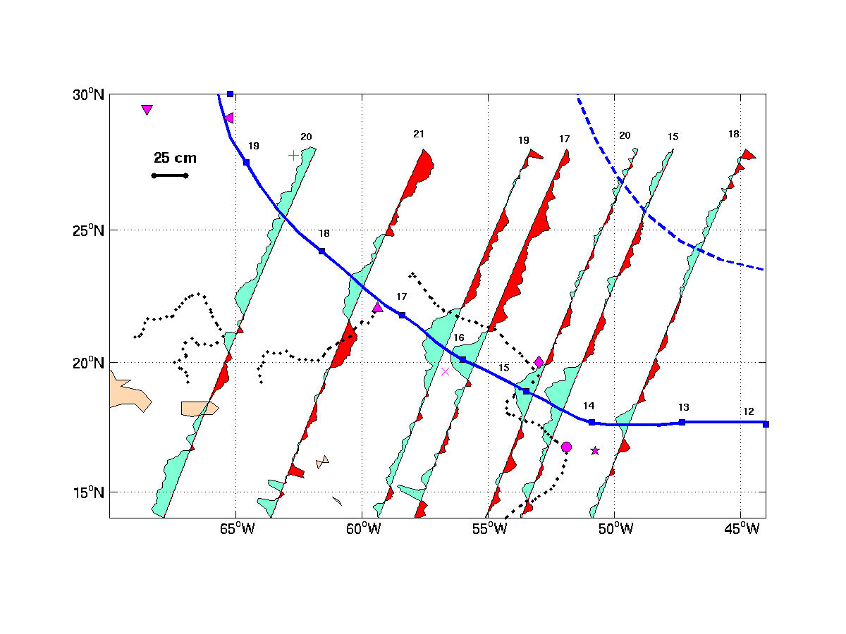
Sea level Change from Altimetry (Jason 1 & 2)
~25 cm , maximimum trough along track, where Wpi was max

Slide 11
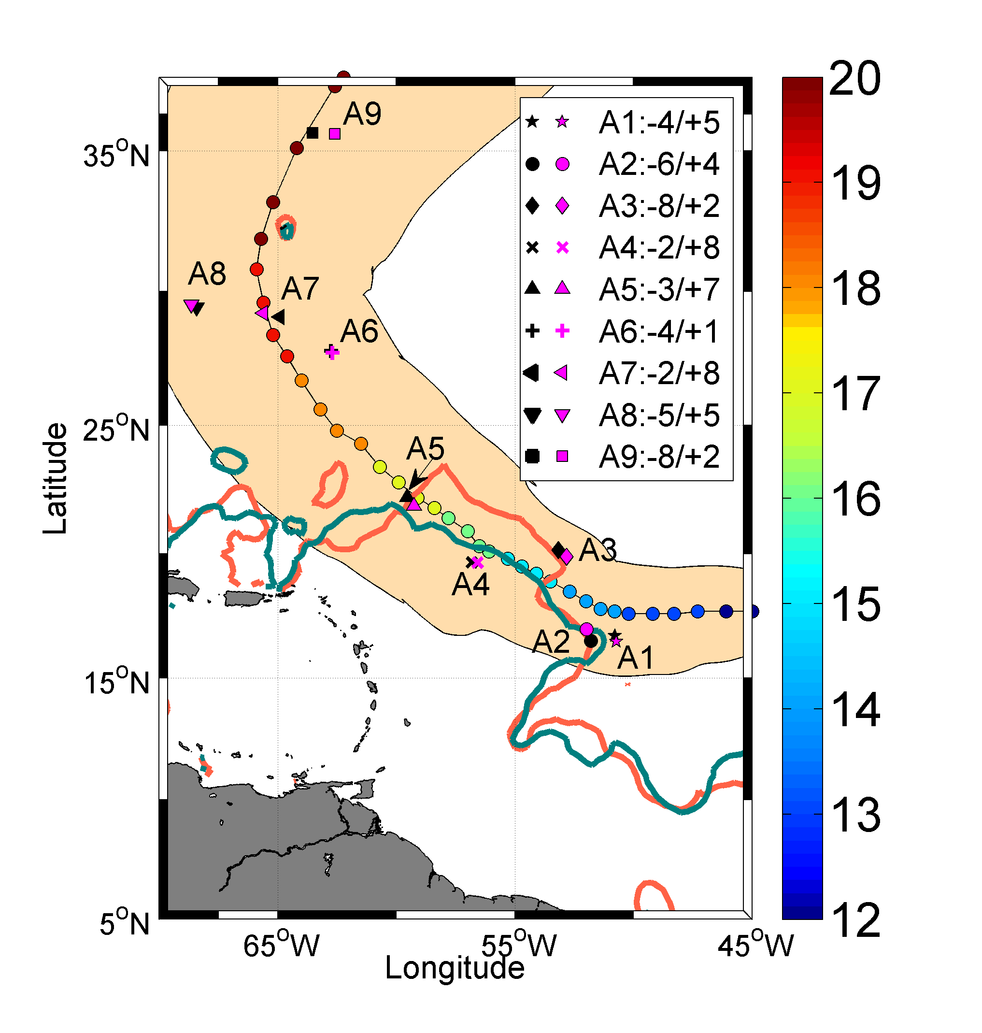
Validation with in situ
In situ sampling of igor high wind wake by ARGO floats

Slide 12
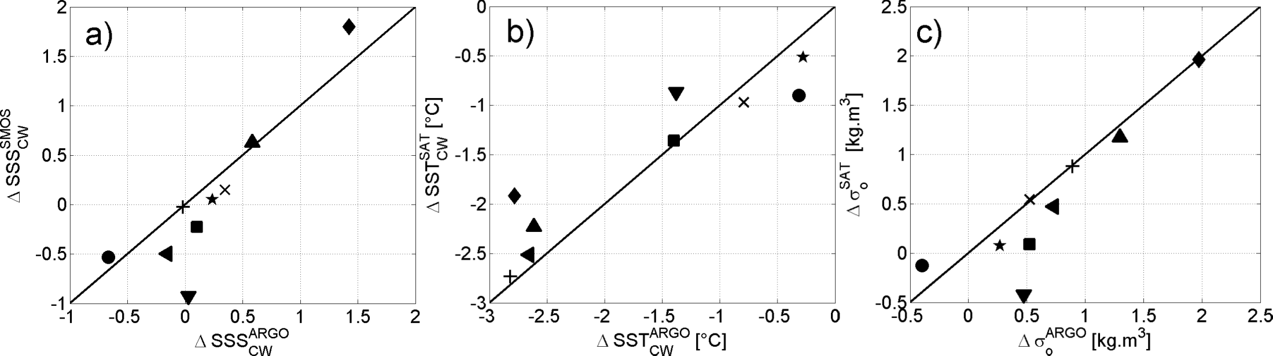
Skin Satellite estimates of the ocean surface response to IGOR
versus ~5 m depth Argo measurements
Salinity
Temperature
Density
Rmse= 0.37 (SSS) , 0.4°C (SST) and 0.34 kg.m⁻³ (density)

Slide 13
Thick BL>20m=> cooling inhibition
by salt-driven stratification
In the Plume

Slide 15
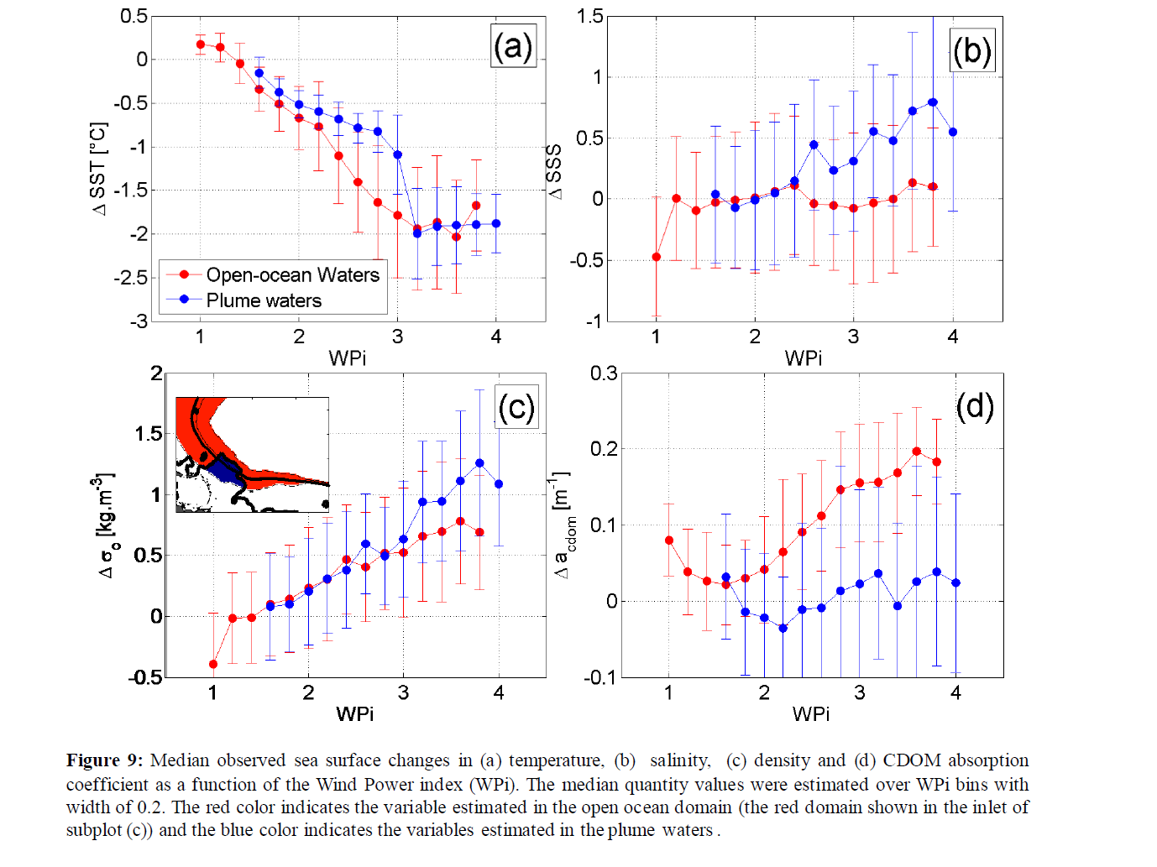

Slide 16
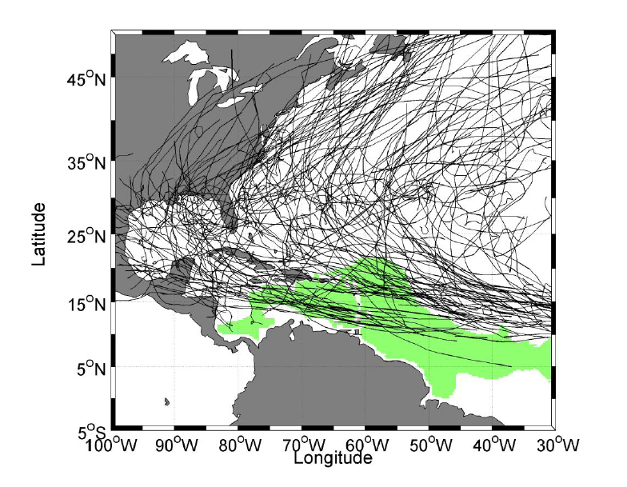

Slide 17
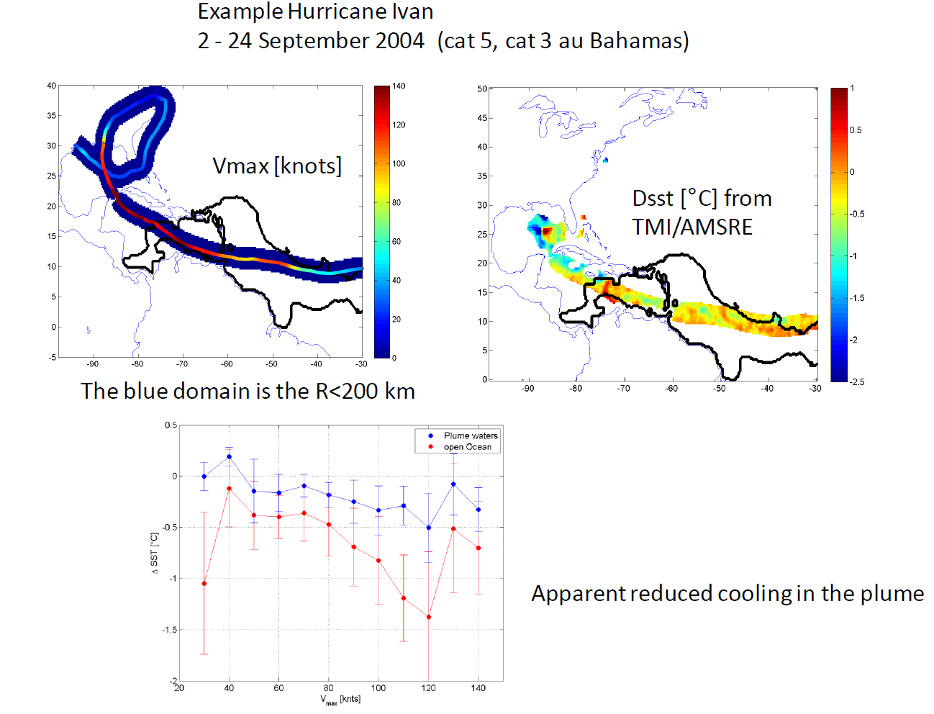

Slide 18
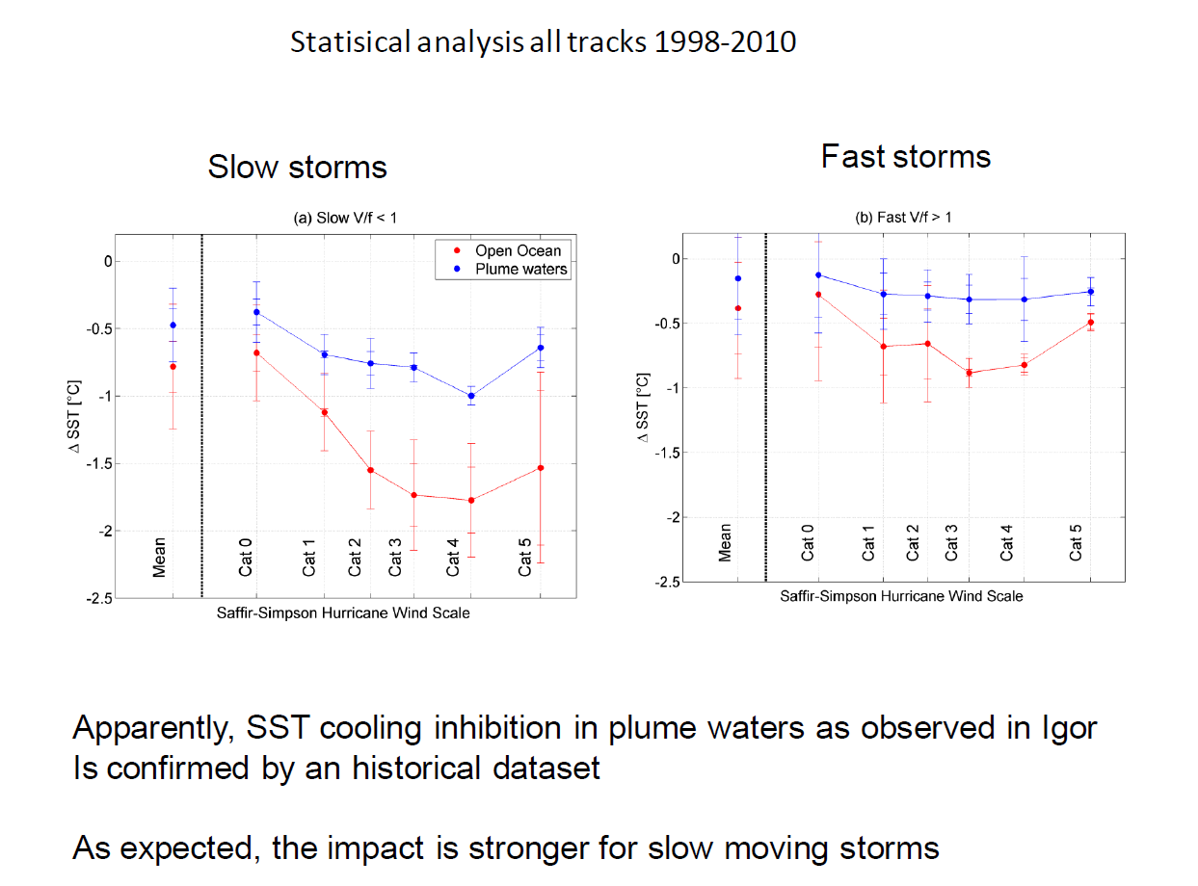

Slide 19
Summary
New Sea Surface Salinity products from Space can be used to improve
our understanding of processes involved in oceanic response to TC
First Evidence of SSS changes in the wake of a TC from Spaceborne data
In combination with SST=> density change
In combination with altimetry (respective signatures of barotropic & barocilinc effects)
Salt-driven stratification in Amazon plume reduces cooling by the wind induced mixing=> potential for TC intensification
SMOS SSS products can be used to better characterize the ocean heat potential variability in Barrier Layer areas
=> improve TC intensification forecasts

