Slide 1
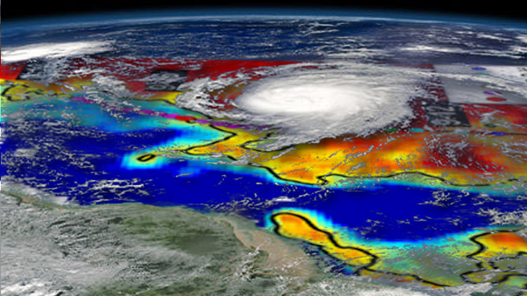
Observations of Ocean response to Hurricane Igor: A Salty Tropical Cyclone Wake observed from Space
N.Reul¹, Y, Quilfen¹, B. Chapron¹, E. Vincent², M. Lengaigne²,
S. Fournier¹, J. Tenerelli³, J. Vialard², C. Boyer de Montégut¹.
1
2
3
44th International Liege Colloquium
on Ocean Dynamics, 7-11 May 2012

Slide 2
Context

Slide 3
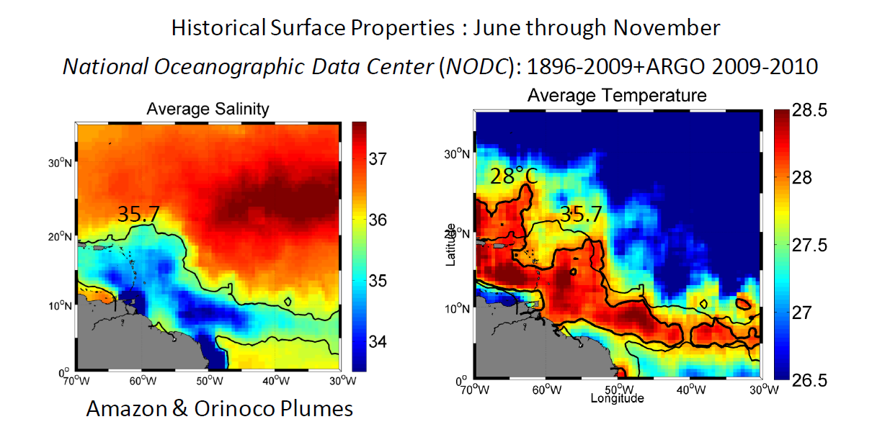
Hyrdography of the North-Western Tropical Atlantic during Hurricane season
Freshwater Plume waters warmer by >1°C than open ocean
Waters during the hurricane season

Slide 4
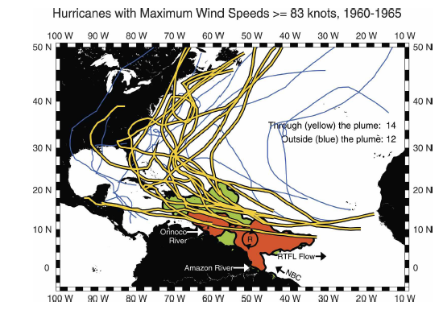
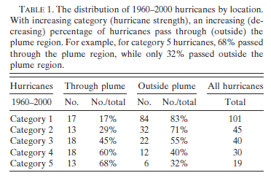
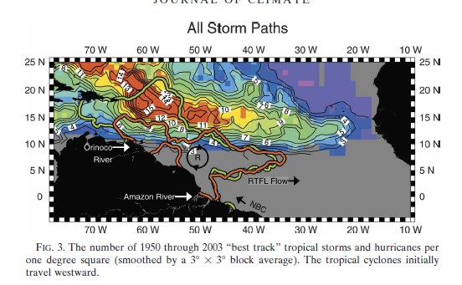
Amazon and Orinoco River Plumes and NBC Rings: Bystanders or Participants in
Hurricane Events?
A. FFIELD, J CLIM 2007
Warm anomaly,
NBC rings &
Freshwater plume Barrier-layer effects

Slide 5
Multi-sensor
Observations
In the wake of Hurricane
Igor

Slide 6
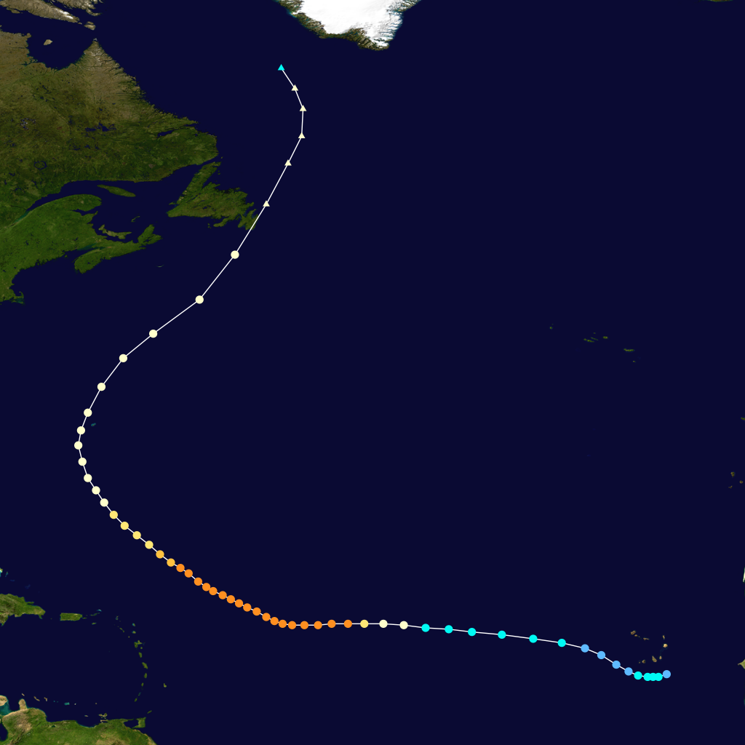
Igor Category 4 Hurricane-September 2010
09/19
Cat 4-5
09/17
09/13
09/11
09/15

Slide 7
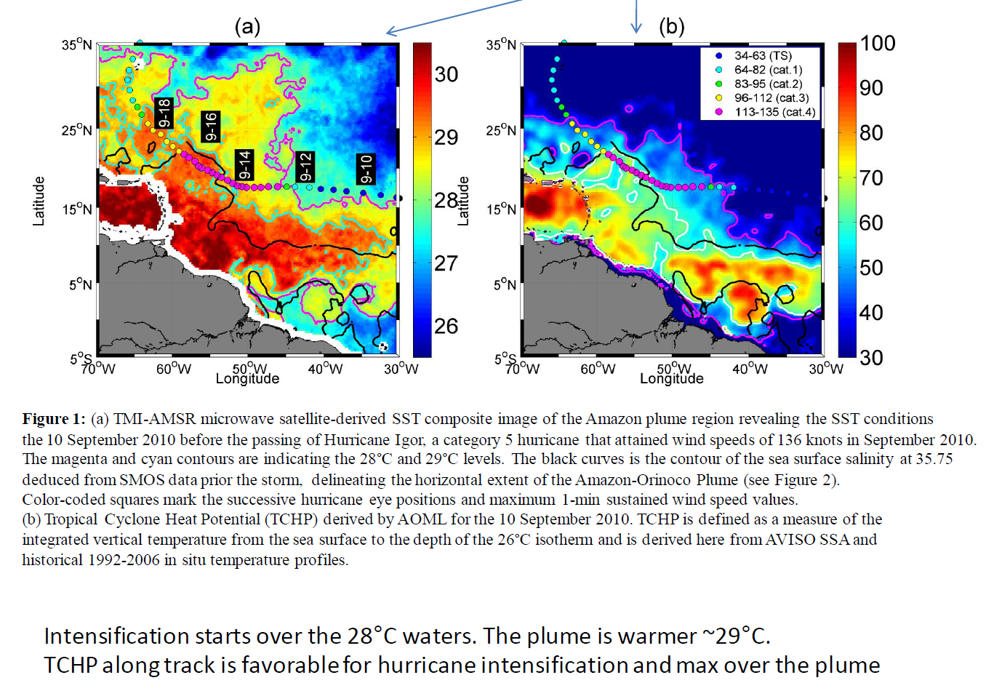
Pre-storm conditions
Tropical Cyclone Heat Potential (TCHP)
derived by AOML 10 Sep
TMI-AMSRE SST 10 Sep
[kJ cm²]
Amazon Plume extent from SMOS data 1 week before Igor (SSS=35.5)

Slide 8
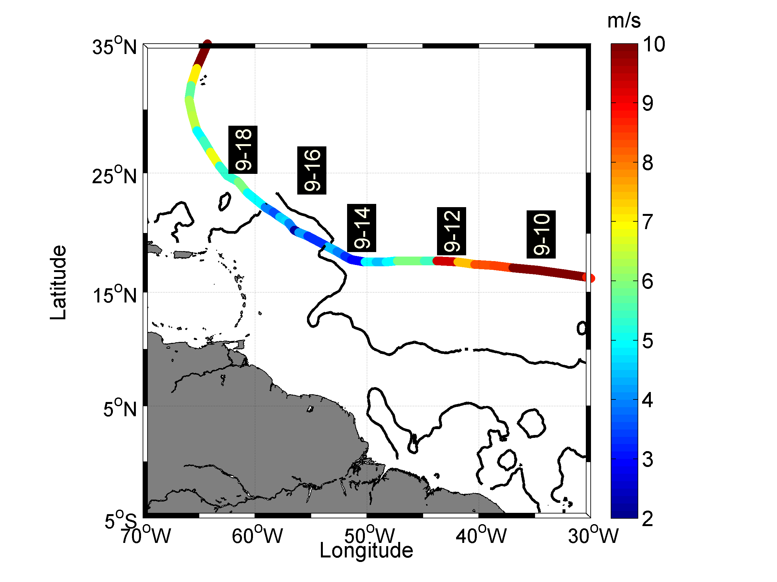
Storm Forward Translation Speed
Igor slowed down as it travelled across the Amazon River Plume: Vt=3-5 m/s
=> Ocean-atmosphere interactions were potentially maximized

Slide 9
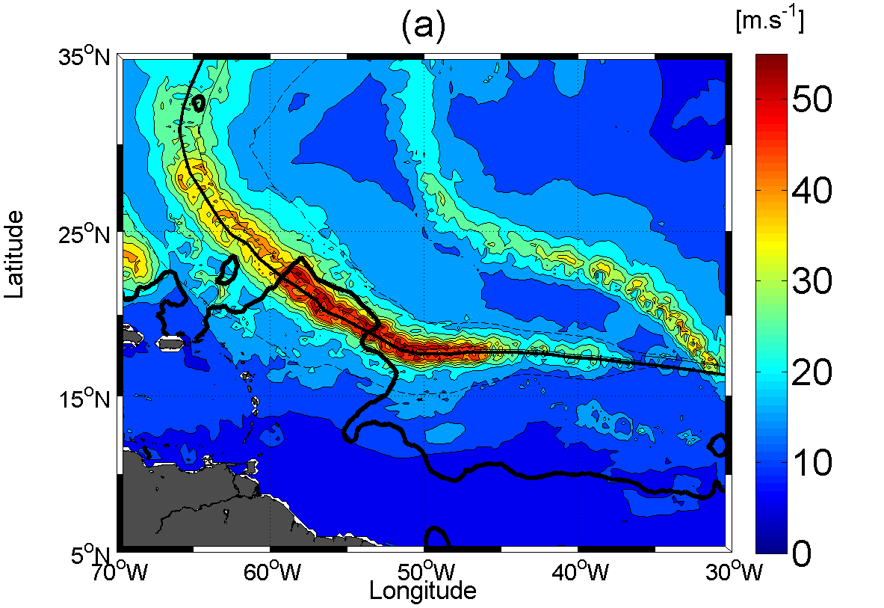
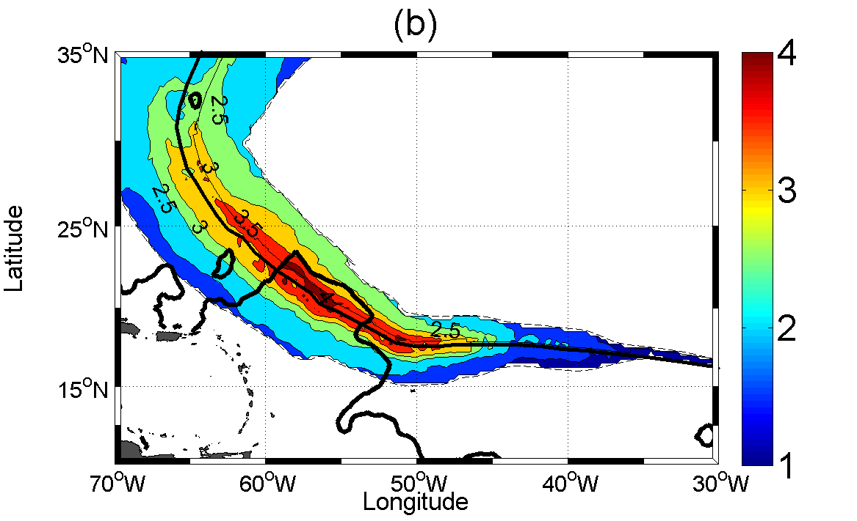
Atmospheric forcing
Max Wind Speed
Wind Power Index
Radius at 34 knts
GFDL model data
=>good agreement with obs
during Igor
(Reul et al, JGR 2012)
Proxy for wind energy input
to the ocean (Vincent et al, JGR 2012)
=>Strongest atmospheric forcing over the Amazon River Plume

Slide 10
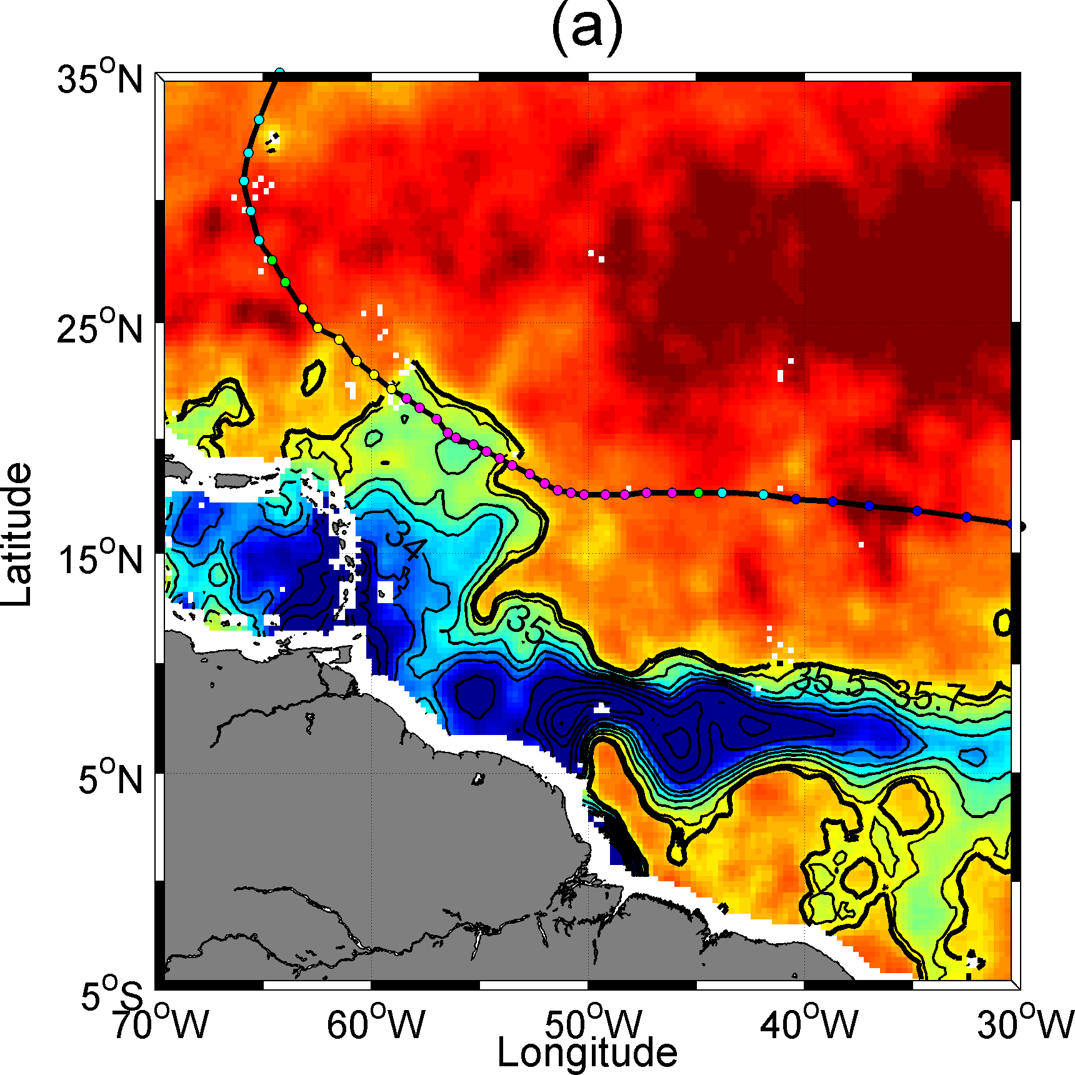
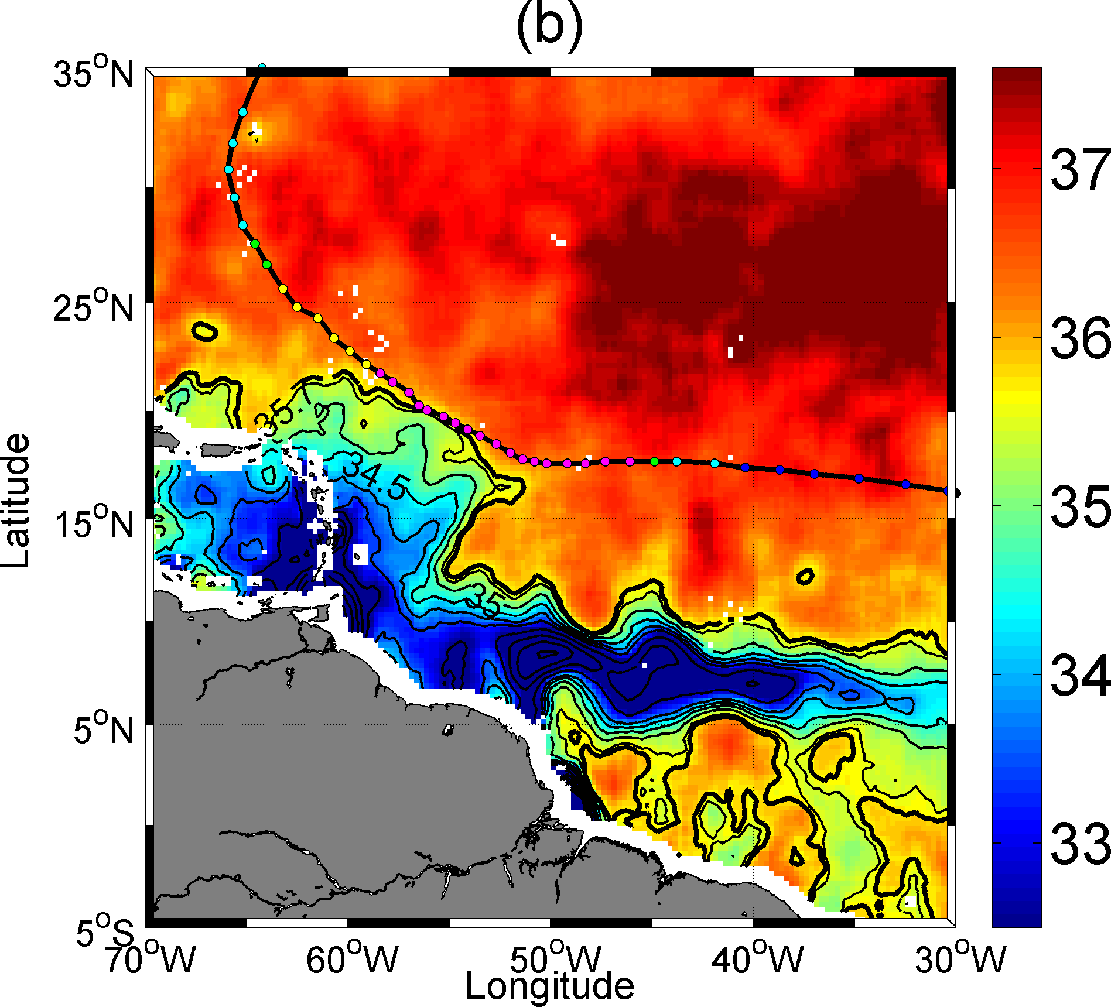
Surface area~ 89000 km²> Lake Superior, the world largest freshwater lake: a transfer of 1 GTo of Salt in 5 days
SMOS SSS 1 week Before IGOR
SMOS SSS 1 week After IGOR
Figure 2: Two SMOS microwave satellite-derived SSS composite images of the Amazon plume region revealing the SSS conditions
(a) before and (b) after the passing of Hurricane Igor, a category 5 hurricane that attained wind speeds of 136 knots in September 2010.
Color-coded circles mark the successive hurricane eye positions and maximum 1-min sustained wind speed values in knots.
Seven days of data centered on (a) 10 Sep 2010 and (b) 22 Sep 2010 have been averaged to construct the SSS images, which are smoothed
by a 1° x 1° block average.

Slide 11
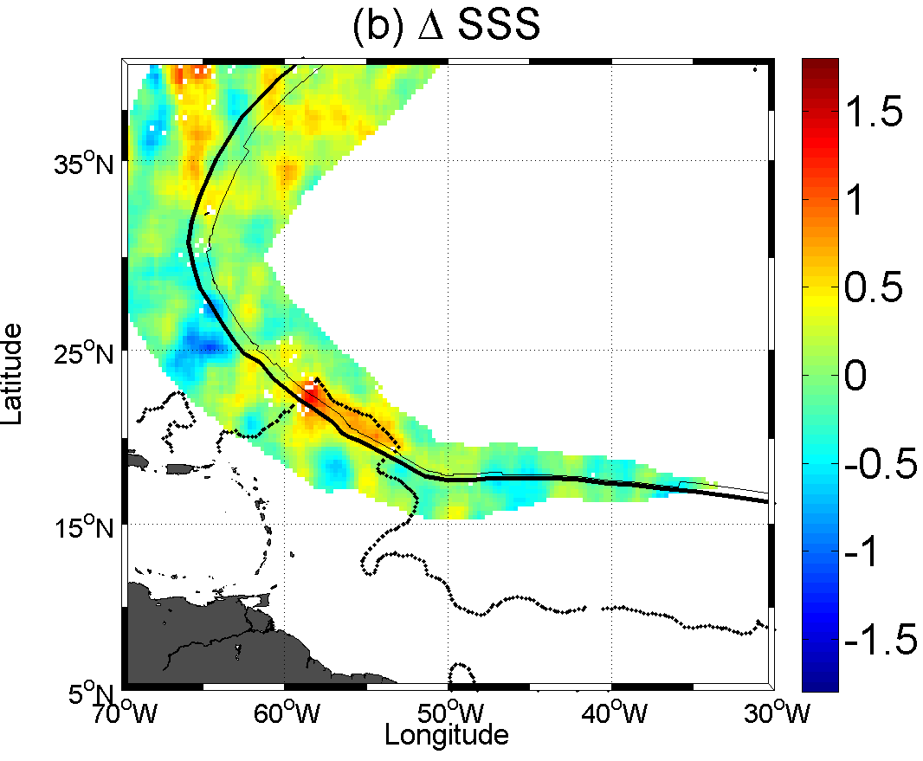
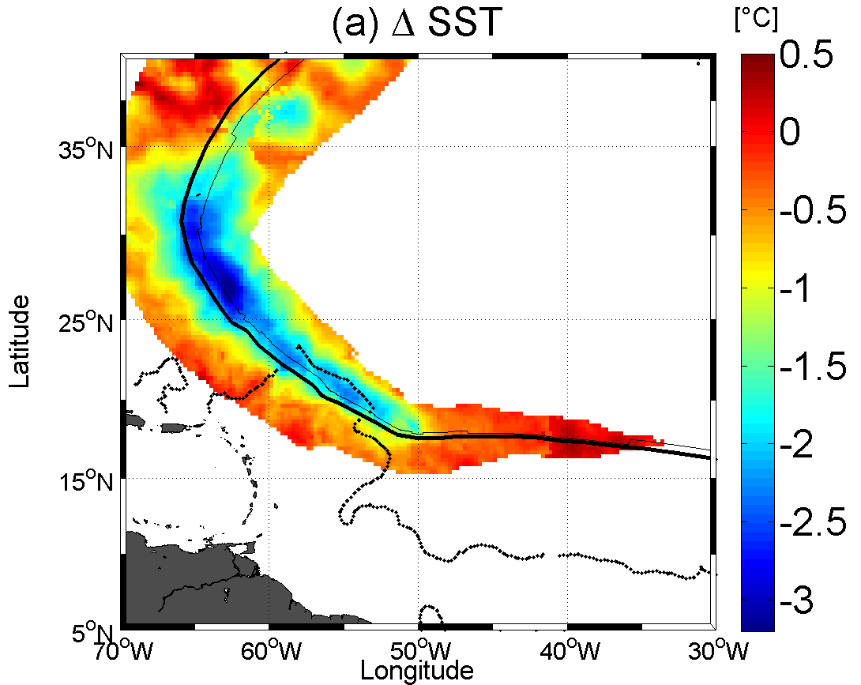
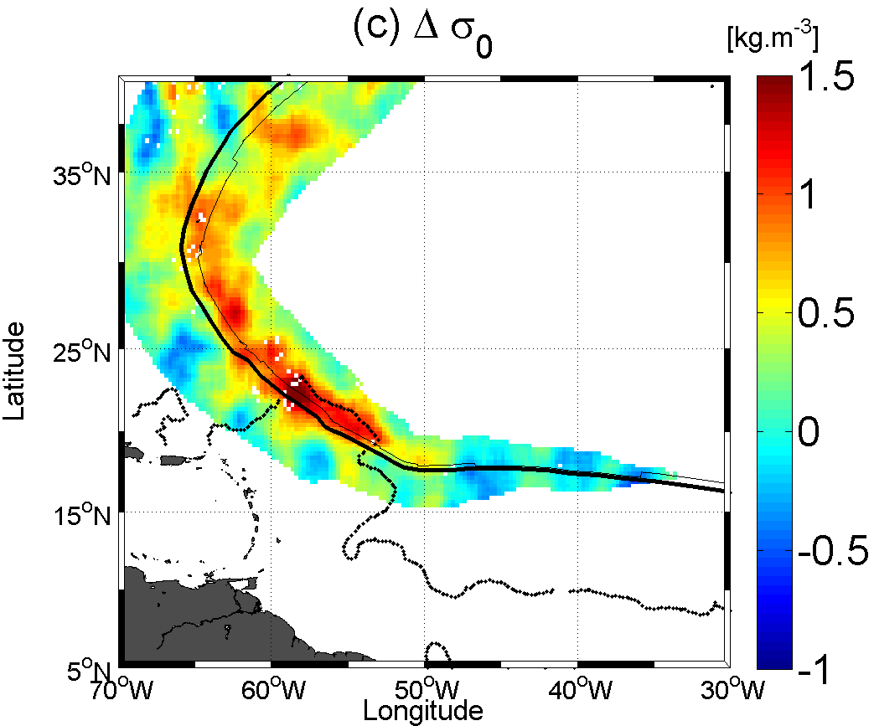
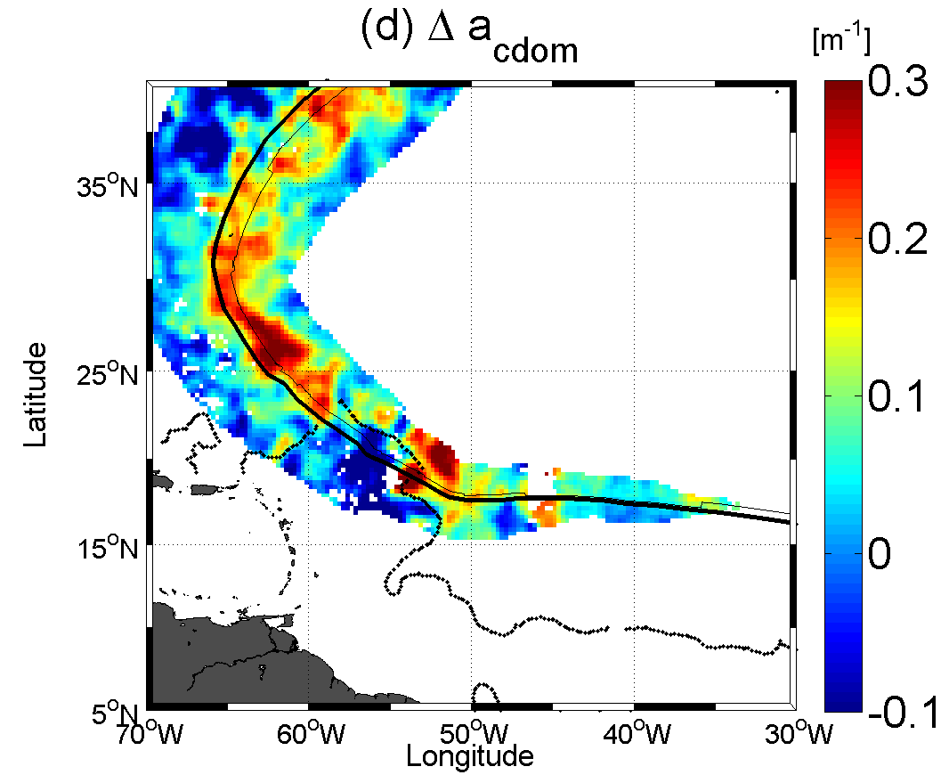
Surface wakes of Igor: SST, SSS,Density, Color

Slide 12
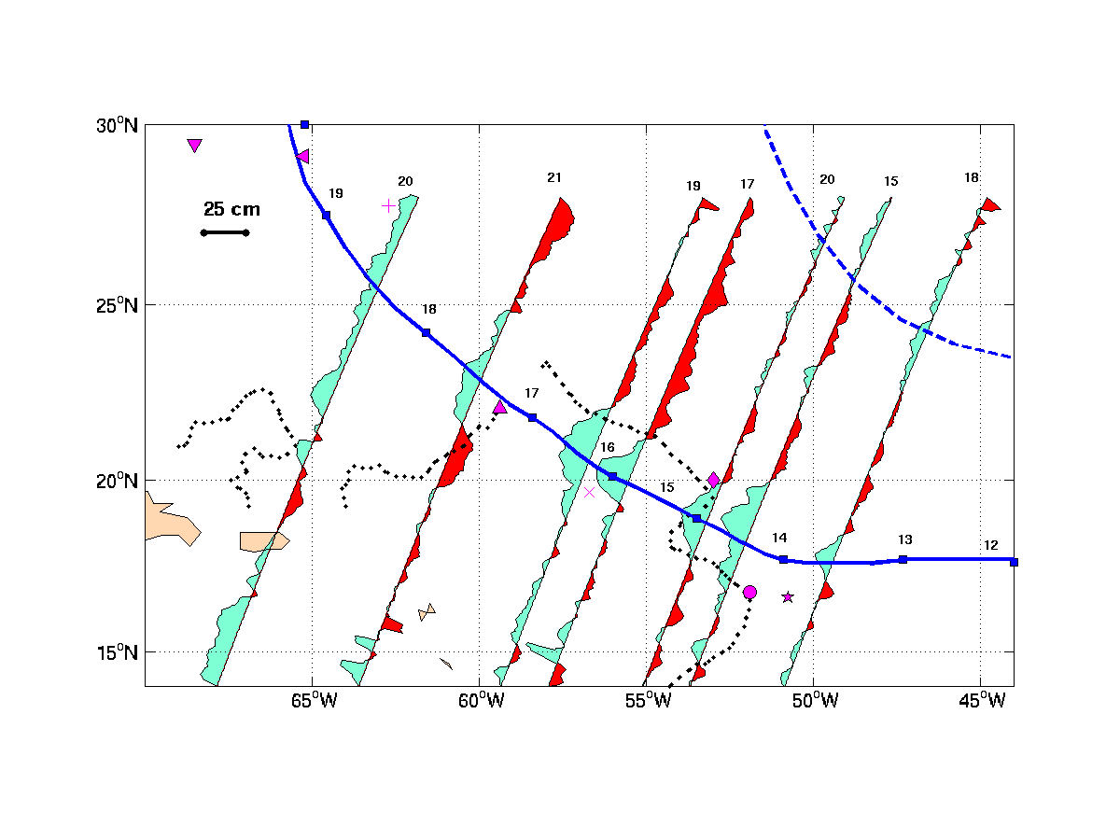
Sea level Change from Altimetry (Jason 1 & 2)
~25 cm , maximimum trough along track, where Wpi was max

Slide 13
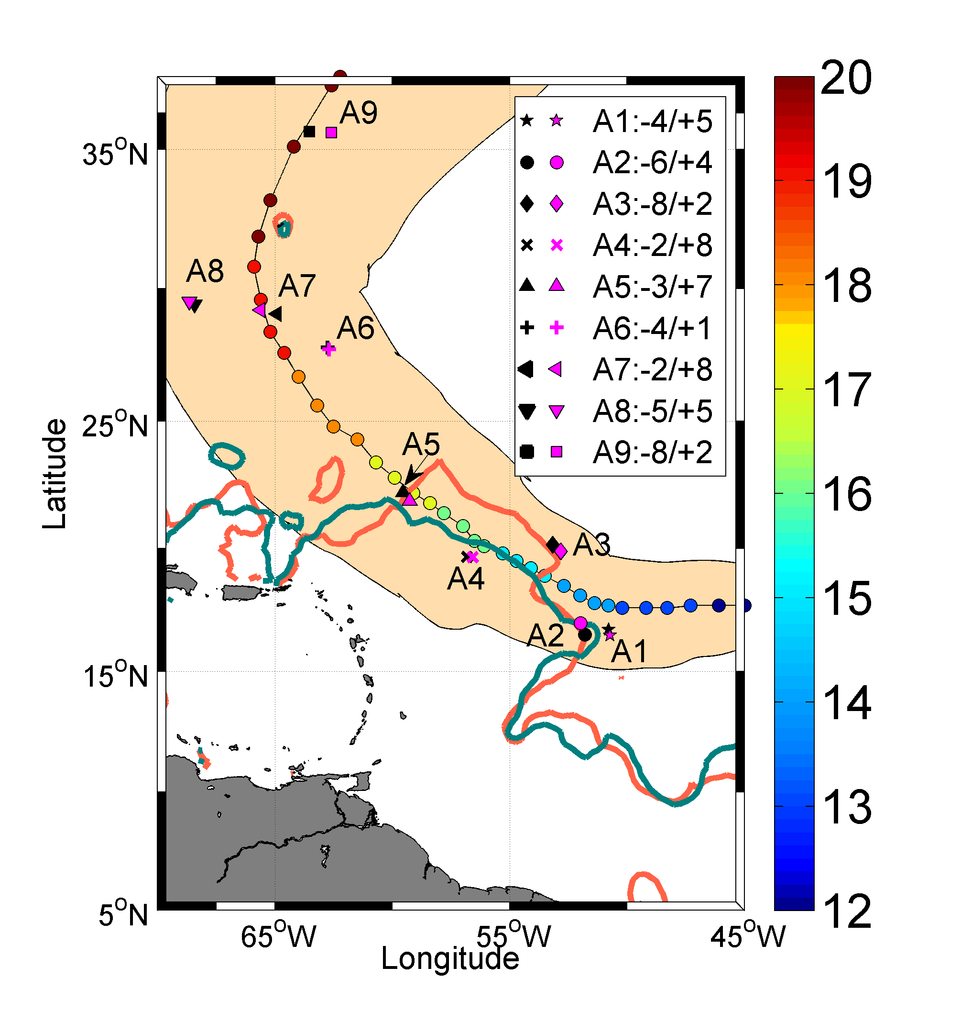
Validation with in situ
In situ sampling of igor high wind wake by ARGO floats

Slide 14
Skin Satellite estimates of the ocean surface response to IGOR
versus ~5 m depth Argo measurements
Salinity
Temperature
Density
Rmse= 0.37 (SSS) , 0.4°C (SST) and 0.34 kg.m⁻³ (density)

Slide 15
Barrier Layer below the plume:
~25 m thick left side of the track
~10 m thick right-side of the track

Slide 16
Very strong stratification
on the storm left hand-side
inhibited mixing
Reduced surface cooling
Reduced SSS increase
Despite strong wind energy
Input to the ocean

Slide 17
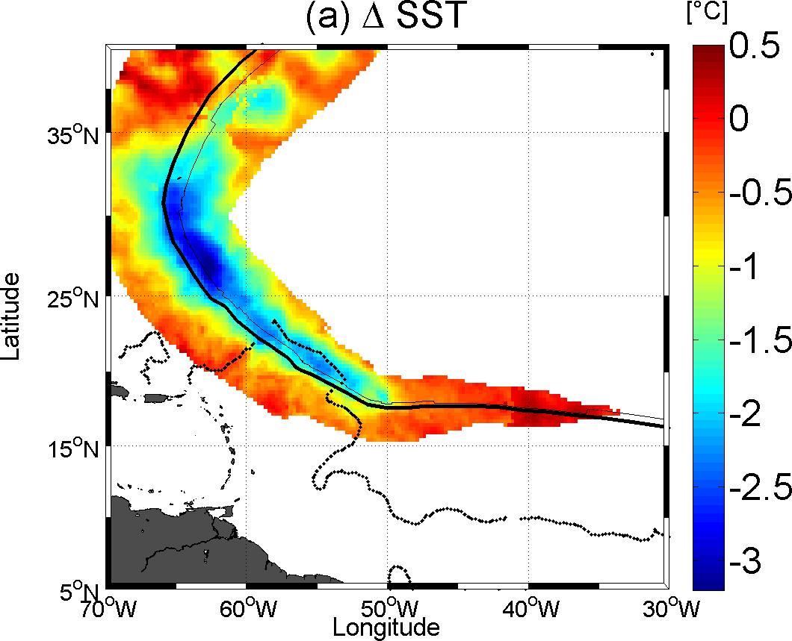
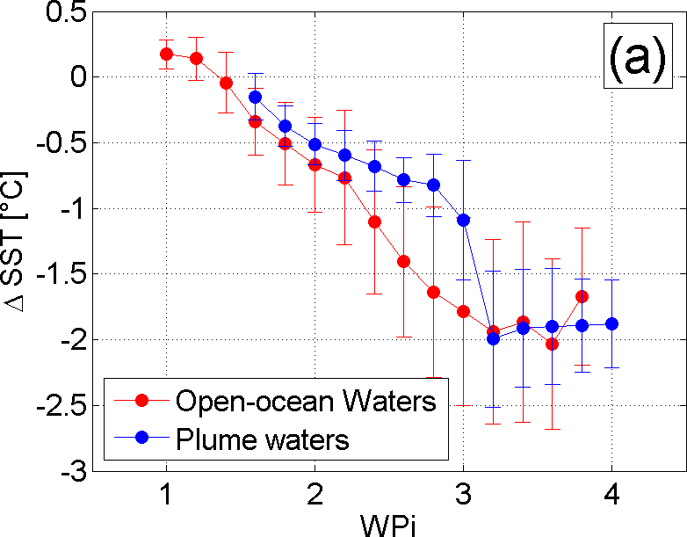
Evidence of a reduced cooling over stratified plume waters
For equivalent wind energy input to the ocean (Wpi):
=> Reduced cooling over the plume

Slide 18
Are the Igor case observations historically verified ?

Slide 19
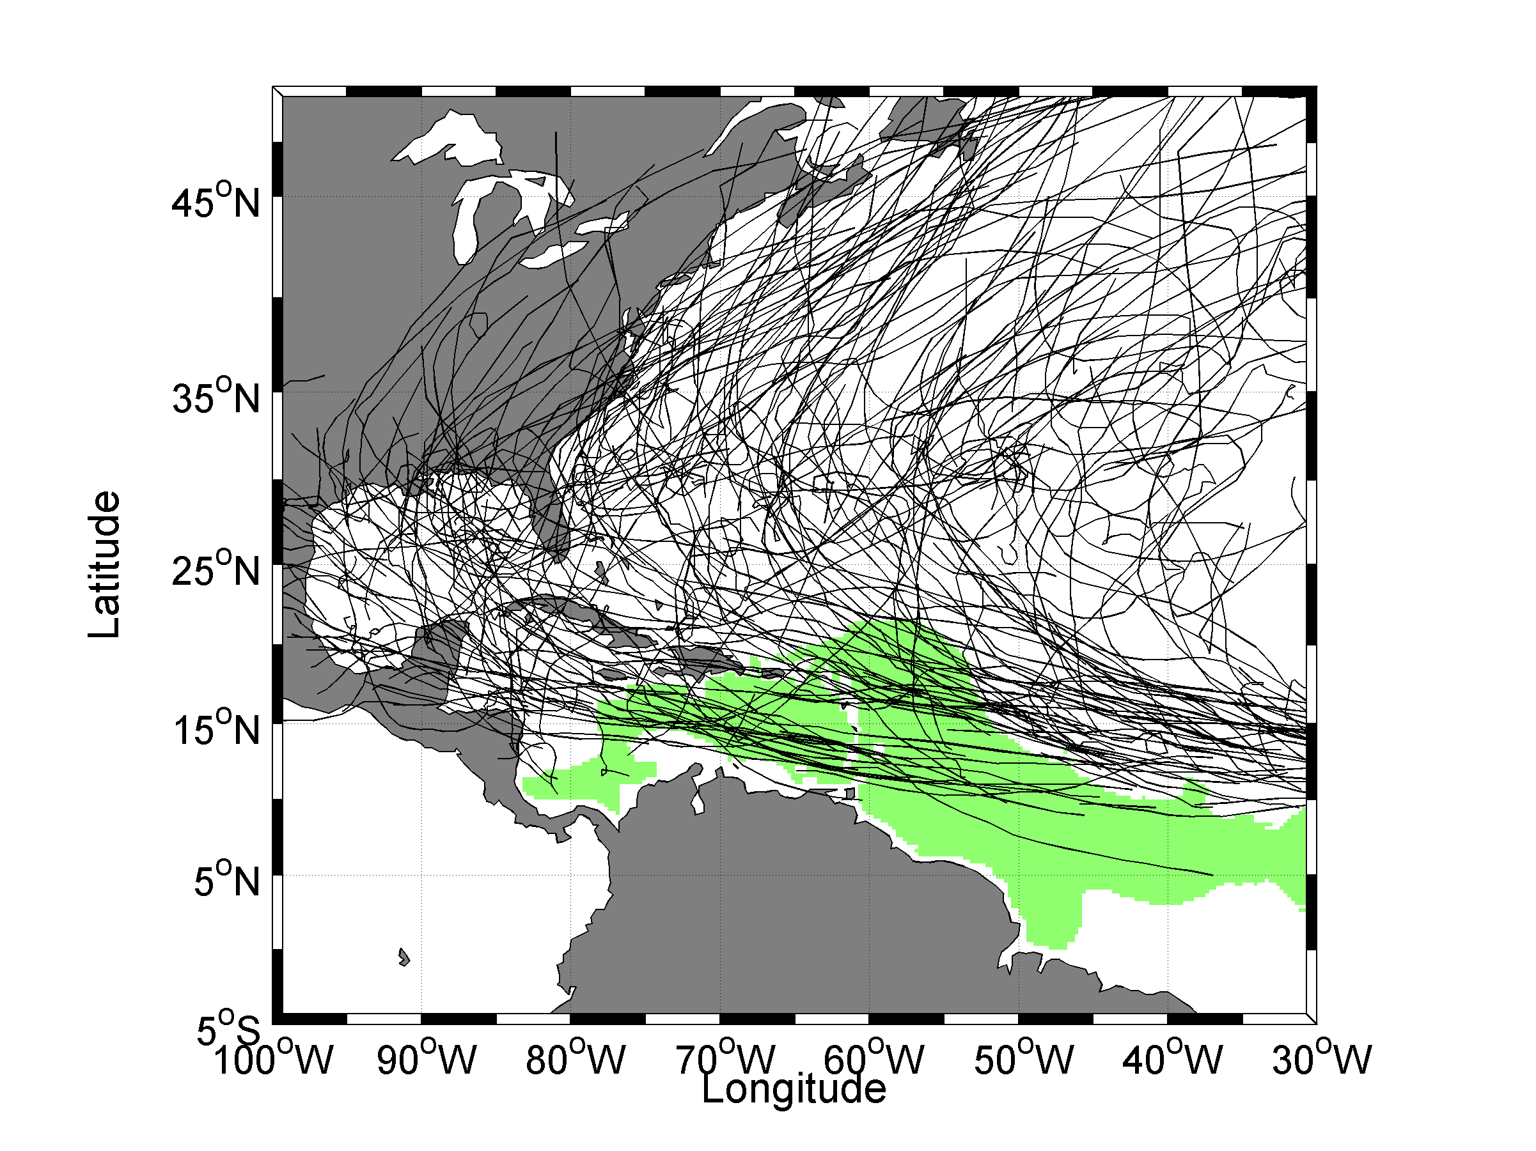
SST response to TCs interactions with the Plume
Ensemble of TC tracks 1998->2010 (Ibtracks)+ TMI-AMSRE SST (REMSS)
Climatological extent of the Amazon-Orinocco Plume during
Hurricane
Season

Slide 20
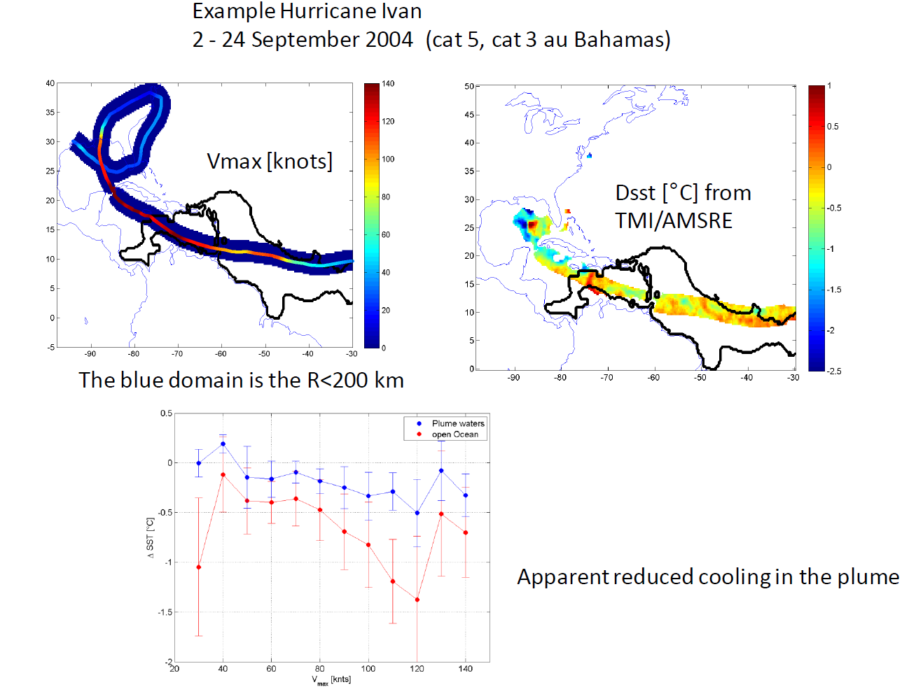
ΔSST
Maximum Wind [knts]

Slide 21
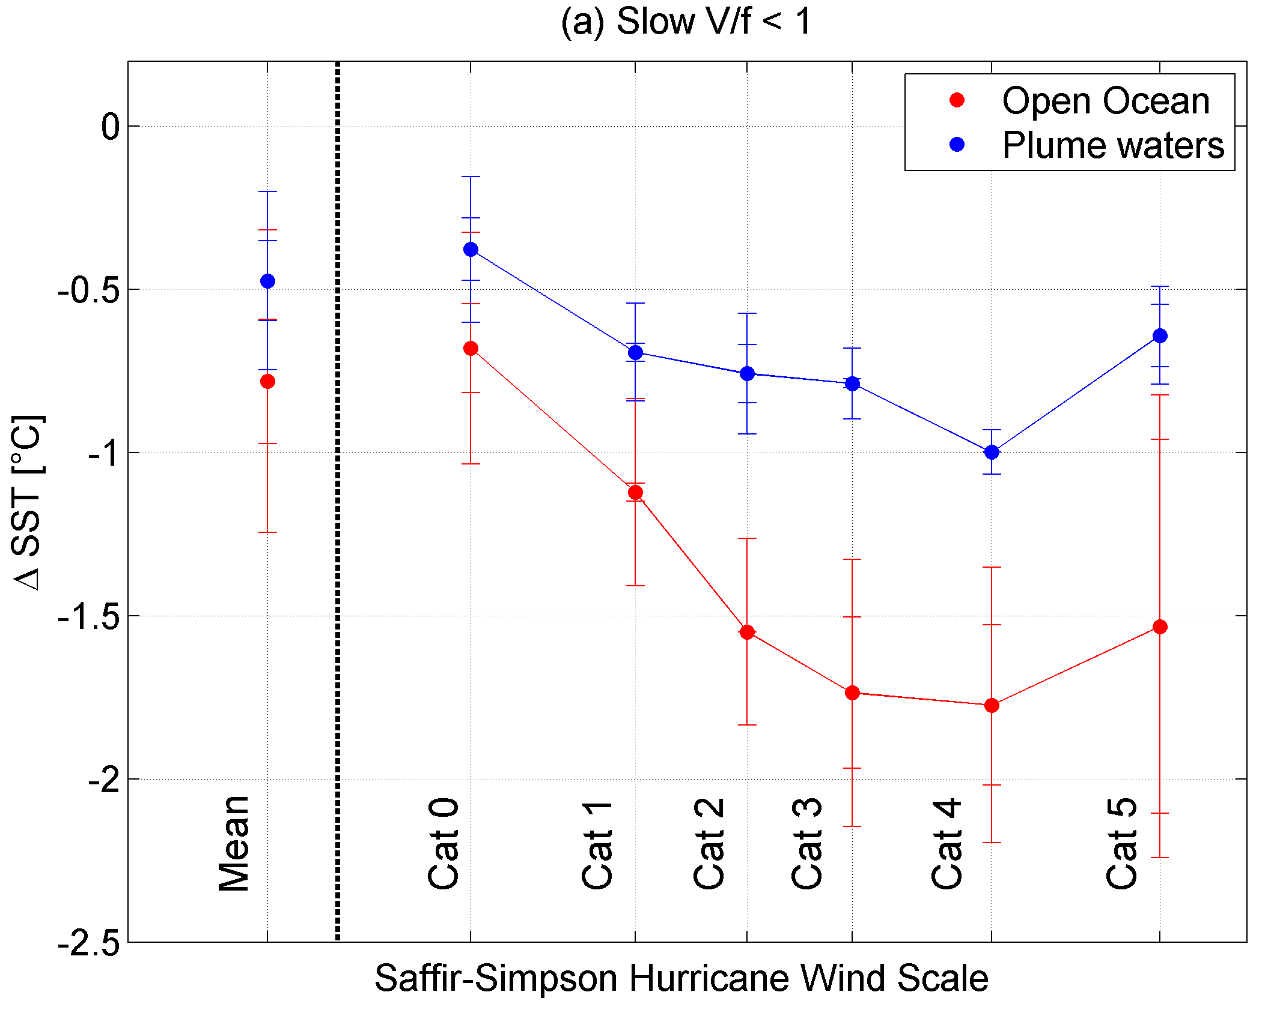
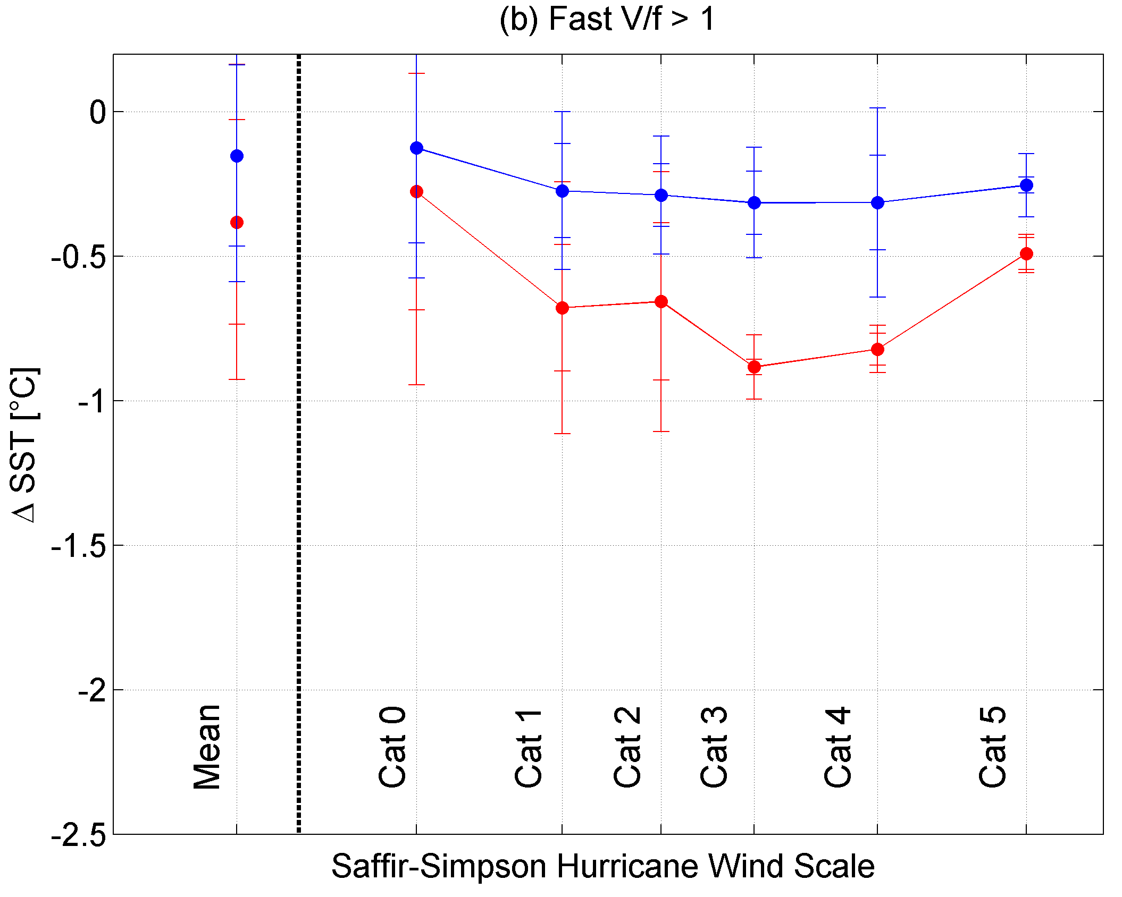
SST response to TCs interactions with the Plume
Overall averaged SST response all tracks 1998-2010

Slide 22
How can we use
Satellite SSS to improve
TC intensification forecasts ?

Slide 23
Ocean Heat Content: a proxy for TC intensification
Example Shay & Brewster, 2010
Sea level anomaly (altimetry)
OHC
Depth of the 26°C isotherm
(altimetry+climatological profiles)

Slide 24
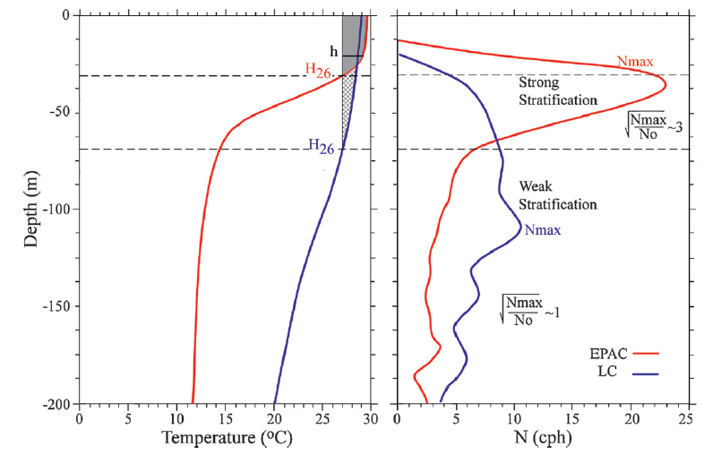
Equivalent ocean Heat Content: accounting for thermal & haline stratification
Strength of the thermocline
stratification
at the base of the
Ocean mixed layer
Shay & Brewster, MWR, 2010

Slide 26
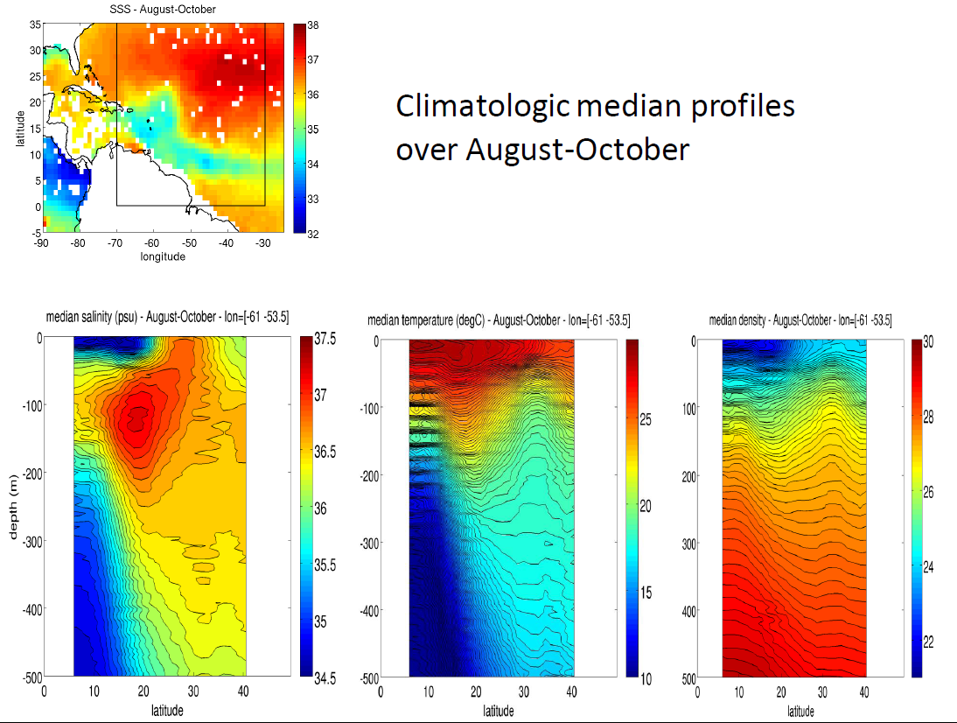
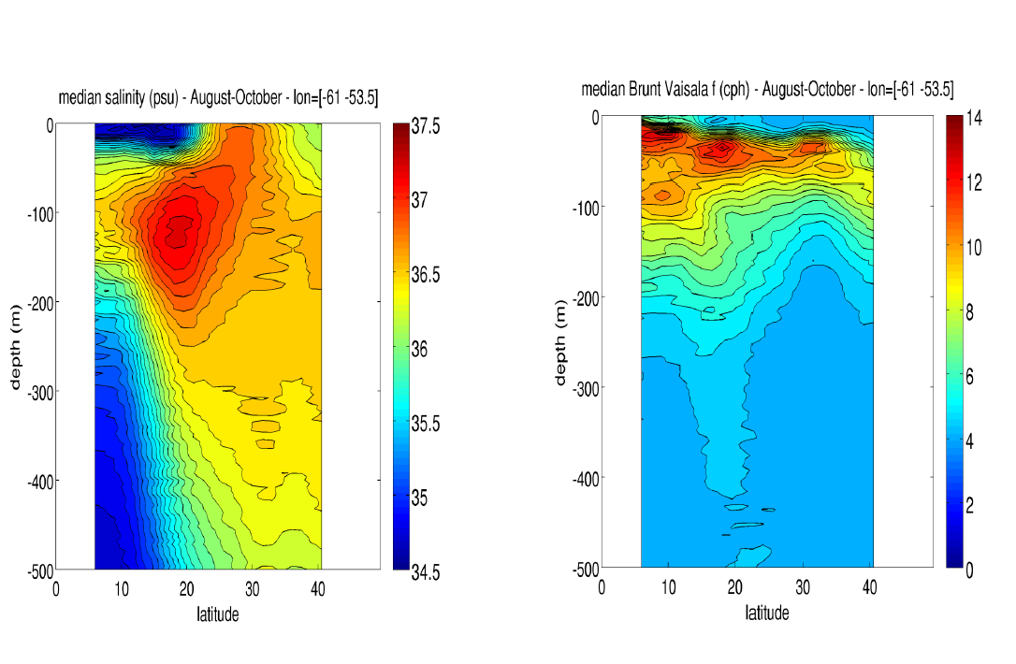

Slide 27
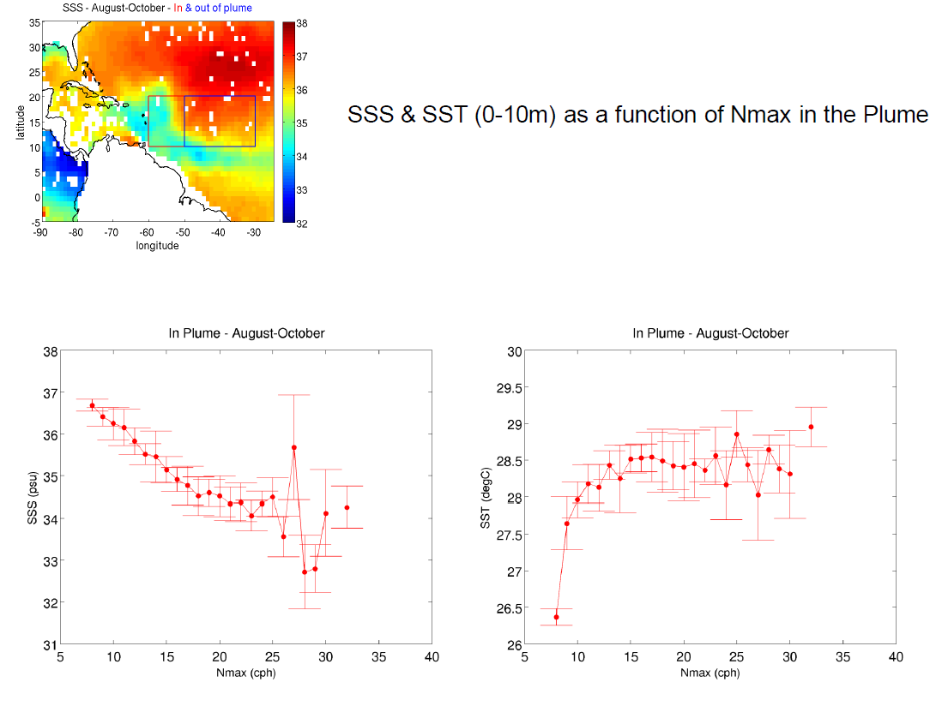
Strong (weak) correlation between SSS (SST) and Nmax below the plume

Slide 28
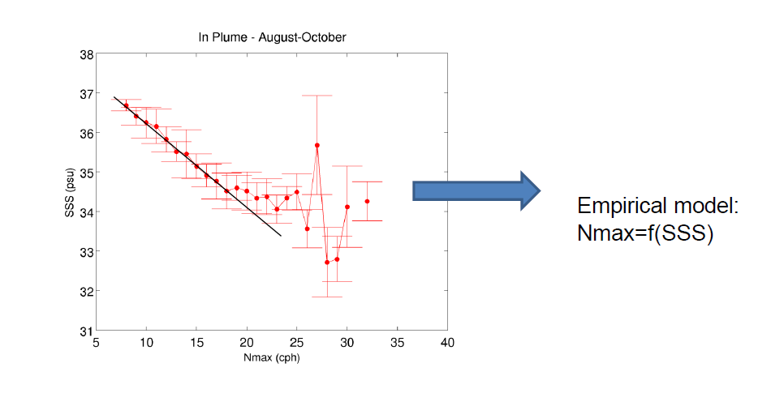
Determining the strength of the stratification (Nmax) at the base of the mixed layer from SSS

Slide 29
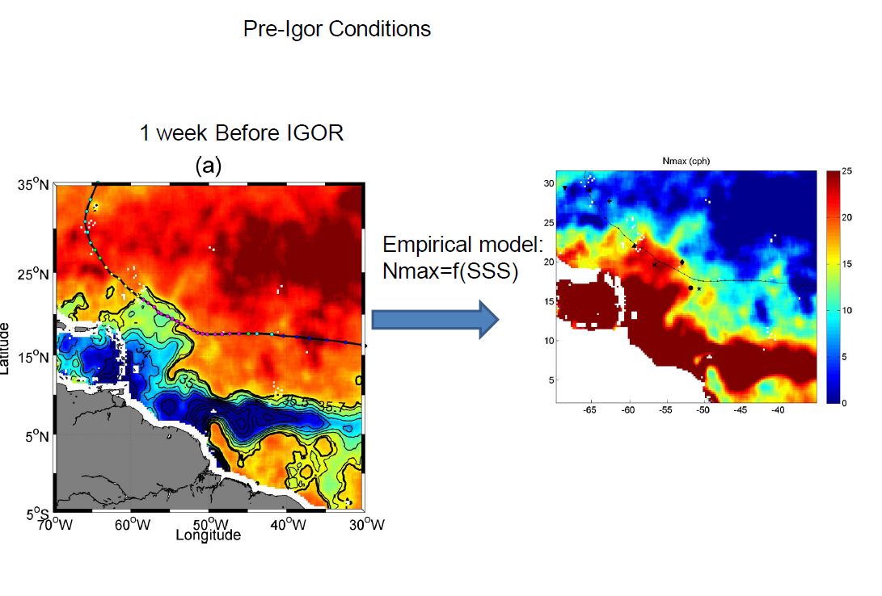
Nmax deduced from SMOS over Igor

Slide 30
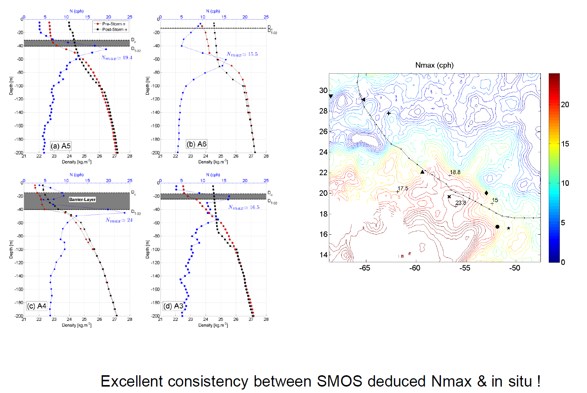
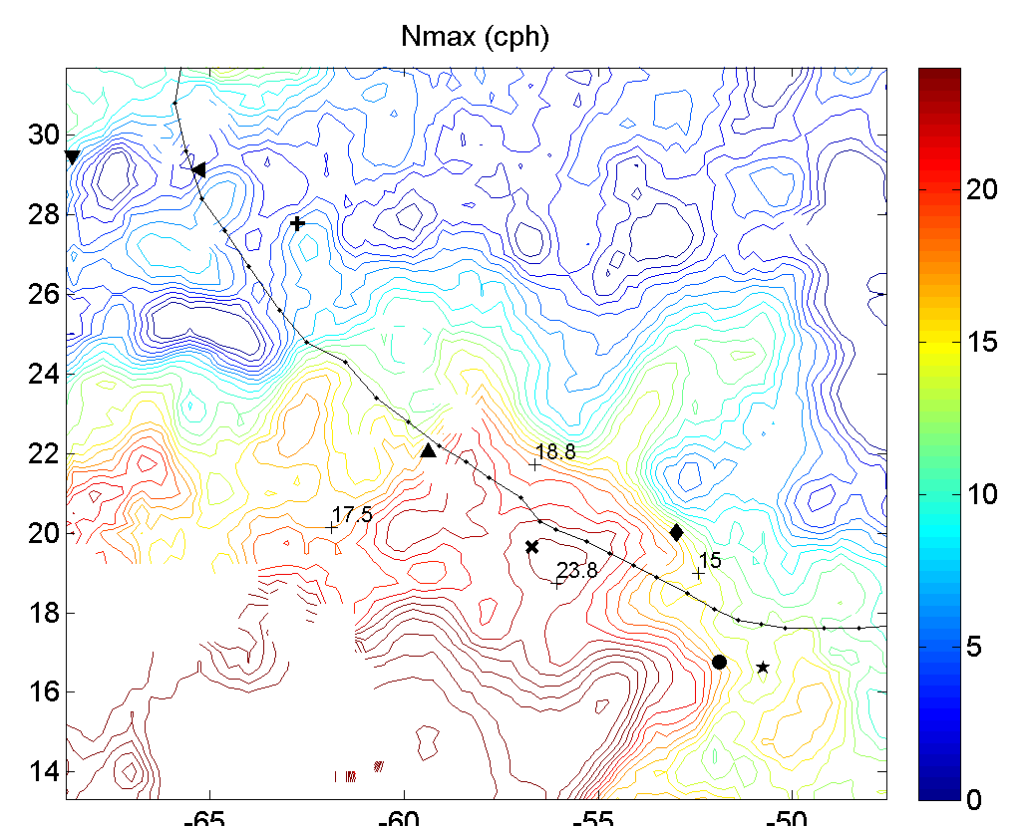
Nmax deduced from SMOS over Igor

Slide 31
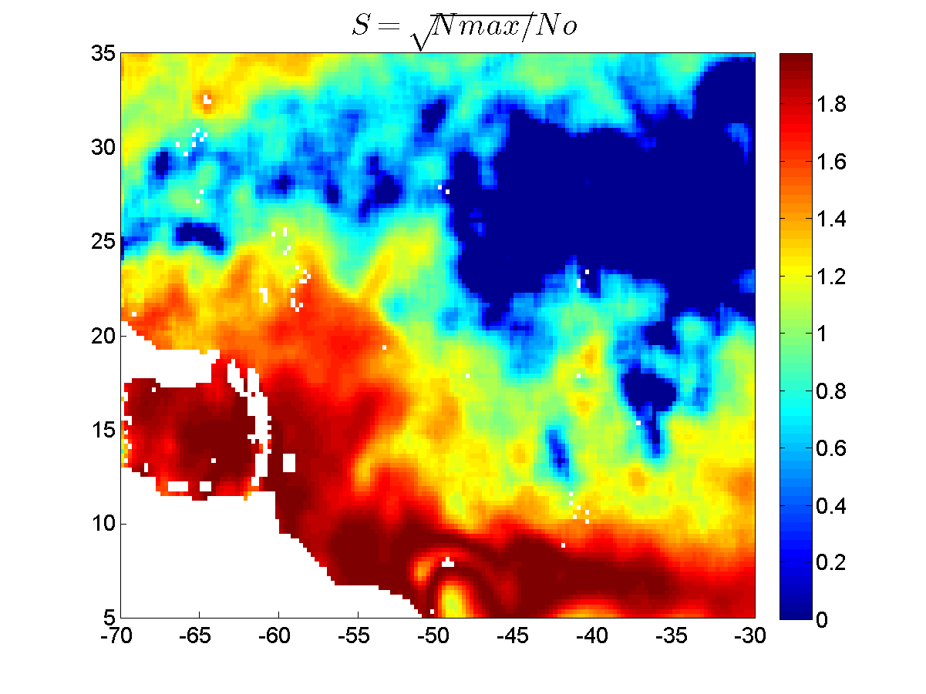
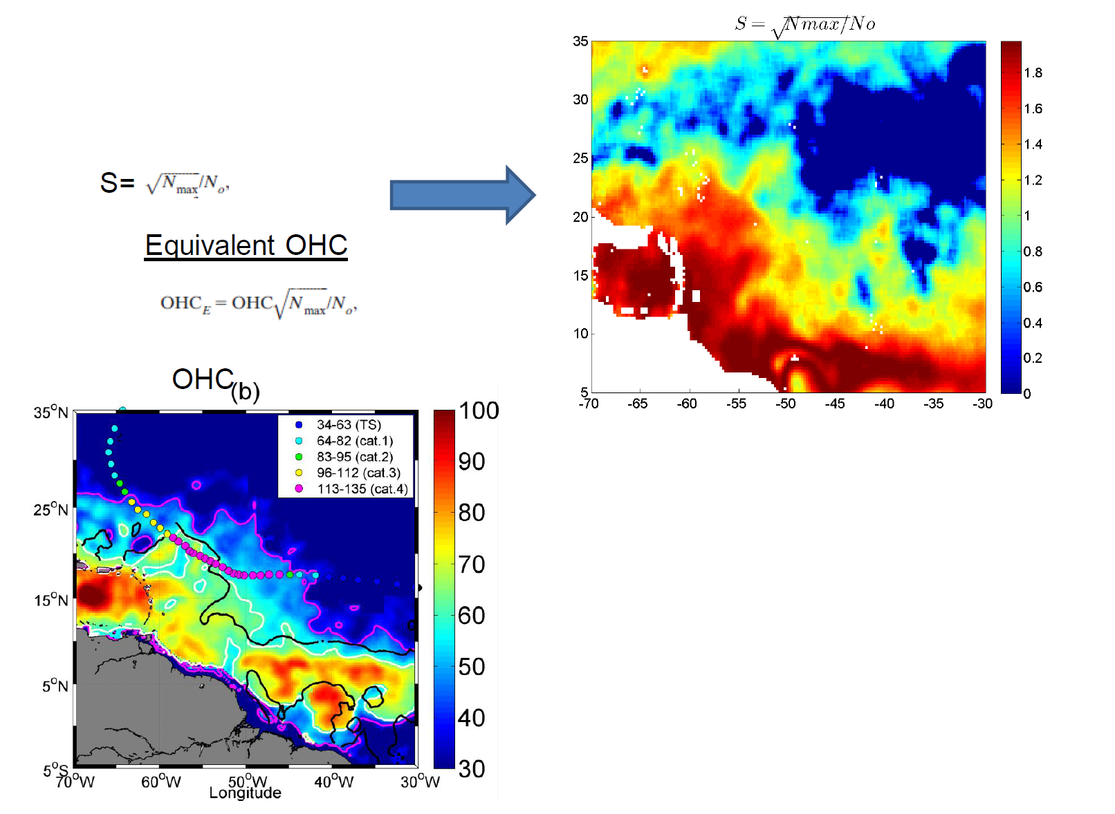
Plume:
=>60% to 80% increase in Heat
Potential available for tropical cyclone
intensification

Slide 32
Summary
New Sea Surface Salinity products from Space can be used to improve
our understanding of processes involved in oceanic response to TC
First Evidence of SSS changes in the wake of a TC from Spaceborne data
In combination with SST=> density change
In combination with altimetry (respective signatures of barotropic & barocilinc effects)
Salt-driven stratification in Amazon plume reduces cooling by the wind induced mixing=> potential mechanism for TC intensification
SMOS & Aquarius SSS products can be used to characterize the strength of the stratification within the plume & help improve ocean heat potential estimates in Barrier Layer areas (NWTA, Pacific East & West freshpools, bay of bengal)
=> improve TC intensification forecasts

