Slide 1






Severe Marine Weather Studies using
SMOS L-band Sensor
Hurricane Igor
Tropical Storm Julia
Nicolas Reul¹, J. Tenerelli², B.Chapron¹, Y. Quilfen¹, D. Vandemark and Y. Kerr³

Slide 2
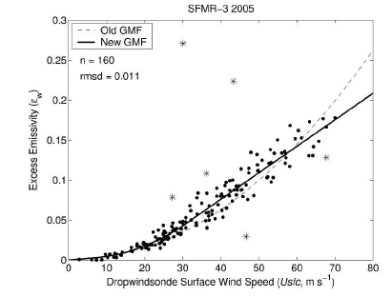


Wind speed retrieval in extreme winds : SFMR
Increase of the microwave ocean emissivity
with wind speed ⬄ surface foam change impacts
Hurricane hunter P-3
This information can be used to retrieve the surface wind speed in Hurricanes:
Principle of the Step Frequency Microwave Radiometer (SFMR) C-band:
NOAA’s primary airborn sensor for measuring Tropical Cyclone surface
wind speeds since 30 year (Ulhorn et al., 2003, 2007).

Slide 3
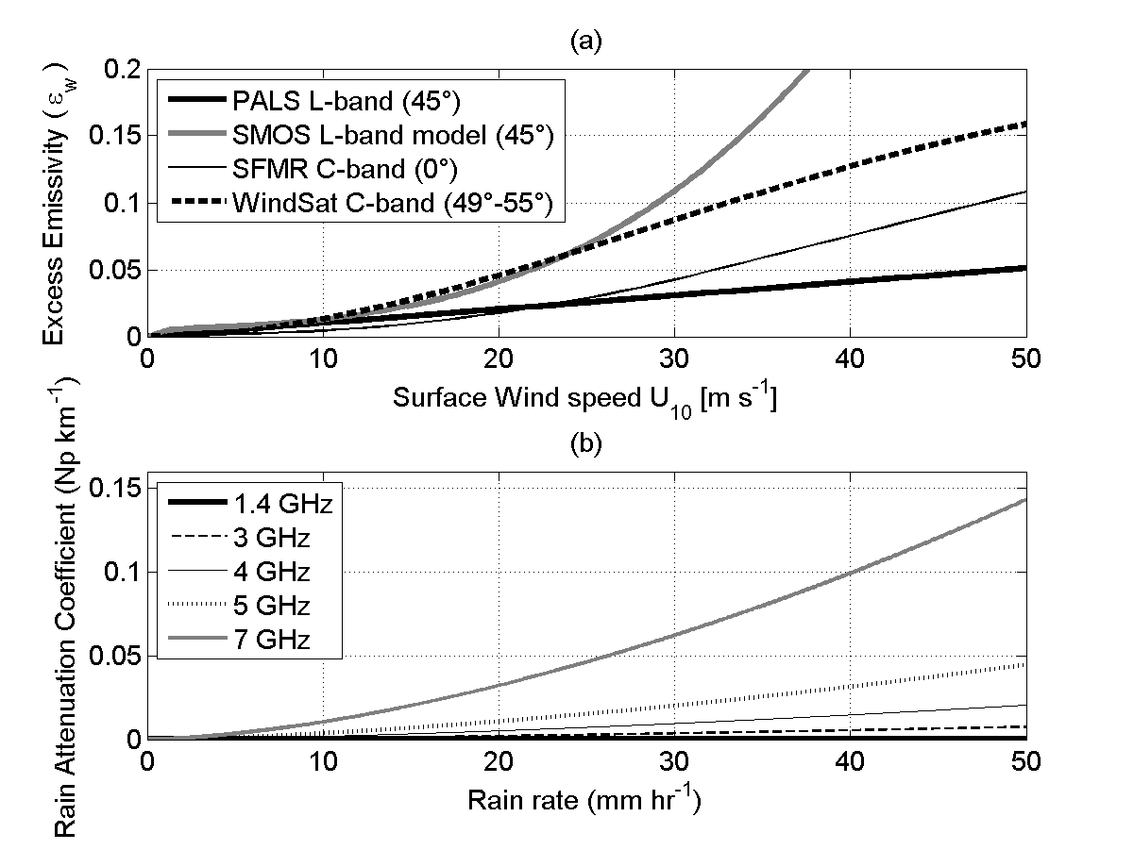
Wind Excess Emissivity at High winds
C-band:
~1K/m/s
L-band:
0.35K/m/s
C-band TB~3 times more sensitive to wind speed than L-band

Slide 4
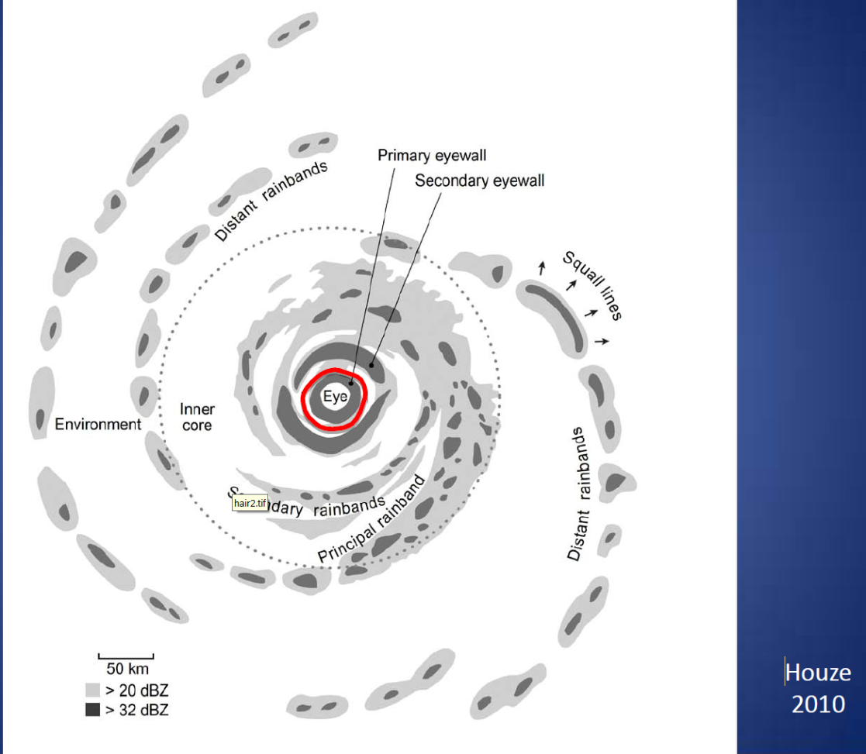
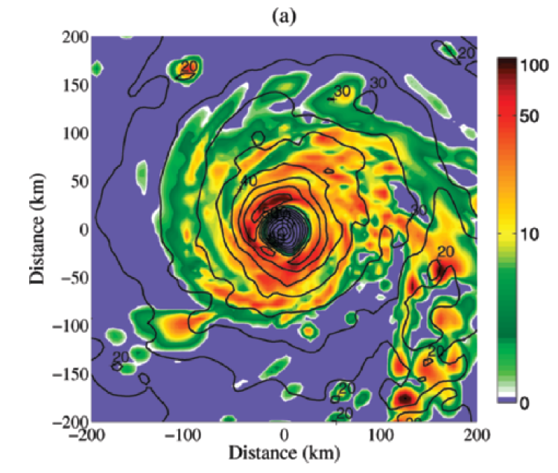
High winds in Hurricanes are very often associated with High rain rates
Rain Anatomy in a hurricane
Rain rate [mm/h]
S.Shen and J. Tenerelli 2007

Slide 5
Rain attenuation at L-band
Because of the small ratio of raindrop size to the SMOS electromagnetic wavelength (~21 cm), scattering by rain is almost negligible at L-band, even at the high rain rates experienced in hurricanes.
Rain impact at 1.4 GHz can be approximated entirely by absorption and emission (Rayleigh scattering approximation valid)
C-band:
@7GHz
L-band:
1.4 GHz
Rain impact Generally two order of magnitude smaller at L-band (1.4 GHz) than at C-band (5-7 GHz)

Slide 6
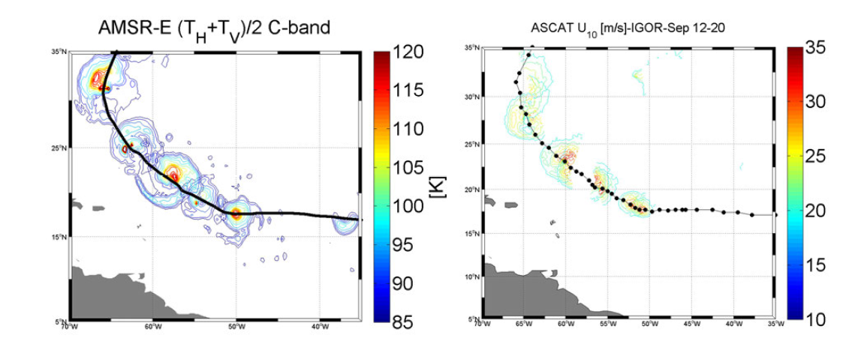
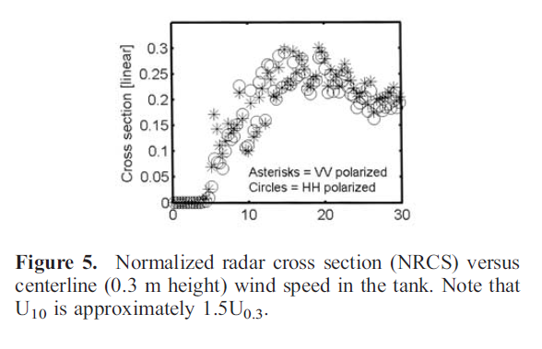
Limitations of current satellite MW observing systems
Operating at frequencies ≥ C-band
Rain
Bands
Signatures
At
C-band
Passive/active data are strongly
affected by rain for f ≥ C-band
Radar data saturates at high winds
=>very difficult to retrieve surface winds
(for passive multiple frequency is required (SFMR))
As L-band is much less affected=>opportunity!

Slide 7
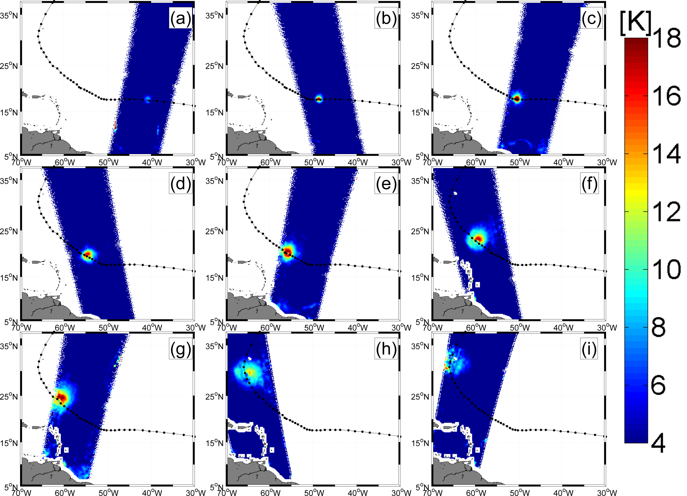
Cat 4 Hurricane Igor 2010

Slide 8
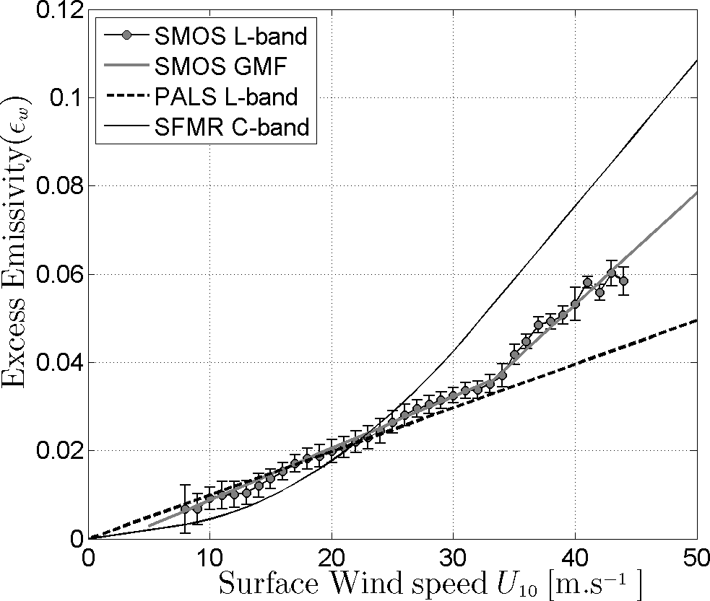
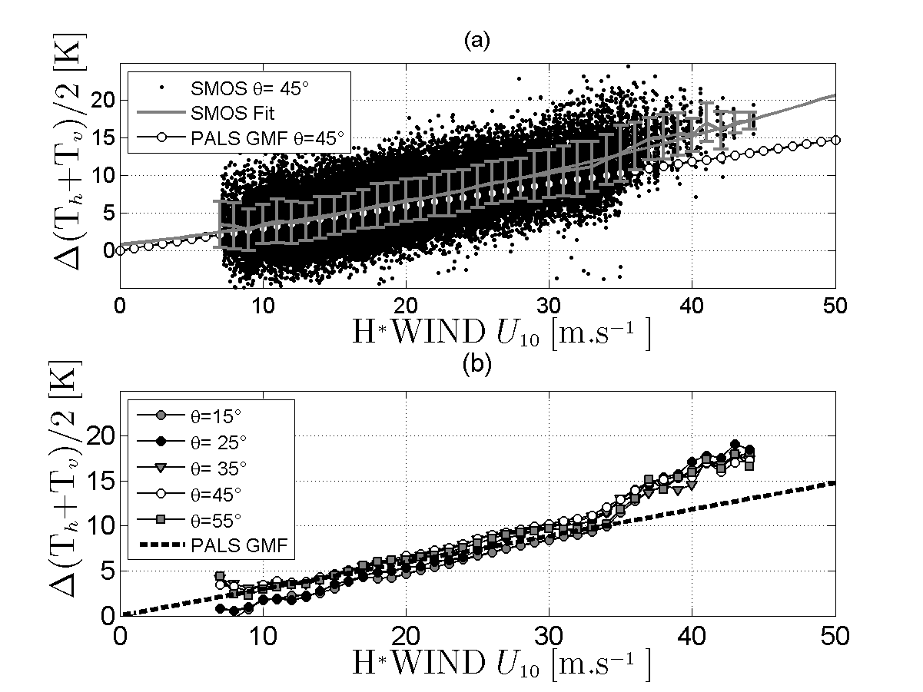
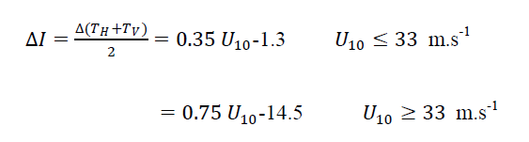
Geophysical Model function: Tb=f(wind speed)
C-band
L-band:
0.7K/m/s
for hurricanes
0.3 k/(m/s)
below
Development of a SMOS wind speed GMF based on Hwind products in IGOR hurricane
Bilinear L-band dependencies with surface wind speed
Reul et al., JGR, 2012

Slide 9
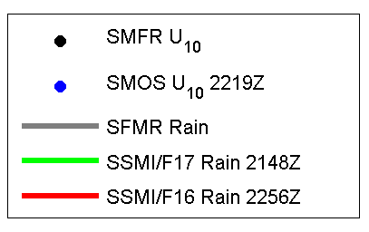
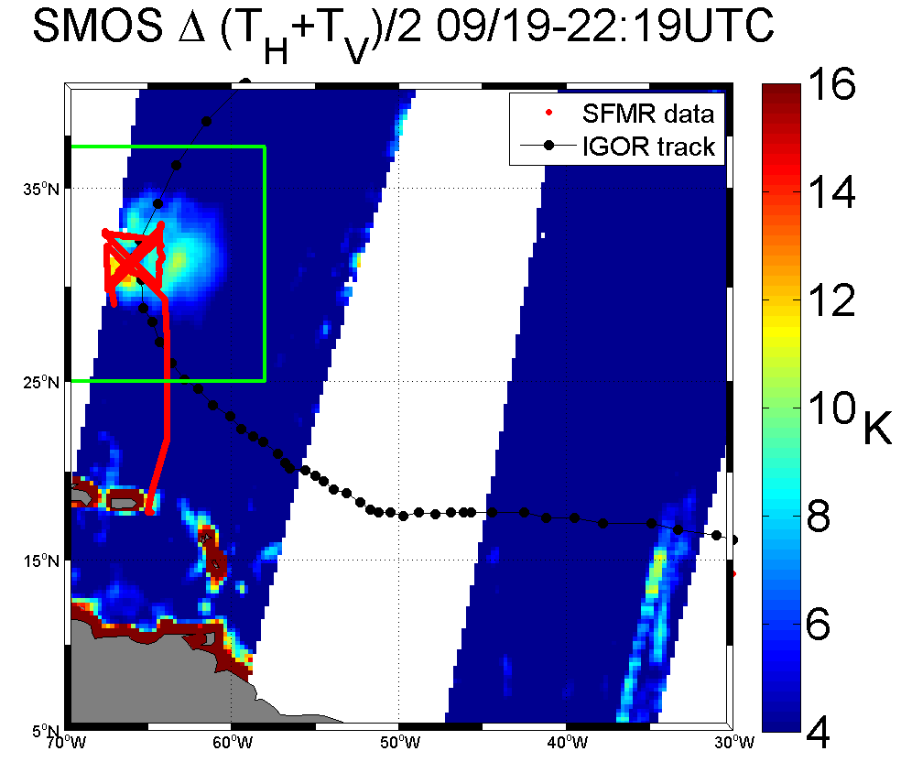
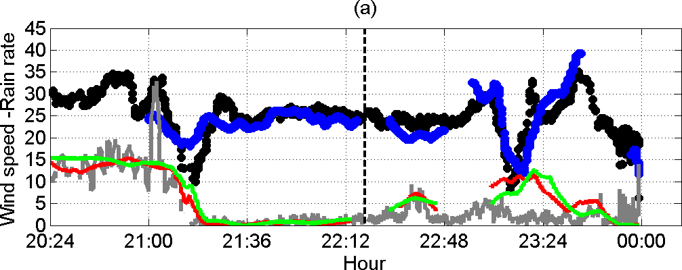
Comparison at SFMR transects
NOAA hurricane
Hunter flight

Slide 10

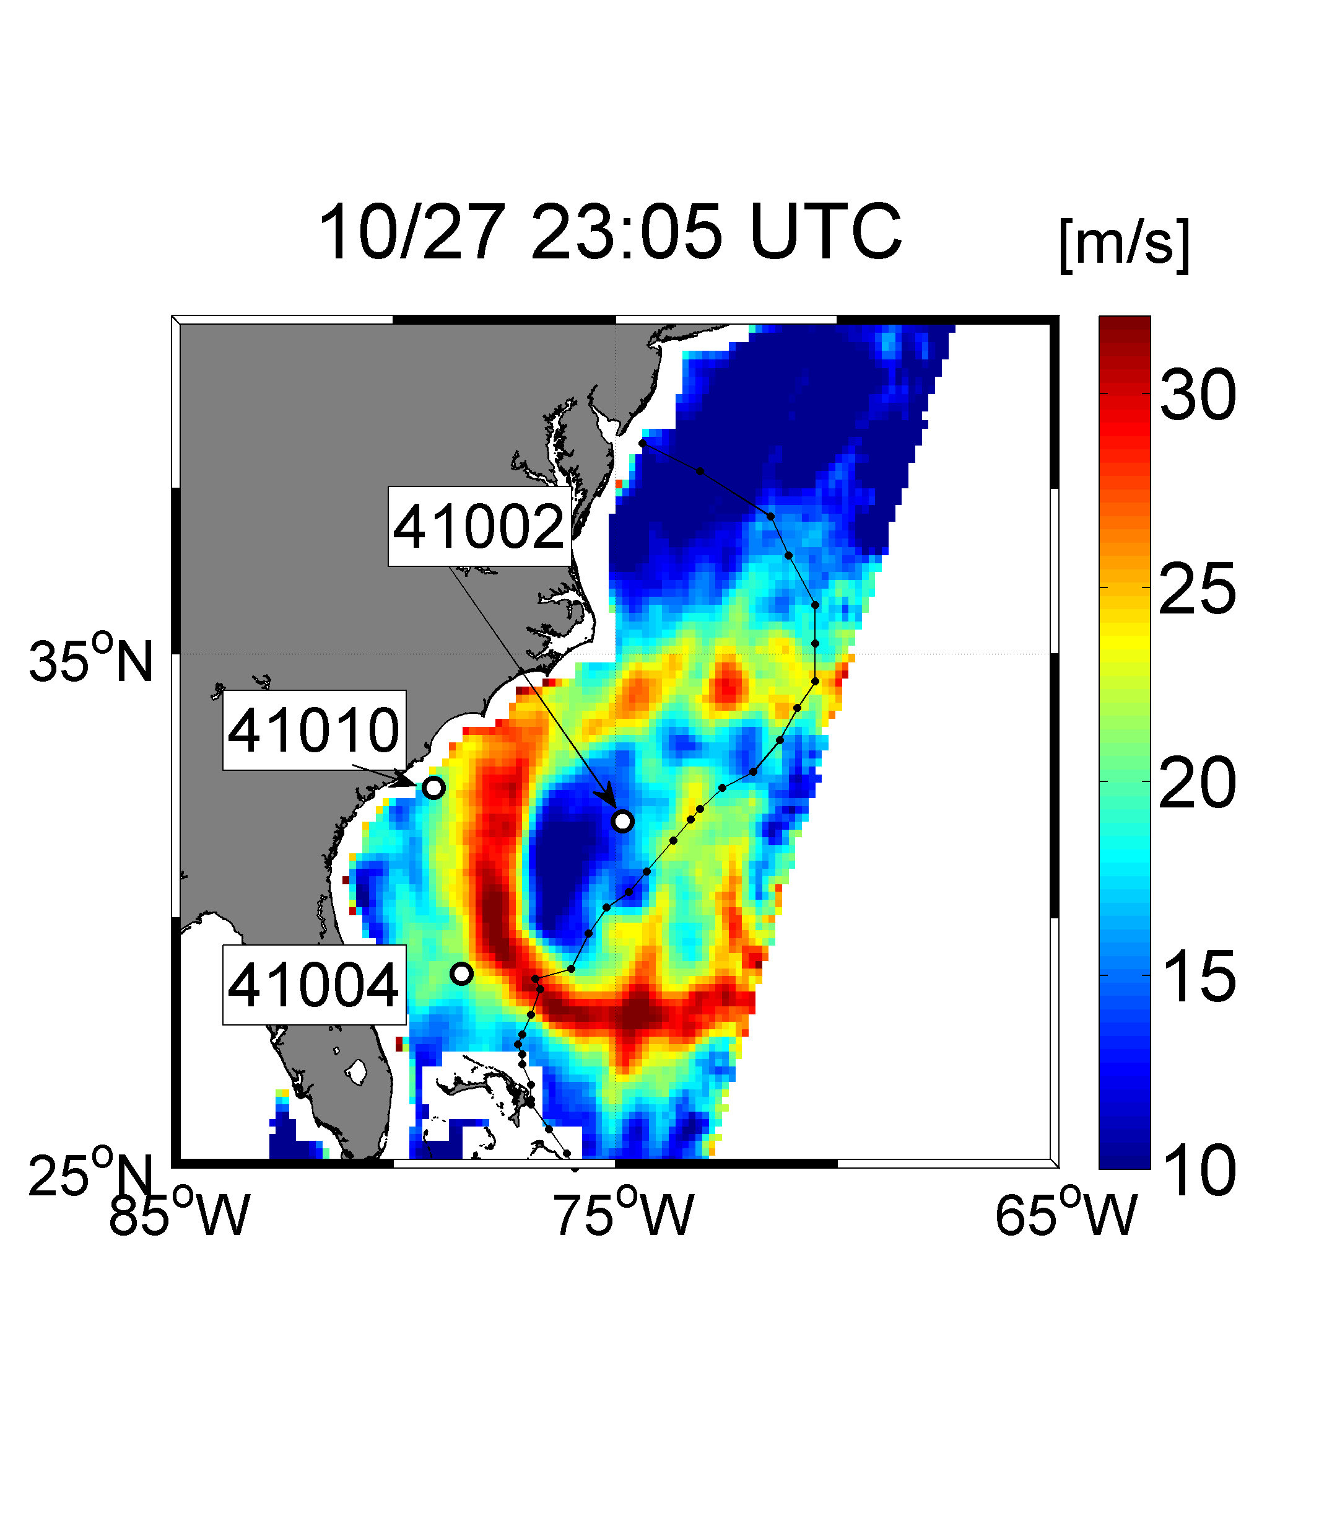
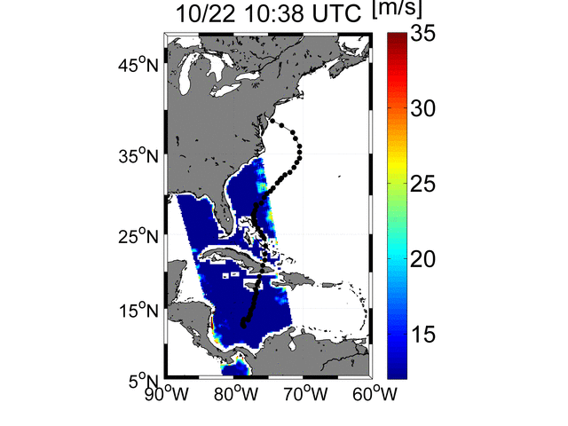
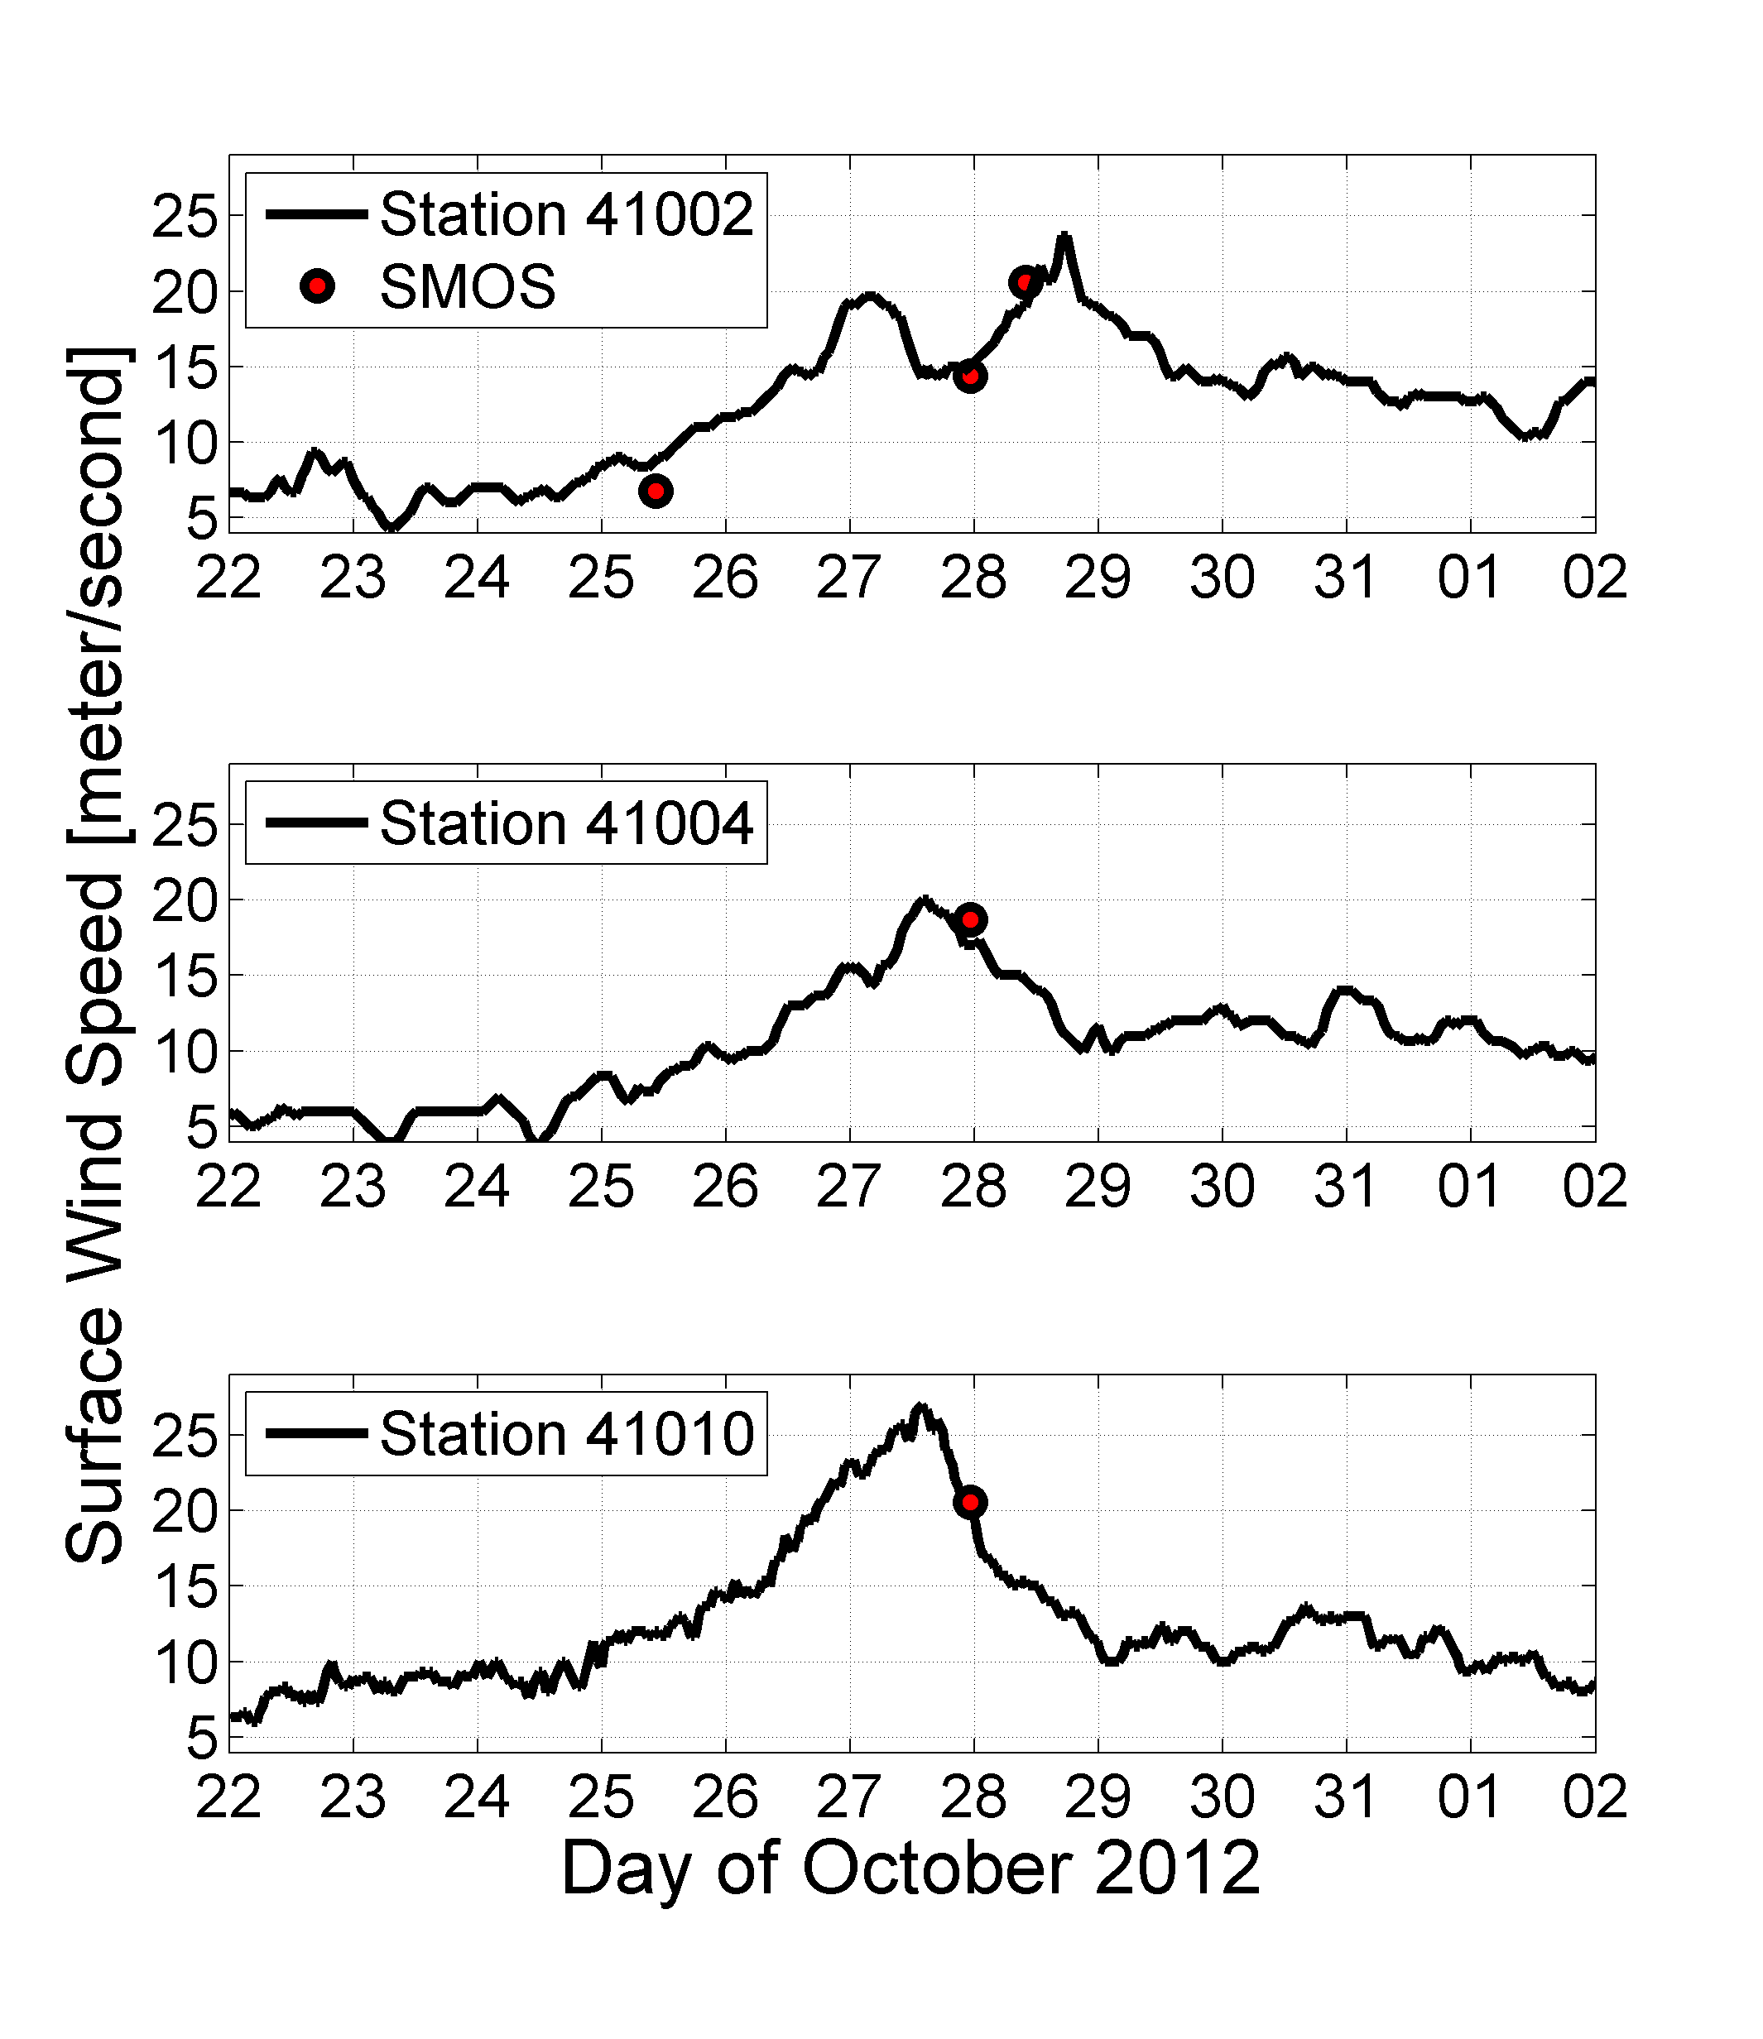
SuperStorm Sandy
Viewed by SMOS
Validation with buoy data
Hurricane Sandy Oct 2012

Slide 11
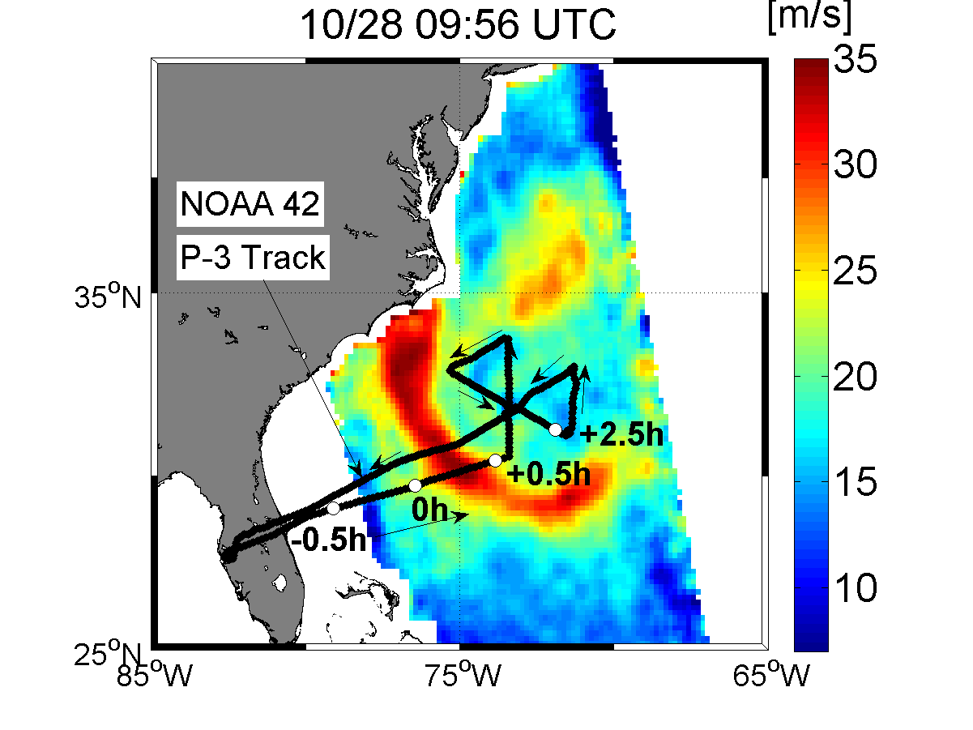
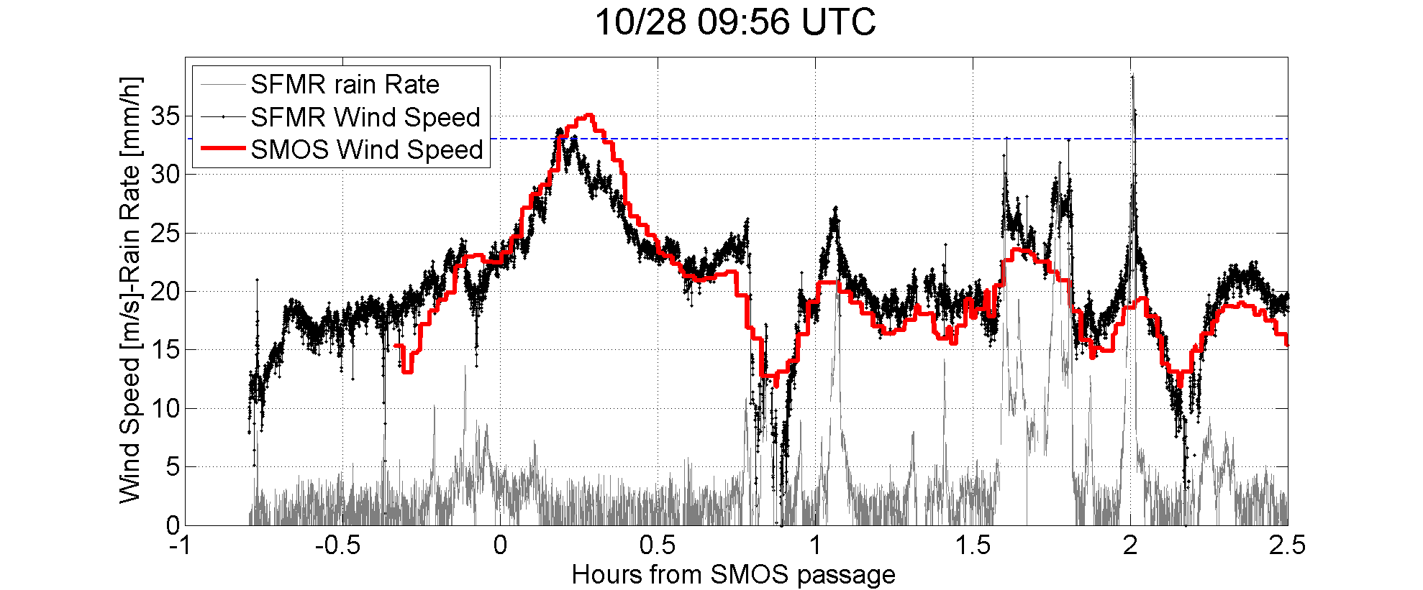
Hurricane Sandy
Validation with NOAA hurricane hunter Aircraft Data (C-band )SFMR
SMOS winds
Accuracy
~<3 m/s

Slide 12
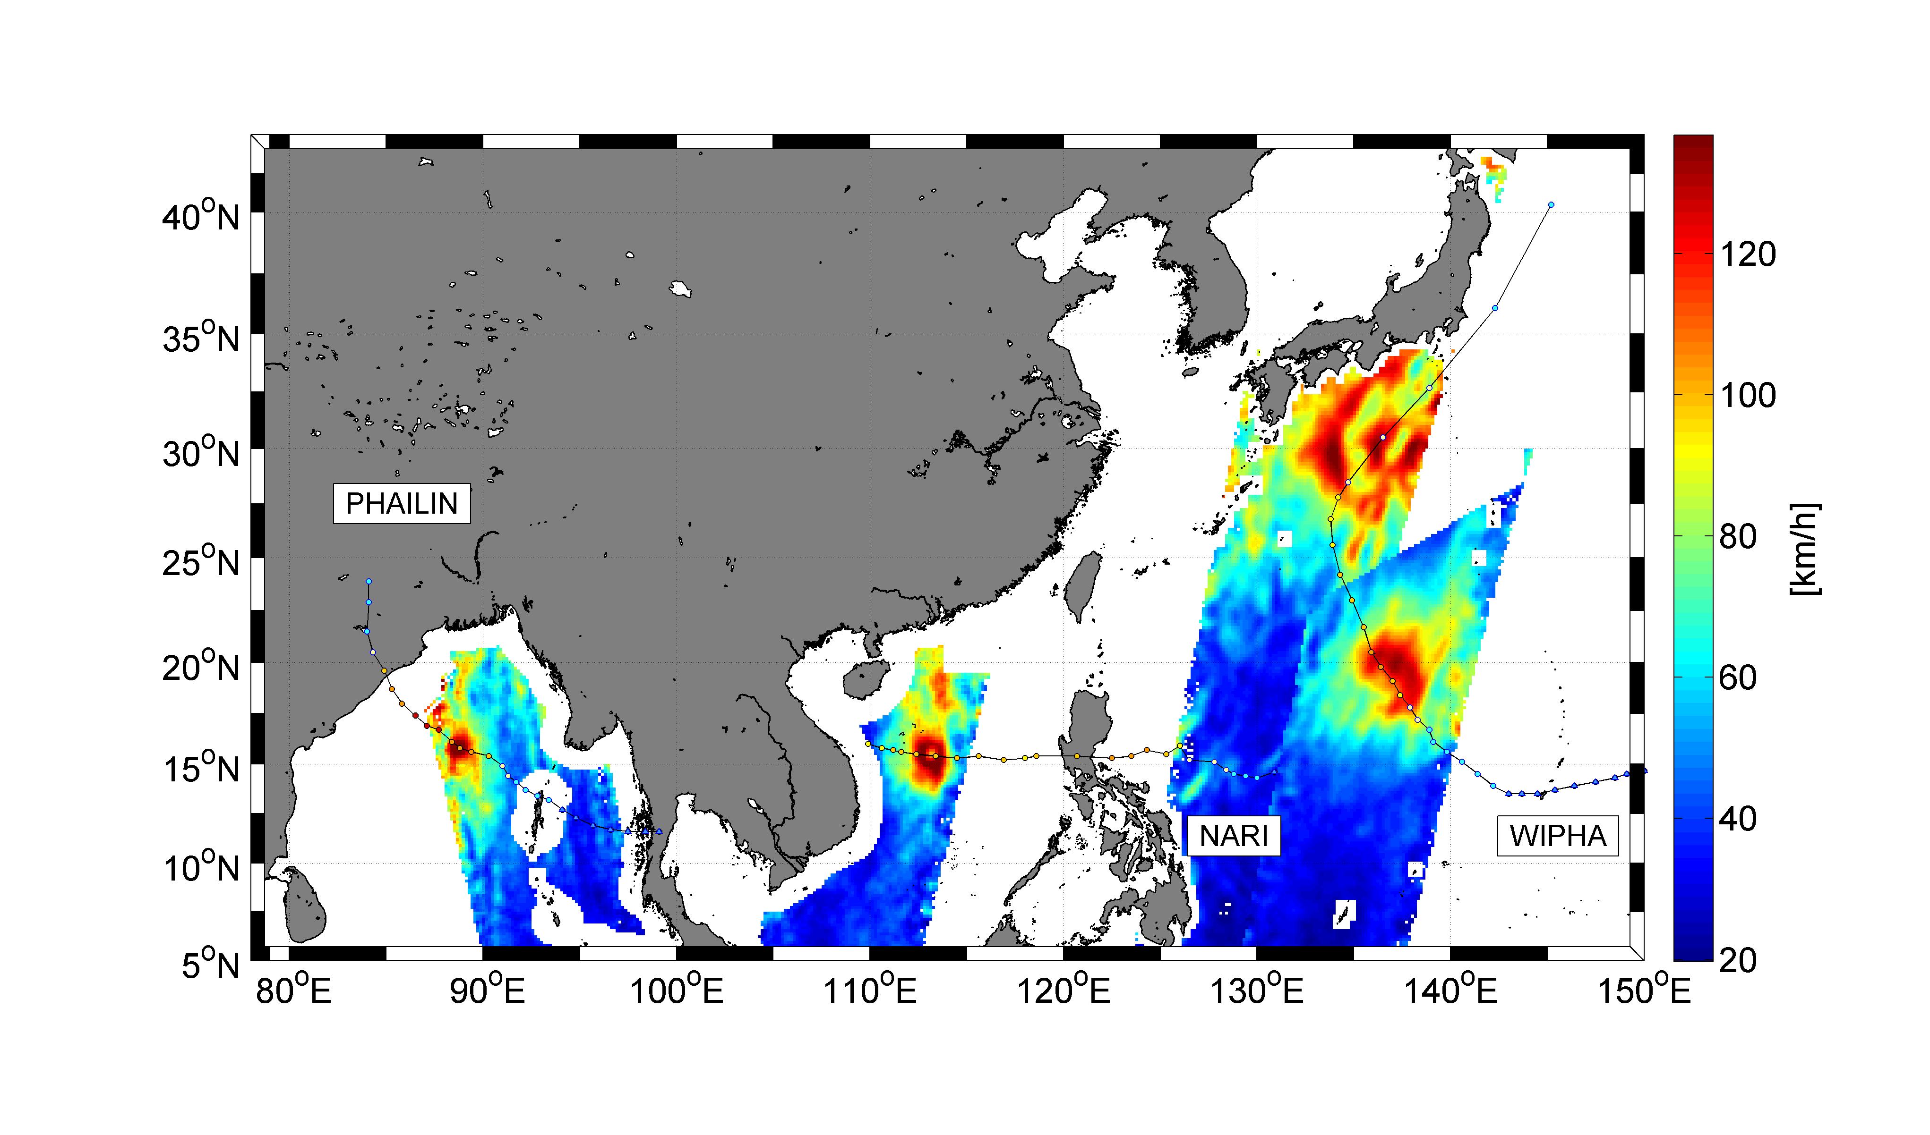
Example of Typhoon samplings: Oct 2013
Legend: Surface wind speed in km/h estimated from SMOS brightness temperature data acquired between the 10th and the 15th October
2013 under Typhoons Phailin (Bay of Bengal 11th Oct), Nari (South China Sea, 13 oct) and Wipha (Western Pacific, 13 th & 15th).
The Typhoons eye tracks are indicated by small magenta dotted curves. Credits: ESA, Ifremer & CLS.

Slide 13
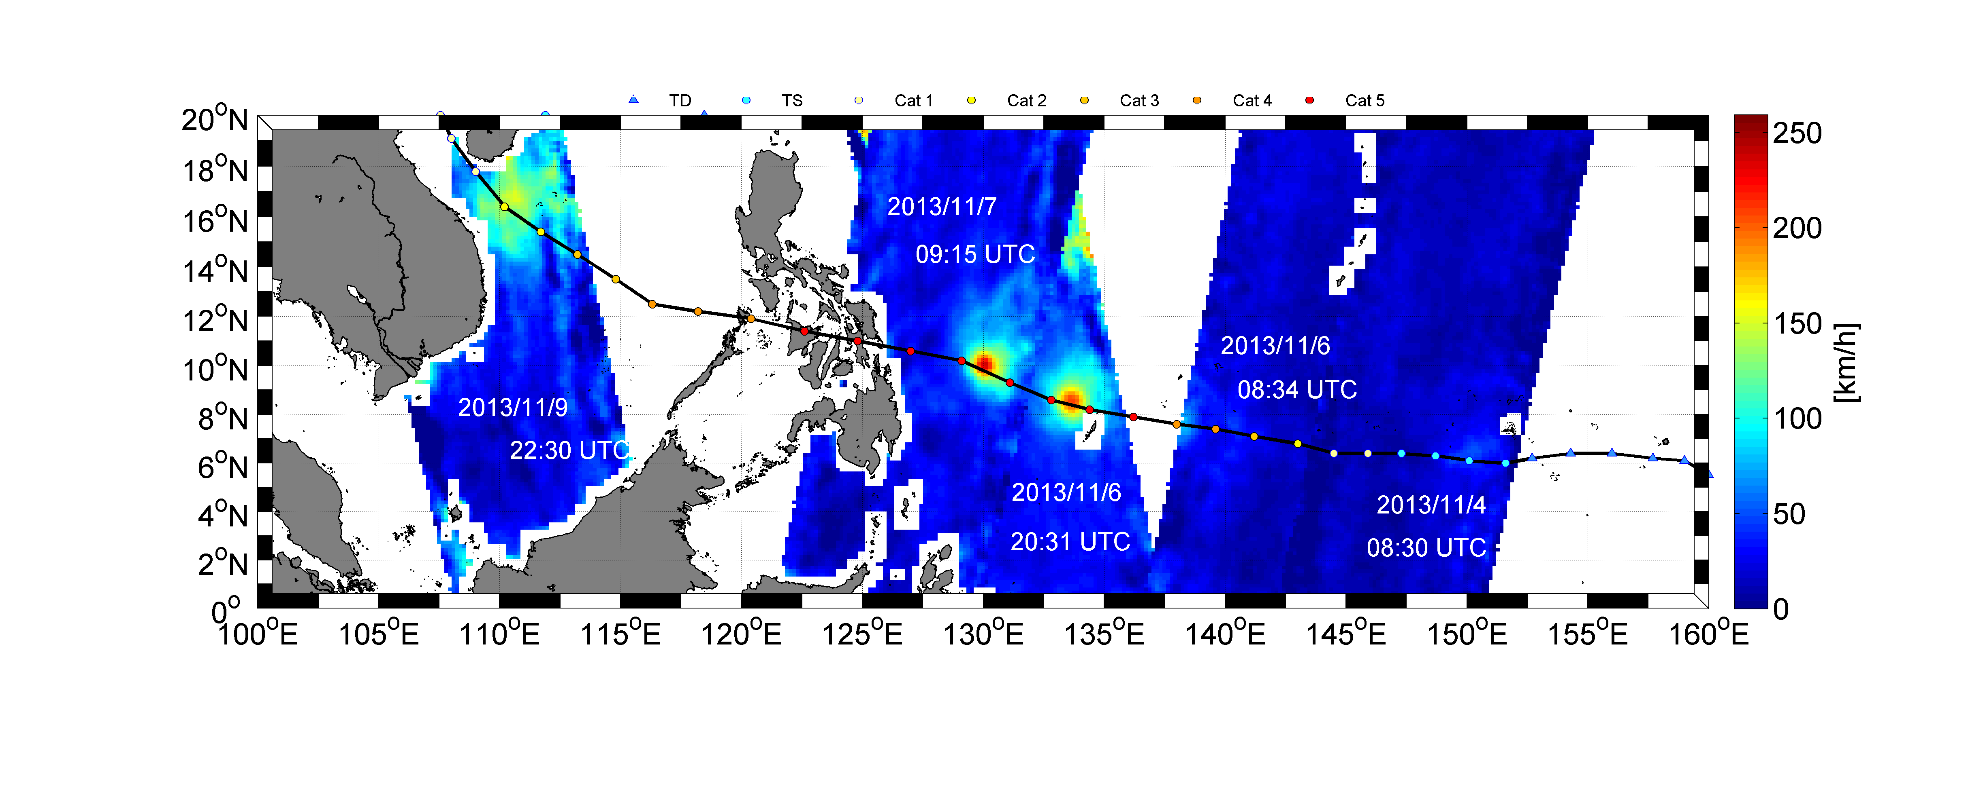
Haiyan Super Typhoon Signature in SMOS data
Figure 1: SMOS retrieved surface wind speed [km/h] along the eye track of super typhoon Haiyan from 4 to 9 Nov 2013.

Slide 14
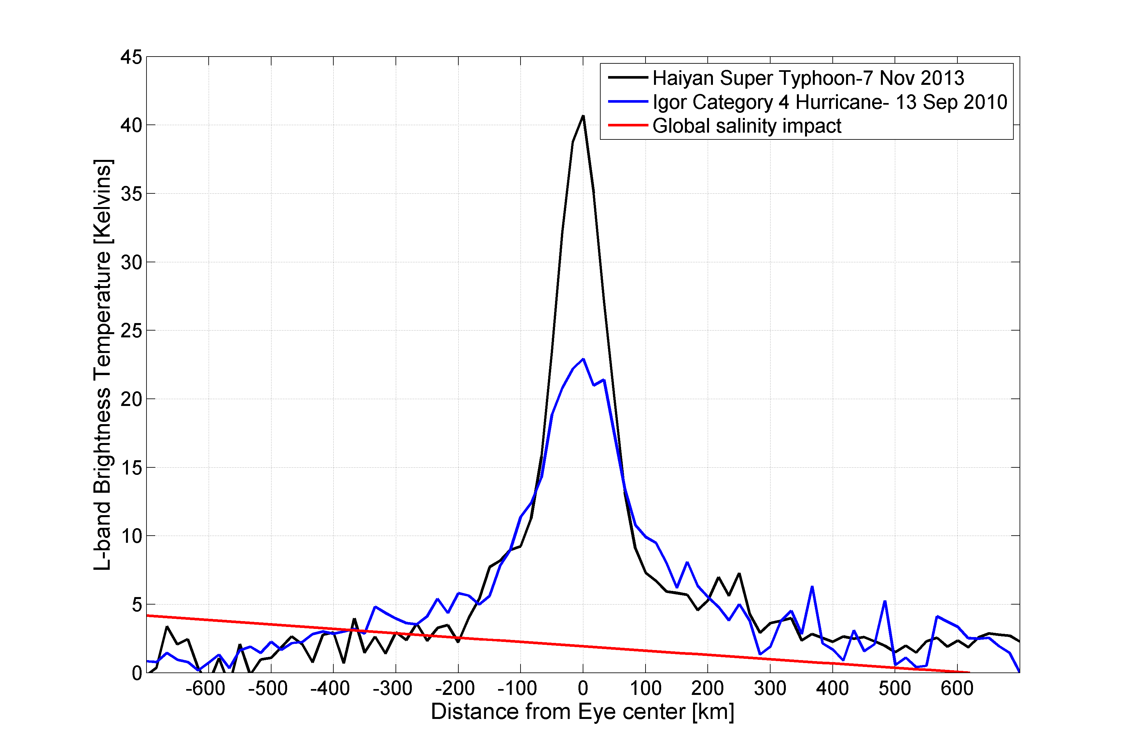
Haiyan Super Typhoon Signature in SMOS data
Super-
Typhoon
Haiyan
(2013)
ΔTb=41 K !
Cat 4 Hurricane
Igor (2010)
ΔTb=22 K !
Haiyan Typhoon in 2013:
The brightest natural source of L-band radiation ever measured over the oceans
=>an unprecedented natural extreme

Slide 15
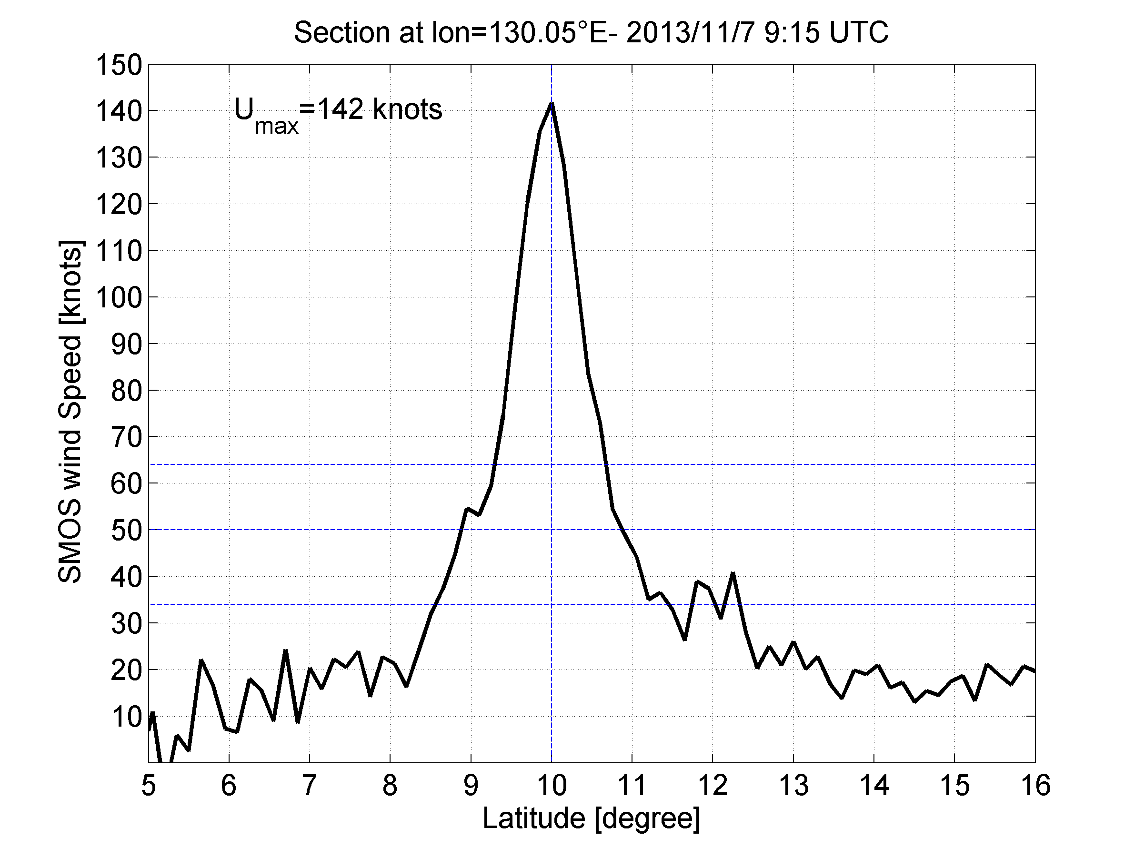
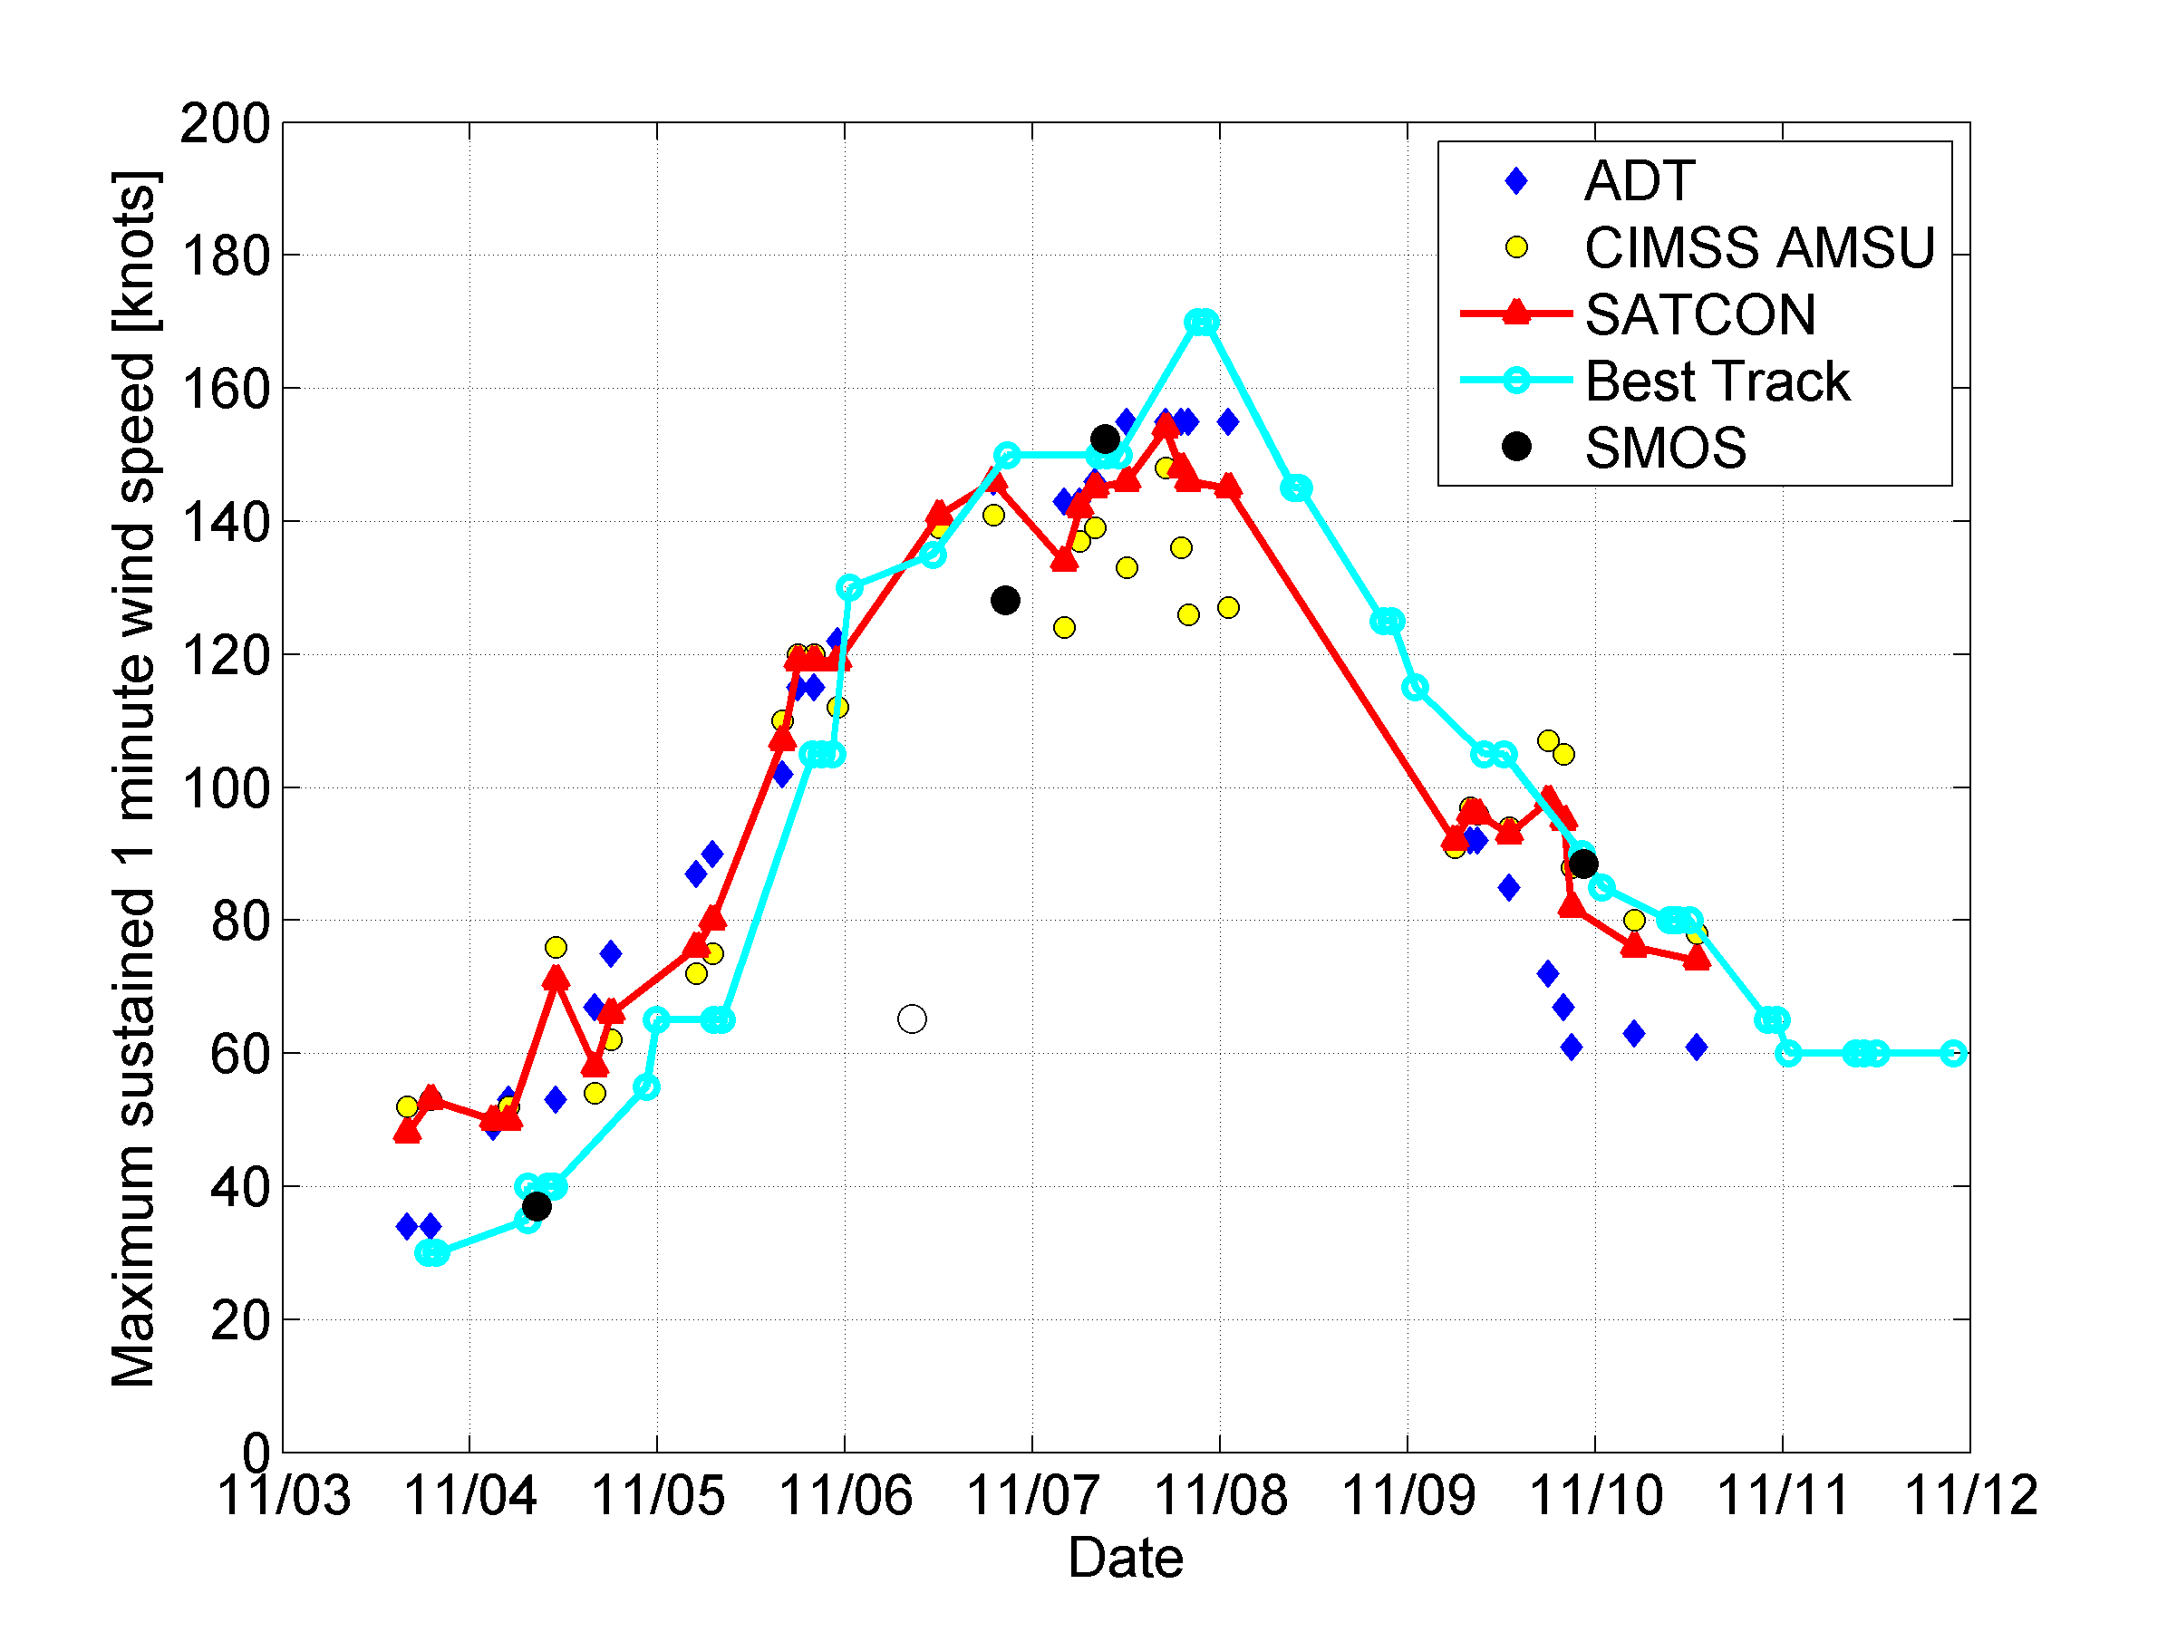
Haiyan Super Typhoon Signature in SMOS data
Surface wind speed deduced from the SMOS estimated excess brightness temperature.
Maximum sustained 1 minute wind speed estimated during Haiyan Typhoon. From SMOS data (black filled dots) compared to Advanced Dvorak Technique (ADT=blue diamond), CIMSS (yellow filled dots), SATCON (red) and Best Track from NHC (cyan).
Excellent agreement between SMOS max winds estimates and other traditional
Datasets (Dvorak, Best track,..)

Slide 16
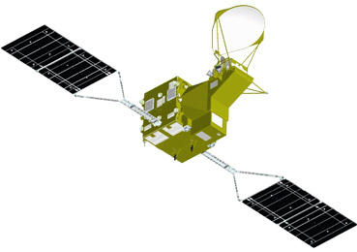
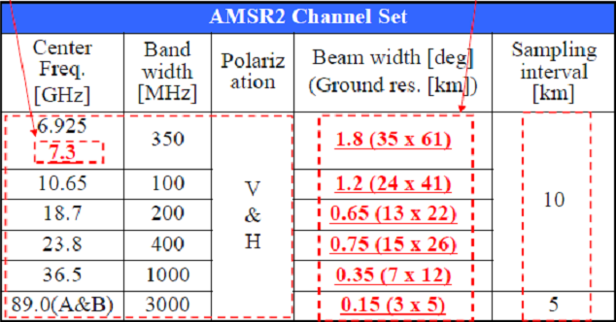
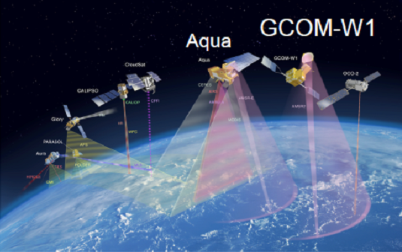
Towards Merged SMOS-AMSR-2-SMAP High wind products
On 18 May 2012 Japan launched a new passive microwave instrument with the largest in the world diameter of antenna - Advanced Microwave Scanning Radiometer (AMSR2) onboard Global Change Observation Mission – Water satellite (GCOM-W1 “Shizuku”)
Additional channel
Better than AMSR-E
Potential accuracy for SWS retrievals is 1 m/s
Same as AMSR-E

Slide 17
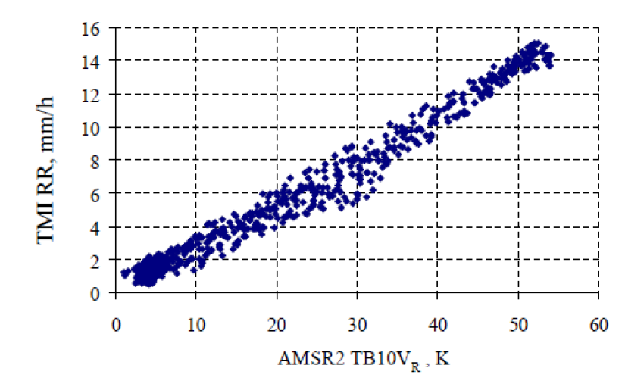
AMSR2 all weather wind speed retrieval algorithms
Zabolotskikh E et al. GRL, 2014
Over most rainy atmospheres rain radiation at 10.65, 7.3, and 6.9 GHz can be parameterized in terms of ΔT_{B}^{V}_{7,6} and ΔT_{B}^{V}_{10,7}. and related to rain rate (RR). After subtraction of the rain part from the total T_{B} rain-free SWS can be applied.

Slide 18
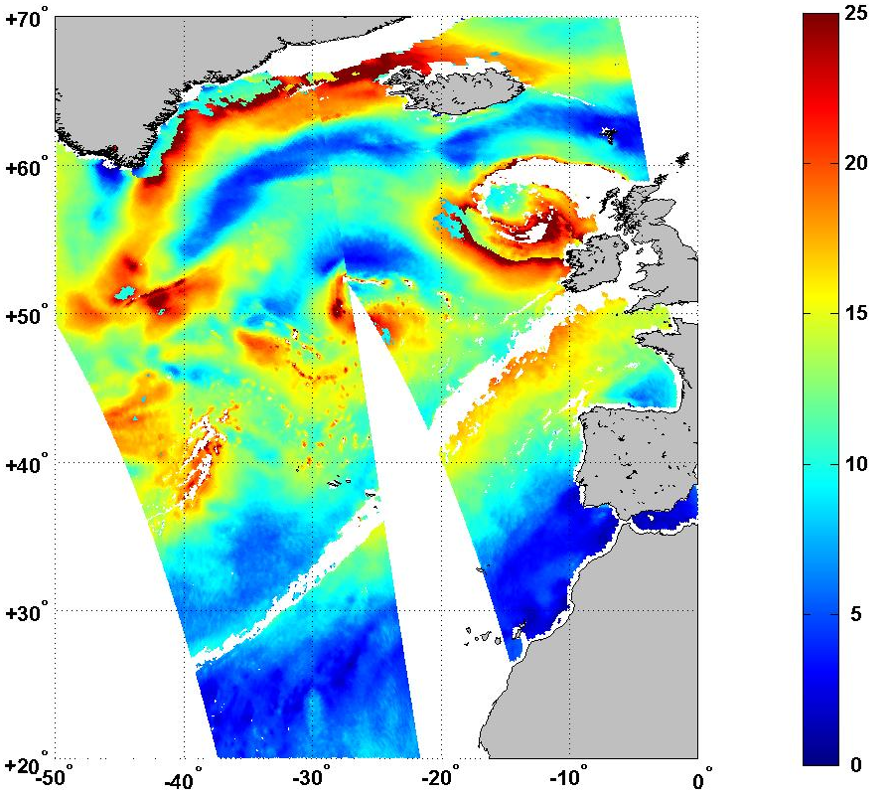
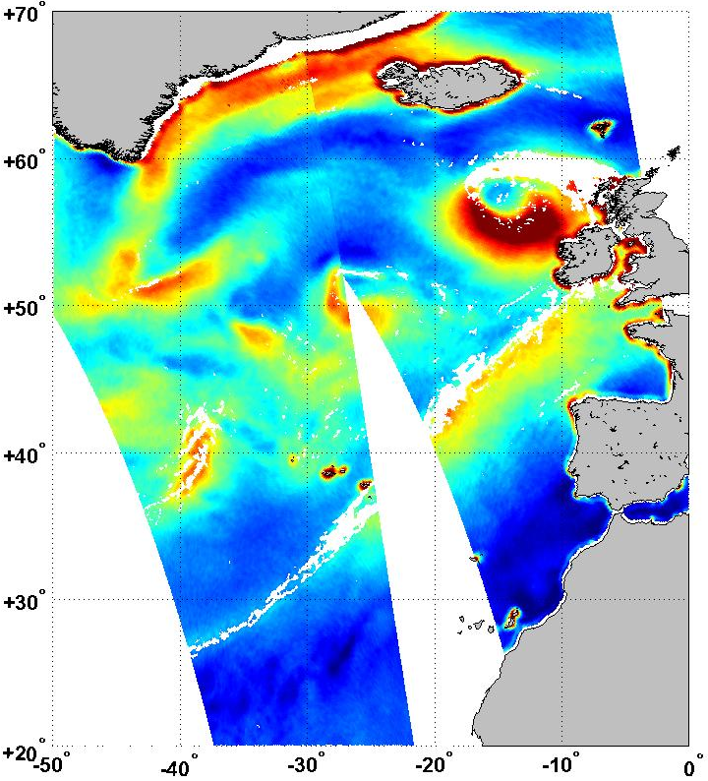
Towards Merged SMOS-AMSR-2-SMAP High wind products
Surface wind speed (SWS) in the extratropical cyclone 29 January 2013
AMSR2 JAXA standard product
AMSR2 new algorithm
Zabolotskikh E et al. GRL, 2014

Slide 19
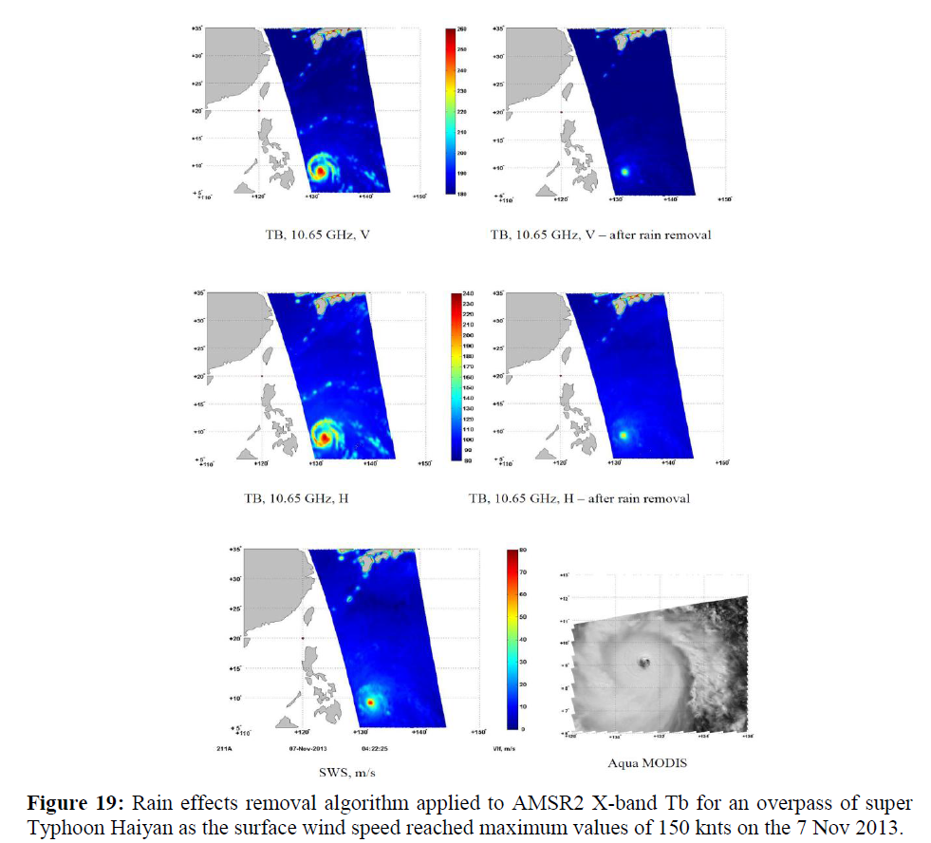
AMSR2 wind speed retrieval algorithm applied to Haiyan

Slide 20
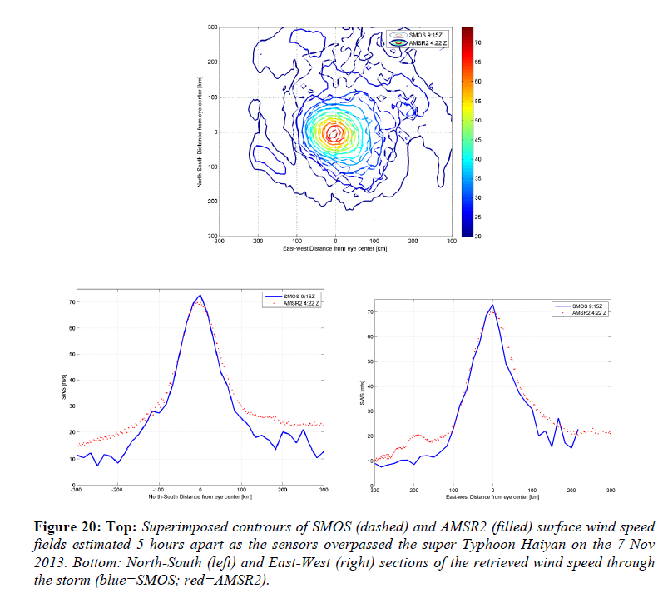
SMOS versus AMSR2 SWS in Haiyan

Slide 21
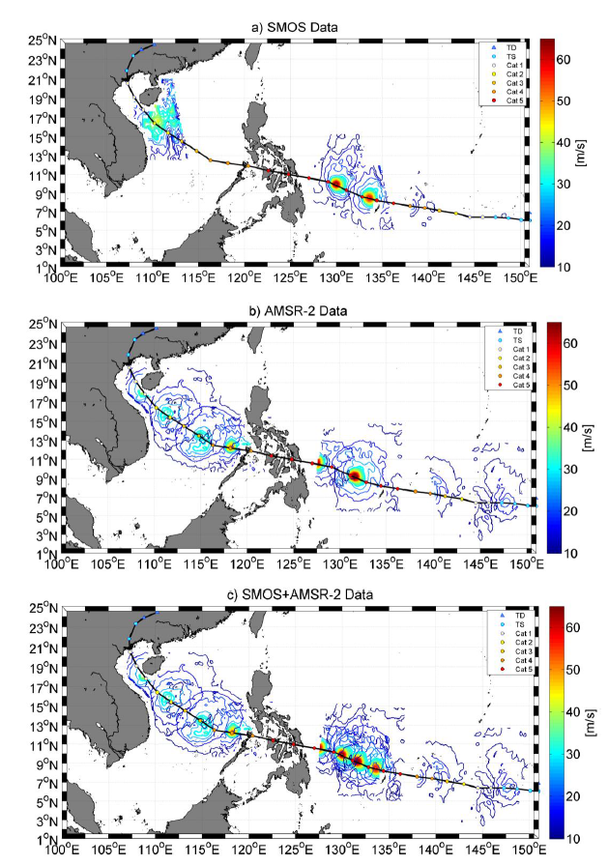
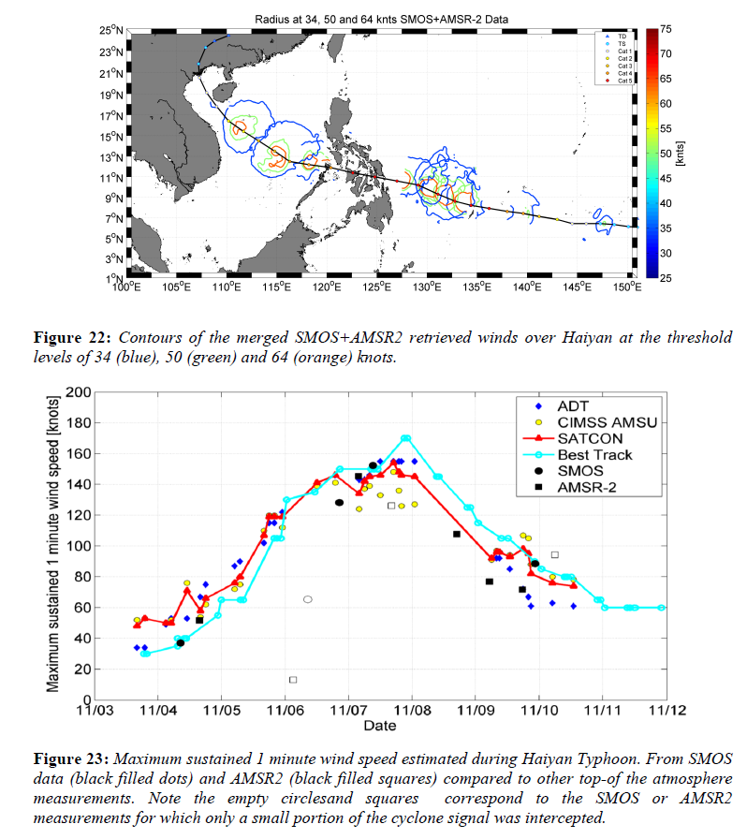
Towards Merged SMOS-AMSR-2-SMAP High wind products

Slide 22
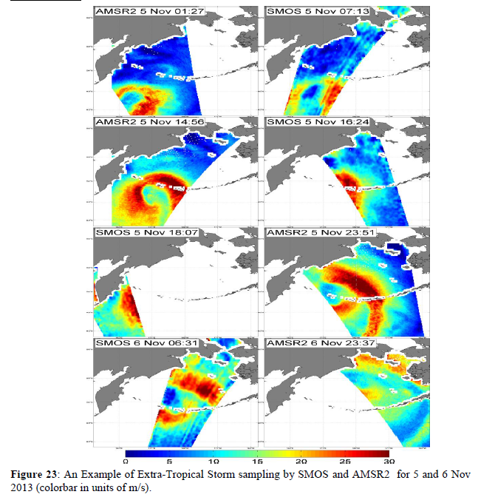
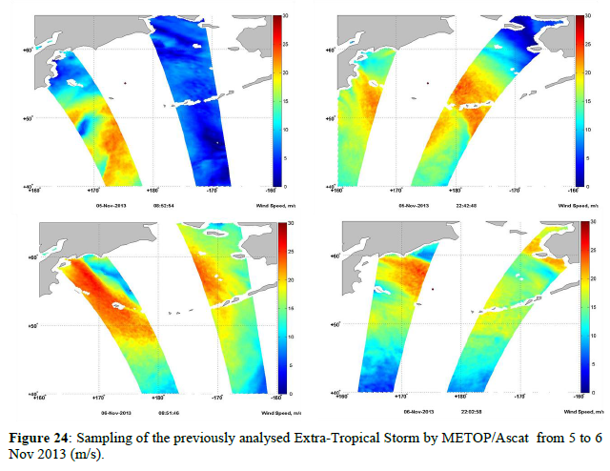
Towards tracking Extra-Tropical Storms with SMOS & AMSR2
SMOS (L-band)+ AMSR-2 (C-band)
Ascat

Slide 23
Summary (1)
We evidenced clear SMOS brightness temperature signal associated with the passage of Hurricanes
By analysing SMOS intercept with Hurricane Igor in 2010 and collecting an ensemble on auxilliary wind speed informations, we developed a Geophysical Model Function relating the SMOS Tb estimated at the surface (corrected for atmosphere) to the surface wind speed.
We have shown that SMOS can allow to retrieve important structural surface wind features within hurricanes such as the radius of wind speed larger than 34, 50 and 64 knots. These are Key parameters to monitor tropical cyclone intensification
Ascat can provide R34 but not R50 & R64=>SMOS does
SMOS clearly outperform ASCAT & ECMWF in the Igor case in area far from
Aircraft observations

Slide 24
Summary (2)
The potential effect on rain at L-band was analyzed:
Below hurricane force (33 m/s)
=>some Rain impacts on the Tbs were found but small
(errors on wind speed < 5 m/s)
At very high winds, lack of rain-free data to firmly conclude but certainly weaker than at C-band
An empirical wind speed retrieval algorithm was developed
The latter was tested against an independant Hurricane: the Cat-1 Hurricane Sandy in 2012. SMOS wind speed retrievals were compared to NODC buoy data and SFMR wind speed:
Agreement within ± 3 m/s was found
Main instrumental limitations are spatial resolution, RFI & land contamination

Slide 25
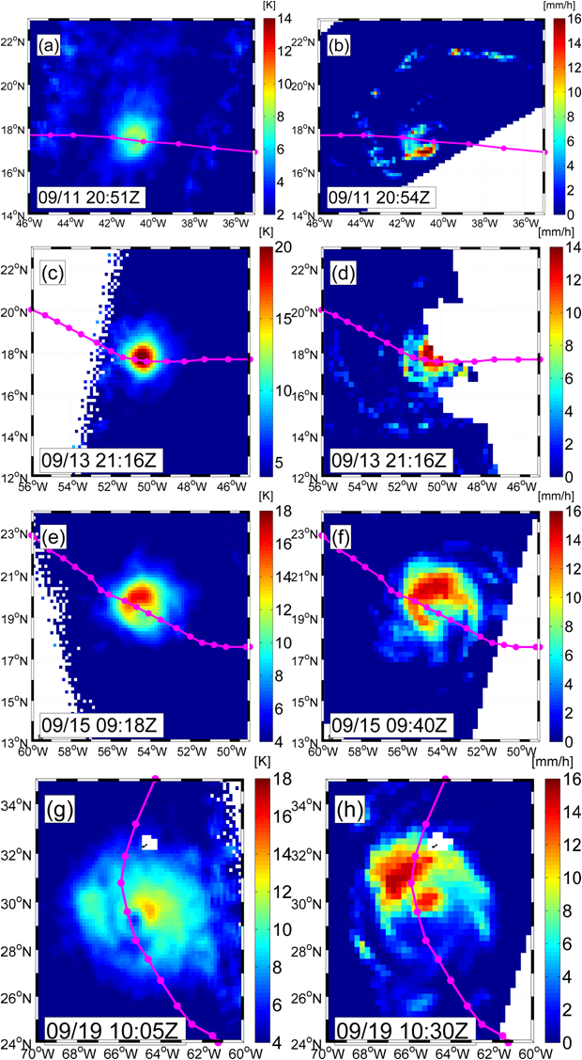
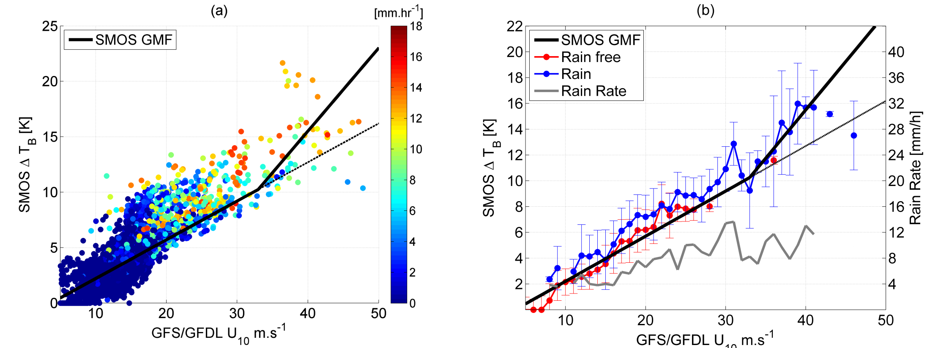
Potential rain Impact at L-band
SMOS Tb
Rain rates
TRMM
Windsat
SSM/I F17
Below hurricane force (33 m/s)
=>some Rain impacts but small
(errors on wind speed < 5 m/s)
At very high winds, lack of rain-free data
to conclude
SSM/I F16

